Slide 1
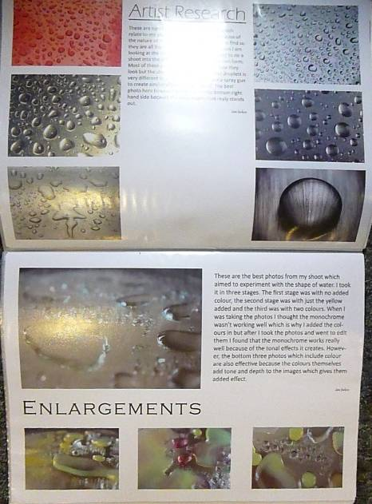
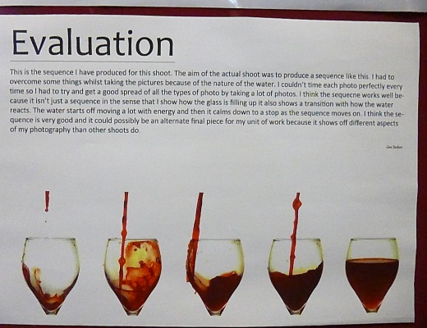
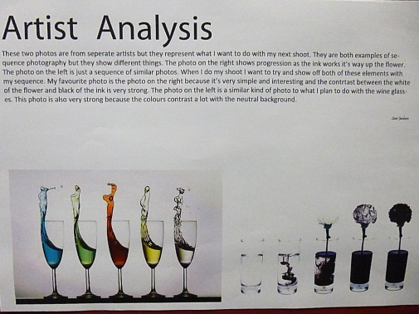
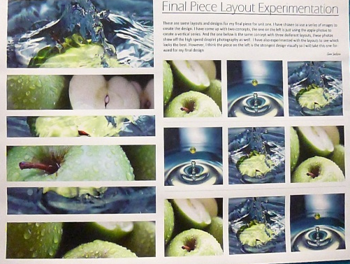
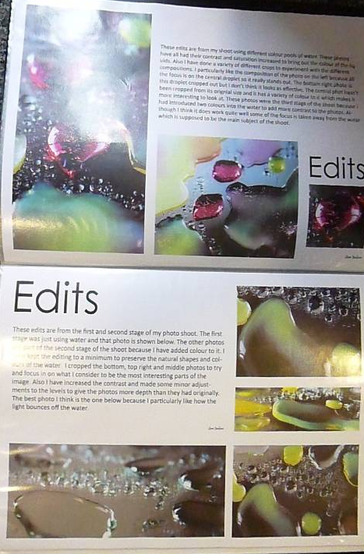
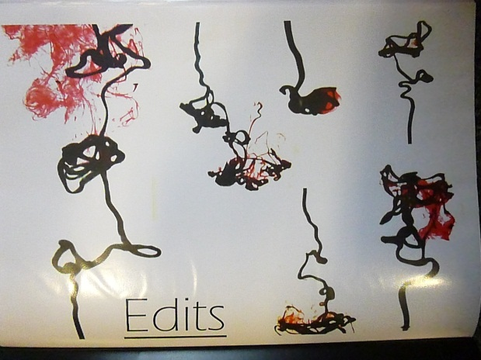
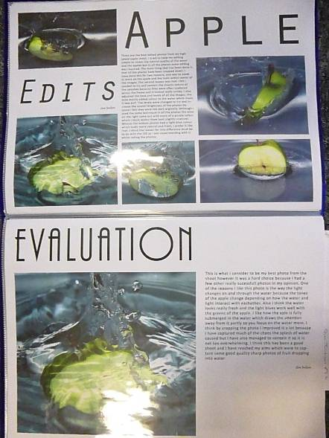
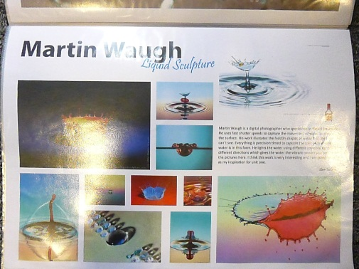
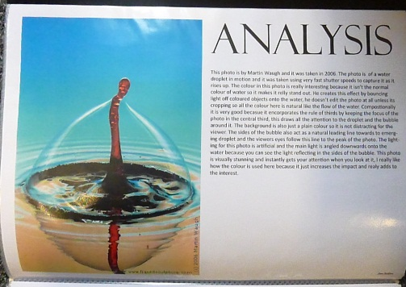
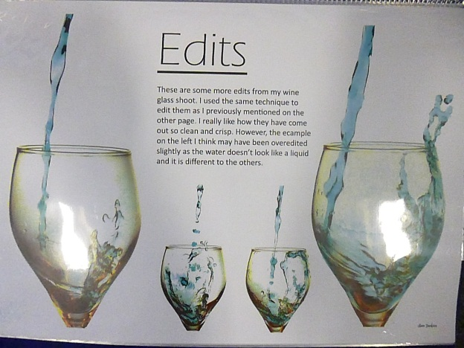
AO1 / NA1 26 / 30
AO2 / NA2 25 / 30
AO3 / NA3 23 / 30
AO4 / NA4 24 / 30
Mark / Marc 98 / 120
PHOTOGRAPHY
FFOTOGRAFFIAETH
ART1

Slide 2
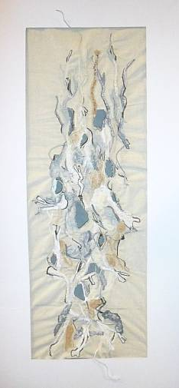
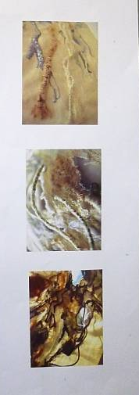
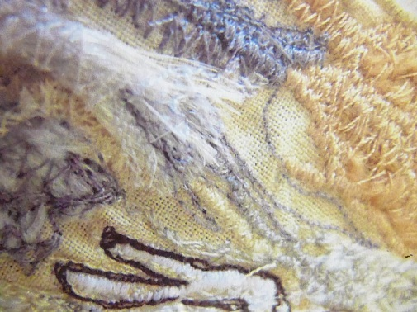
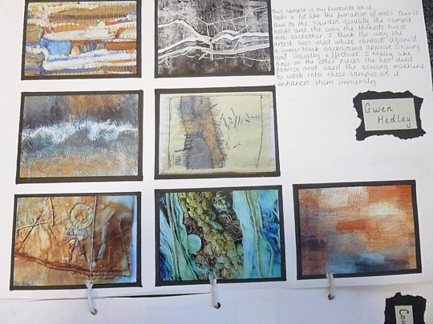
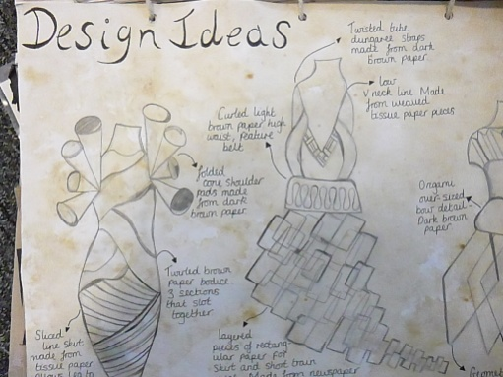
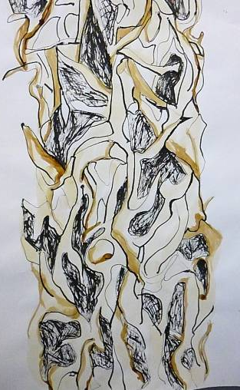
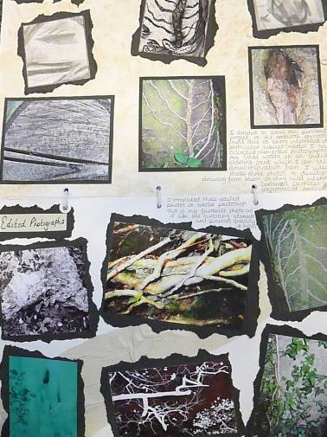
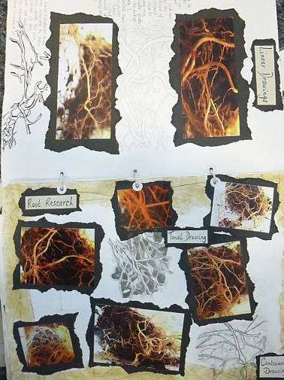
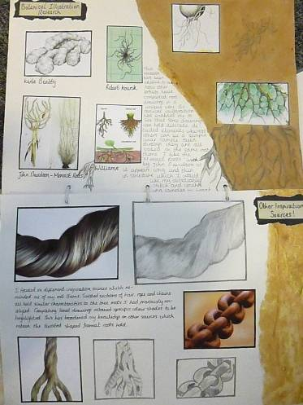
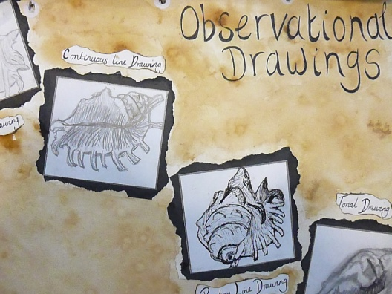
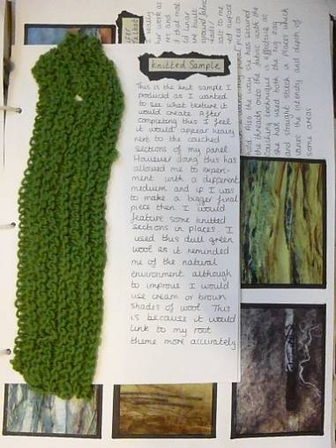
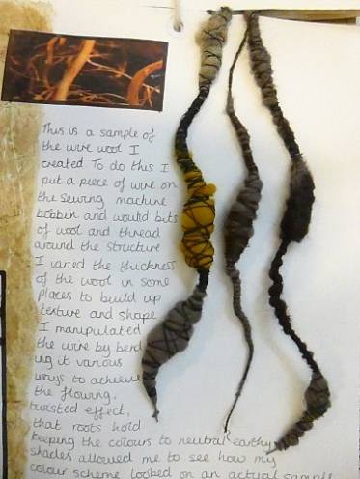
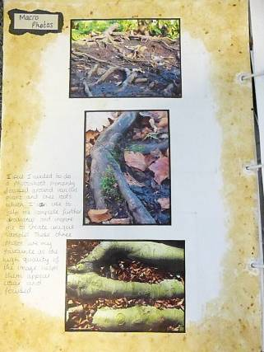
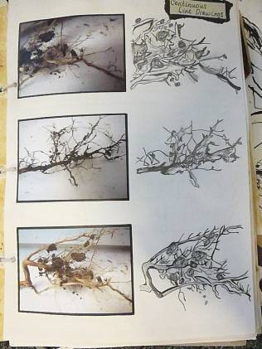
TEXTILE DESIGN
DYLUNIO TECSTILAU
ART1
AO1 / NA1 27 / 30
AO2 / NA2 24 / 30
AO3 / NA3 24 / 30
AO4 / NA4 23 / 30
Mark / Marc 98 / 120

Slide 3
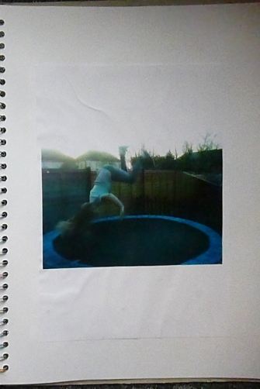
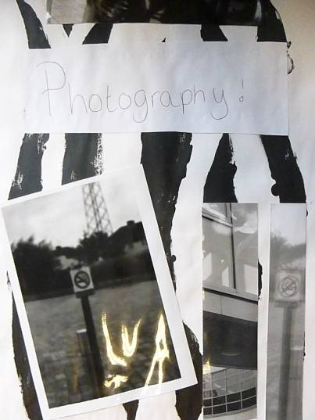
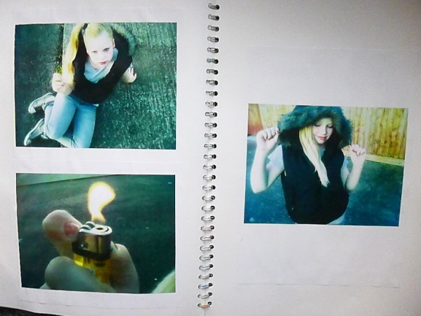
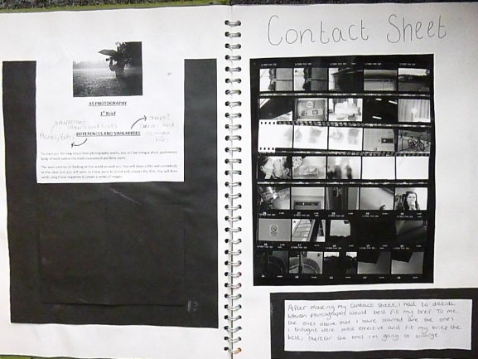
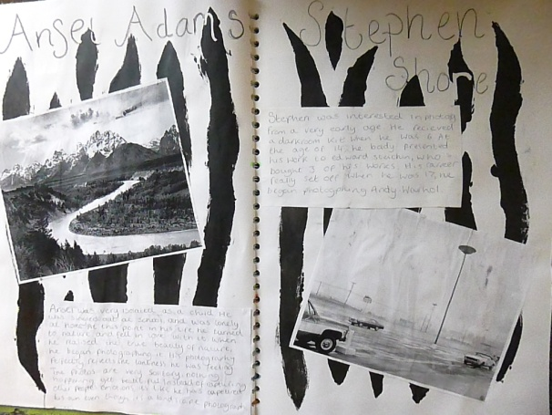
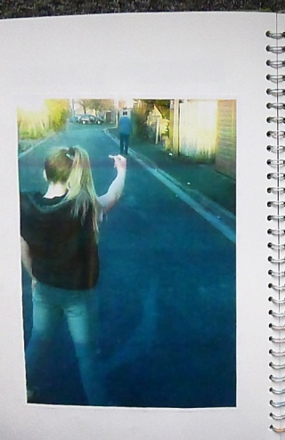
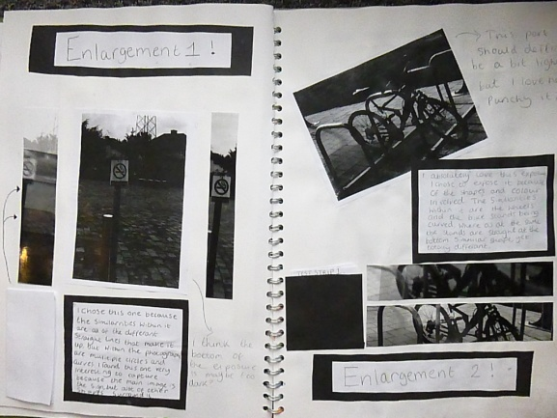
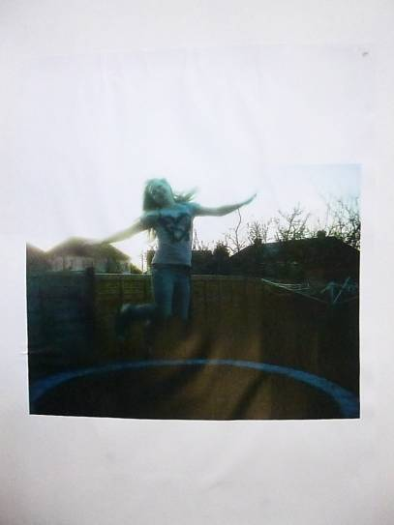
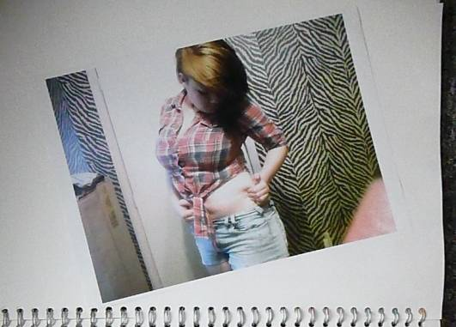
AO1 / NA1 10 / 30
AO2 / NA2 10 / 30
AO3 / NA3 13 / 30
AO4 / NA4 12 / 30
Mark / Marc 45 / 120
PHOTOGRAPHY
FFOTOGRAFFIAETH
ART1

Slide 4
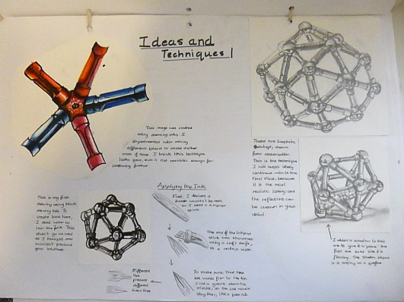
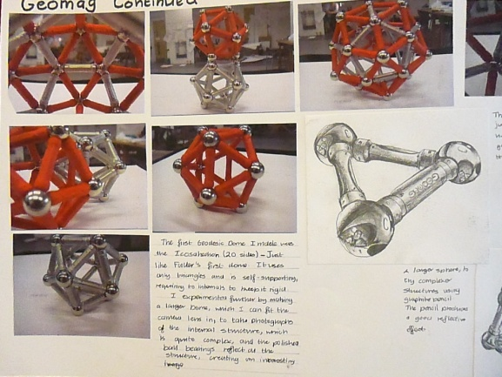
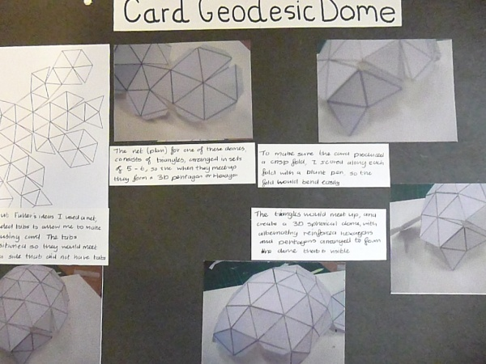
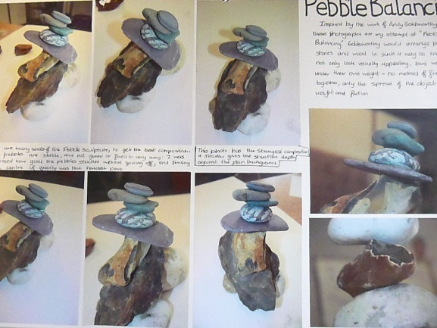
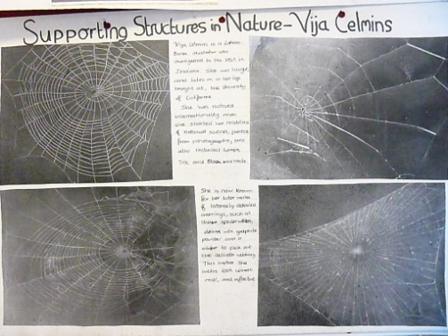
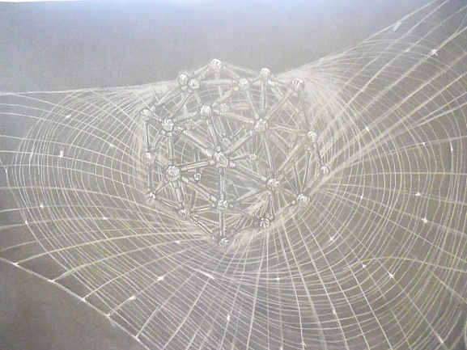
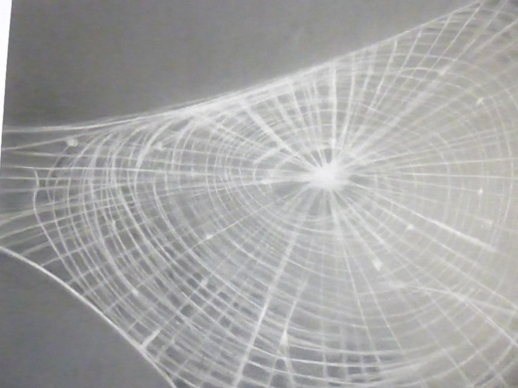
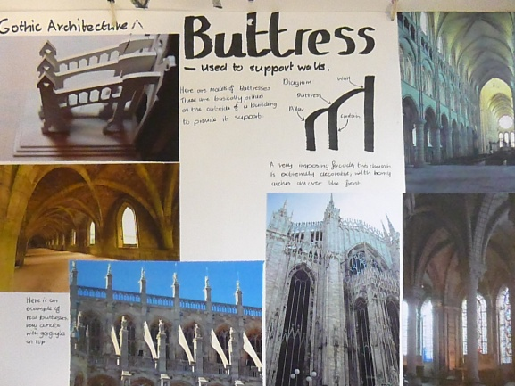
AO1 / NA1 17 / 20
AO2 / NA2 16 / 20
AO3 / NA3 16 / 20
AO4 / NA4 16 / 20
Mark / Marc 65 / 80
Q6 SUPPORTING STRUCTURES
Q6 ADEILEDDAU CYNHALIOL
FINE ART
CELFYDDYD GAIN
ART2

Slide 5
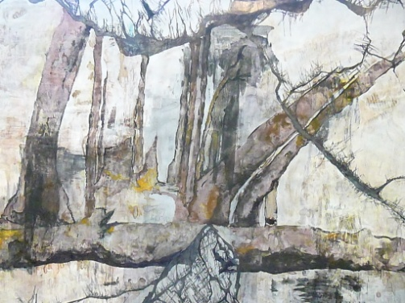
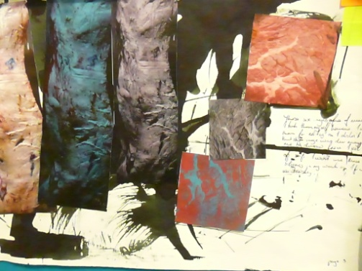
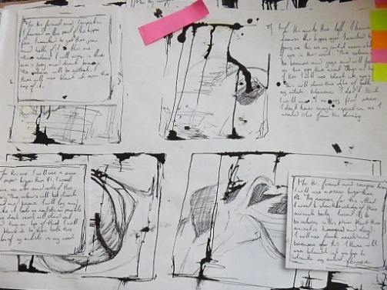
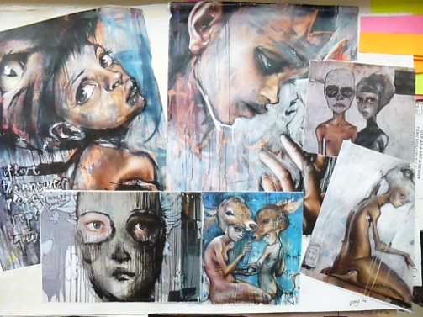
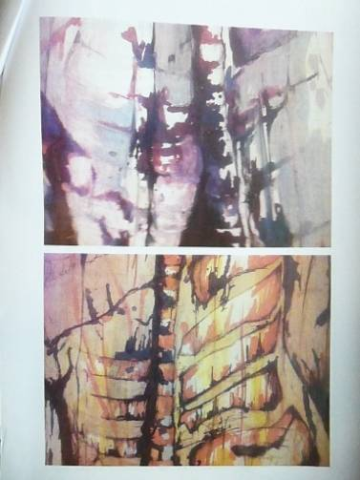
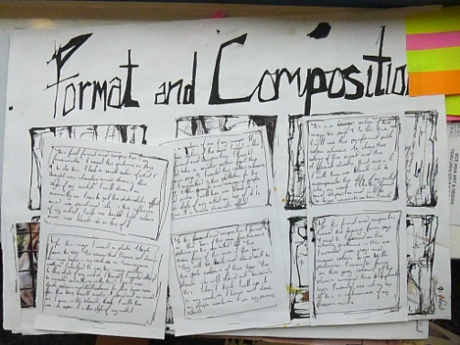
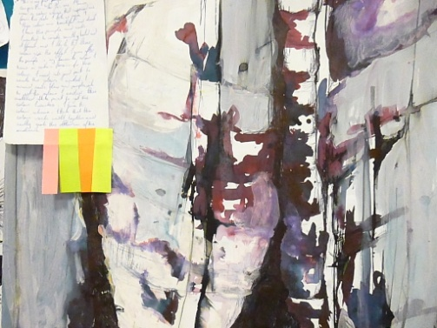
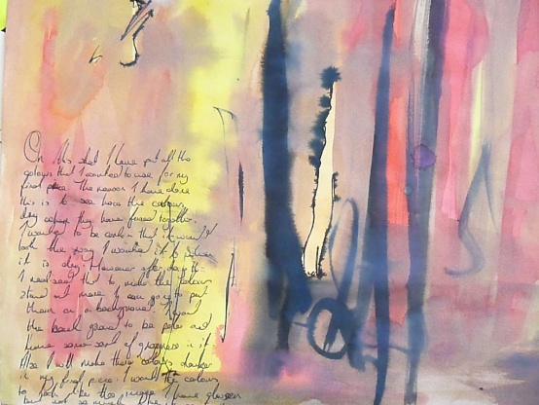
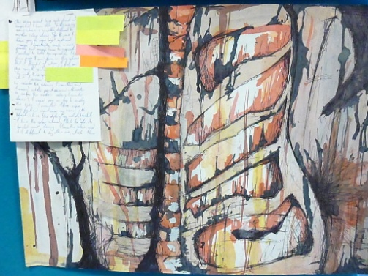



AO1 / NA1 16 / 20
AO2 / NA2 15 / 20
AO3 / NA3 17 / 20
AO4 / NA4 17 / 20
Mark / Marc 65 / 80
Q14 DOCUMENT AN ISSUE THAT IS OF CONCERN TO YOU OR SOMEONE YOU KNOW PERSONALLY
Q14 DOGFENNWCH FATER SY’N ACHOSI PRYDER I CHI NEU I RYWUN RYDYCH CHI’N EI ADNABOD
ART, CRAFT & DESIGN
CELF, CREFFT A DYLUNIO
ART2

Slide 6











AO1 / NA1 17 / 20
AO2 / NA2 15 / 20
AO3 / NA3 17 / 20
AO4 / NA4 15 / 20
Mark / Marc 64 / 80
Q6 SUPPORTING STRUCTURES
Q6 ADEILEDDAU CYNHALIOL
PHOTOGRAPHY
FFOTOGRAFFIAETH
ART2

Slide 7















AO1 / NA1 17 / 20
AO2 / NA2 15 / 20
AO3 / NA3 15 / 20
AO4 / NA4 14 / 20
Mark / Marc 61 / 80
Q12 PROMOTE A SPORTING EVENT OR A COMPETITIVE ACTIVITY
Q12 HYRWYDDECH DDIGWYDDIAD CHWARAEON NEU WEITHGAREDD CYSTADLEUOL
GRAPHIC COMMUNICATION
CYFATHREBU GRAFFIG
ART2

Slide 8








AO1 / NA1 10 / 20
AO2 / NA2 10 / 20
AO3 / NA3 12 / 20
AO4 / NA4 10 / 20
Mark / Marc 42 / 80
Q5 TIME TO SPEND
Q5 AMSER I’W DREULIO/AMSER I WARIO
ART, CRAFT & DESIGN
CELF, CREFFT A DYLUNIO
ART2

Slide 9












 | GCE AS/A2 ART & DESIGN 2012 TAG UG/U2 CELF A DYLUNIO 2012 MODERATION CONFERENCE ARCHIVE (CONTROLLED ASSIGNMENT ) ARCHIF Y GYNHADLEDD SAFONI (ASEINIAD DAN ORUCHWYLIAETH)
AO1 / NA1 7 / 20
AO2 / NA2 6 / 20
AO3 / NA3 6 / 20
AO4 / NA4 7 / 20
Mark / Marc 26 / 80
Q5 TIME TO SPEND
Q5 AMSER I’W DREULIO/AMSER I WARIO
GRAPHIC COMMUNICATION
CYFATHREBU GRAFFIG
ART2

Slide 10






 | GCE AS/A2 ART & DESIGN 2012 TAG UG/U2 CELF A DYLUNIO 2012 MODERATION CONFERENCE ARCHIVE (CONTROLLED ASSIGNMENT ) ARCHIF Y GYNHADLEDD SAFONI (ASEINIAD DAN ORUCHWYLIAETH)
AO1 / NA1 4 / 20
AO2 / NA2 7 / 20
AO3 / NA3 5 / 20
AO4 / NA4 7 / 20
Mark / Marc 23 / 80
Q5 TIME TO SPEND
Q5 AMSER I’W DREULIO/AMSER I WARIO
TEXTILE DESIGN
DYLUNIO TECSTILAU
ART2

Slide 11









TEXTILE DESIGN
DYLUNIO TECSTILAU
ART3
AO1 / NA1 23 / 30
AO2 / NA2 26 / 30
AO3 / NA3 21 / 30
AO4 / NA4 25 / 30
Mark / Marc 95 / 120

Slide 12









AO1 / NA1 17 / 20
AO2 / NA2 17 / 20
AO3 / NA3 14 / 20
AO4 / NA4 15 / 20
Mark / Marc 63 / 80
Q3 Designing
Q3 Dylunio
GRAPHIC COMMUNICATION
CYFATHREBU GRAFFIG
ART4

Slide 13






AO1 / NA1 13 / 20
AO2 / NA2 17 / 20
AO3 / NA3 15 / 20
AO4 / NA4 14 / 20
Mark / Marc 59 / 80
Q 10 Contrast depictions of moods
Q 10 Cyferbynnwch bortreadau o hwyliau
FINE ART
CELFYDDYD GAIN
ART4

Slide 14







 | GCE AS/A2 ART & DESIGN 2012 TAG UG/U2 CELF A DYLUNIO 2012 MODERATION CONFERENCE ARCHIVE (CONTROLLED ASSIGNMENT) ARCHIF Y GYNHADLEDD SAFONI (ASEINIAD DAN ORUCHWYLIAETH)
ART, CRAFT & DESIGN
CELF, CREFFT A DYLUNIO
ART4
AO1 / NA1 15 / 20
AO2 / NA2 13 / 20
AO3 / NA3 15 / 20
AO4 / NA4 13 / 20
Mark / Marc 56 / 80
Q 7 Grids
Q 7 Gridiau

Slide 15






 | GCE AS/A2 ART & DESIGN 2012 TAG UG/U2 CELF A DYLUNIO 2012 MODERATION CONFERENCE ARCHIVE (CONTROLLED ASSIGNMENT) ARCHIF Y GYNHADLEDD SAFONI (ASEINIAD DAN ORUCHWYLIAETH)
ART, CRAFT & DESIGN
CELF, CREFFT A DYLUNIO
ART4
AO1 / NA1 5 / 20
AO2 / NA2 7 / 20
AO3 / NA3 10 / 20
AO4 / NA4 8 / 20
Mark / Marc 31 / 80
Q 7 Grids
Q 7 Gridiau

