Slide 1
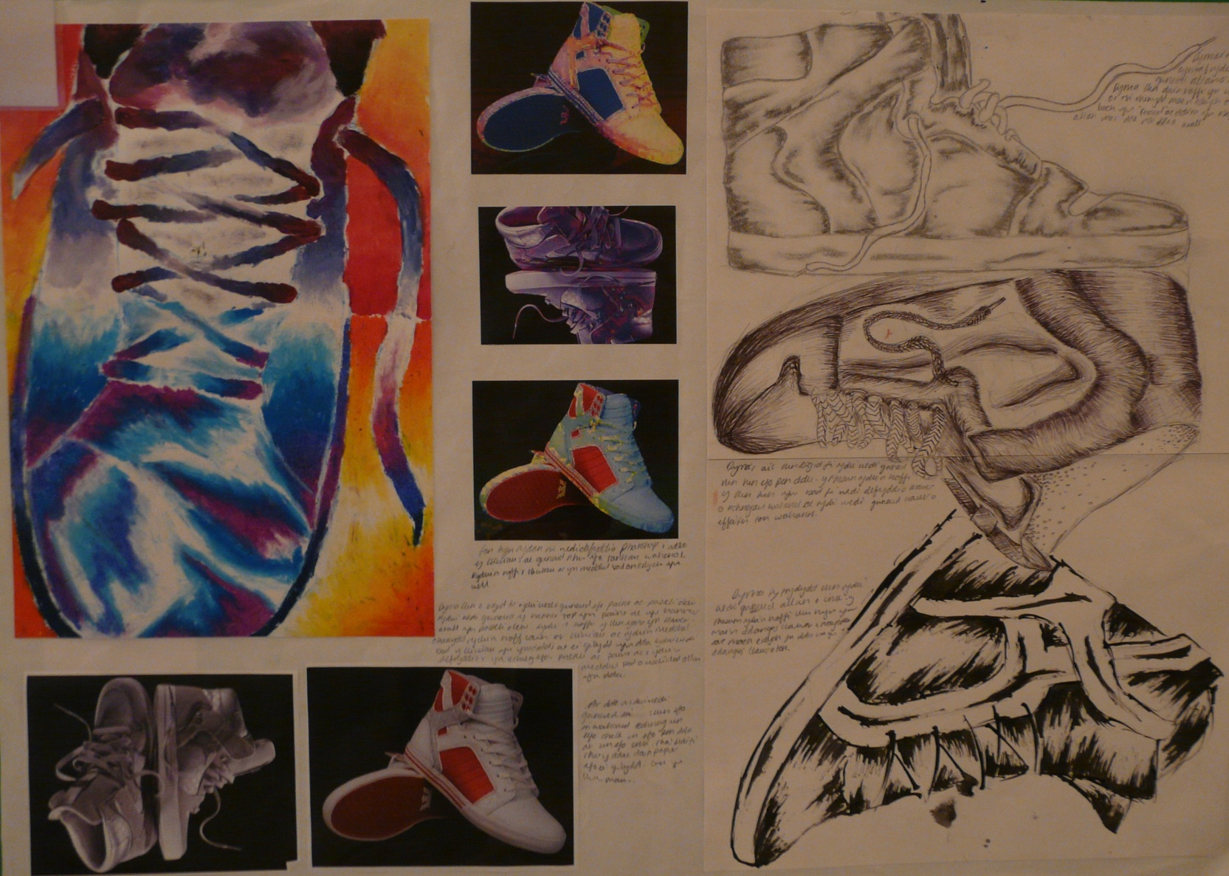
Candidate 1 Portfolio (Applied)

Slide 2
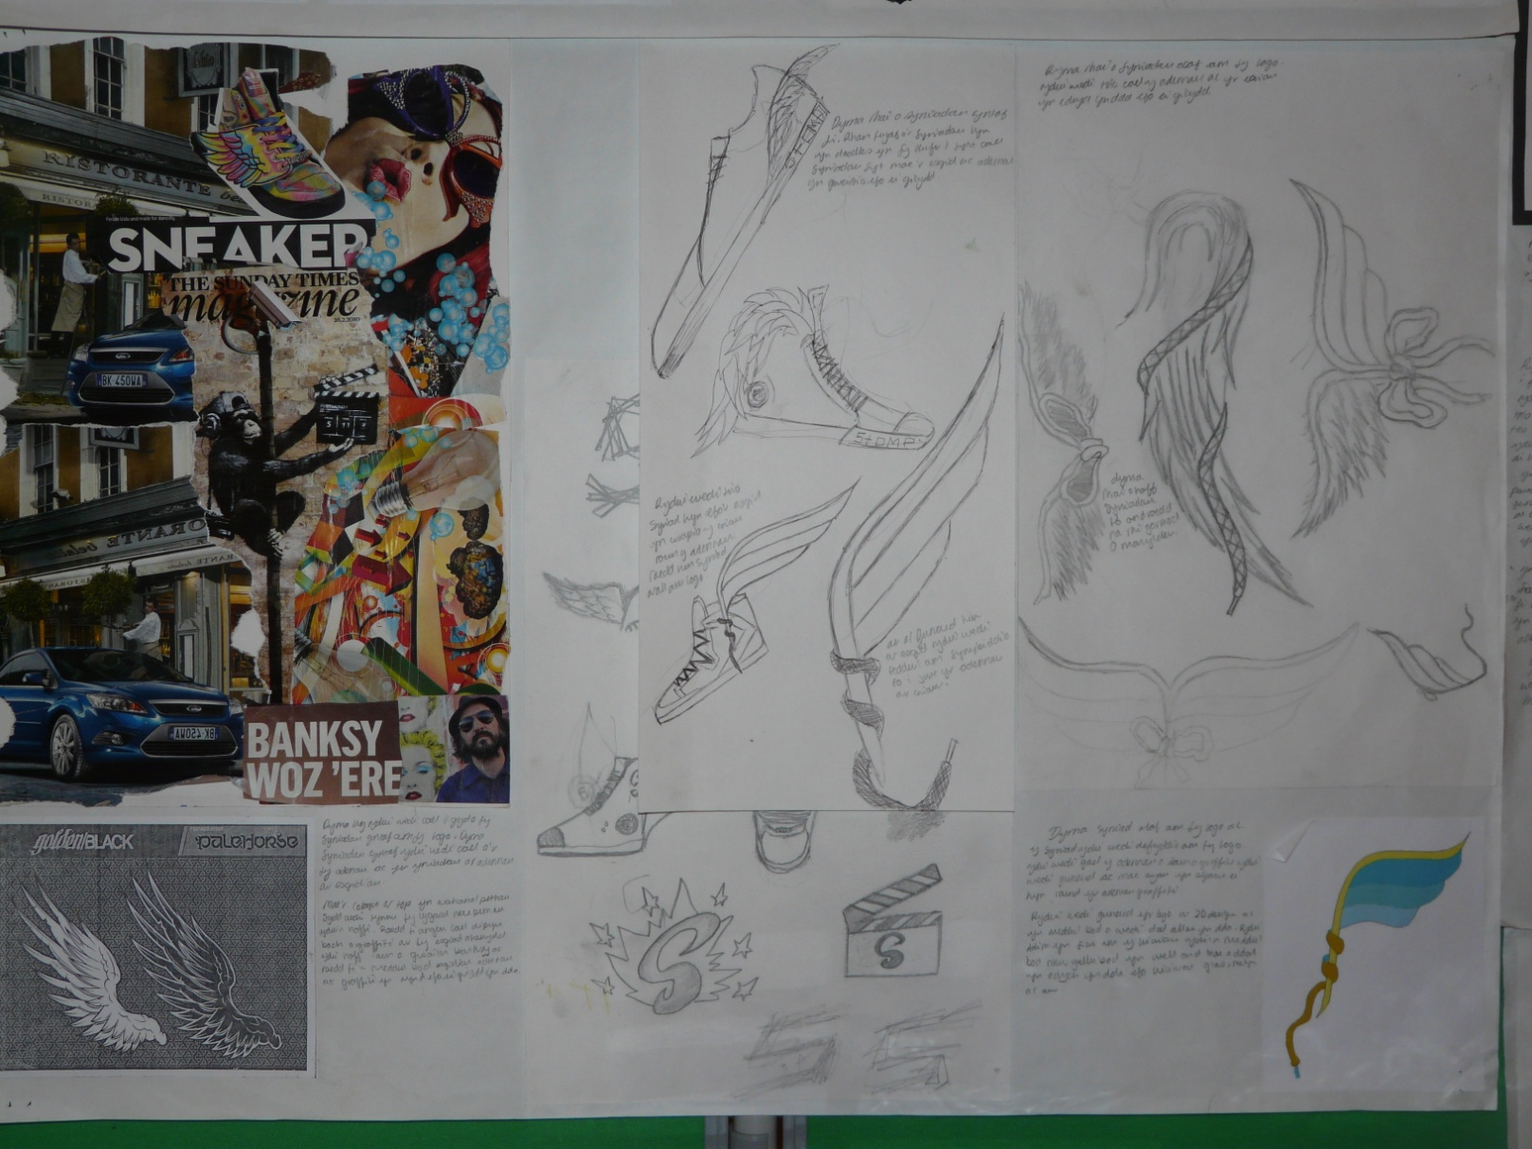
Candidate 1 Portfolio (Applied)

Slide 3
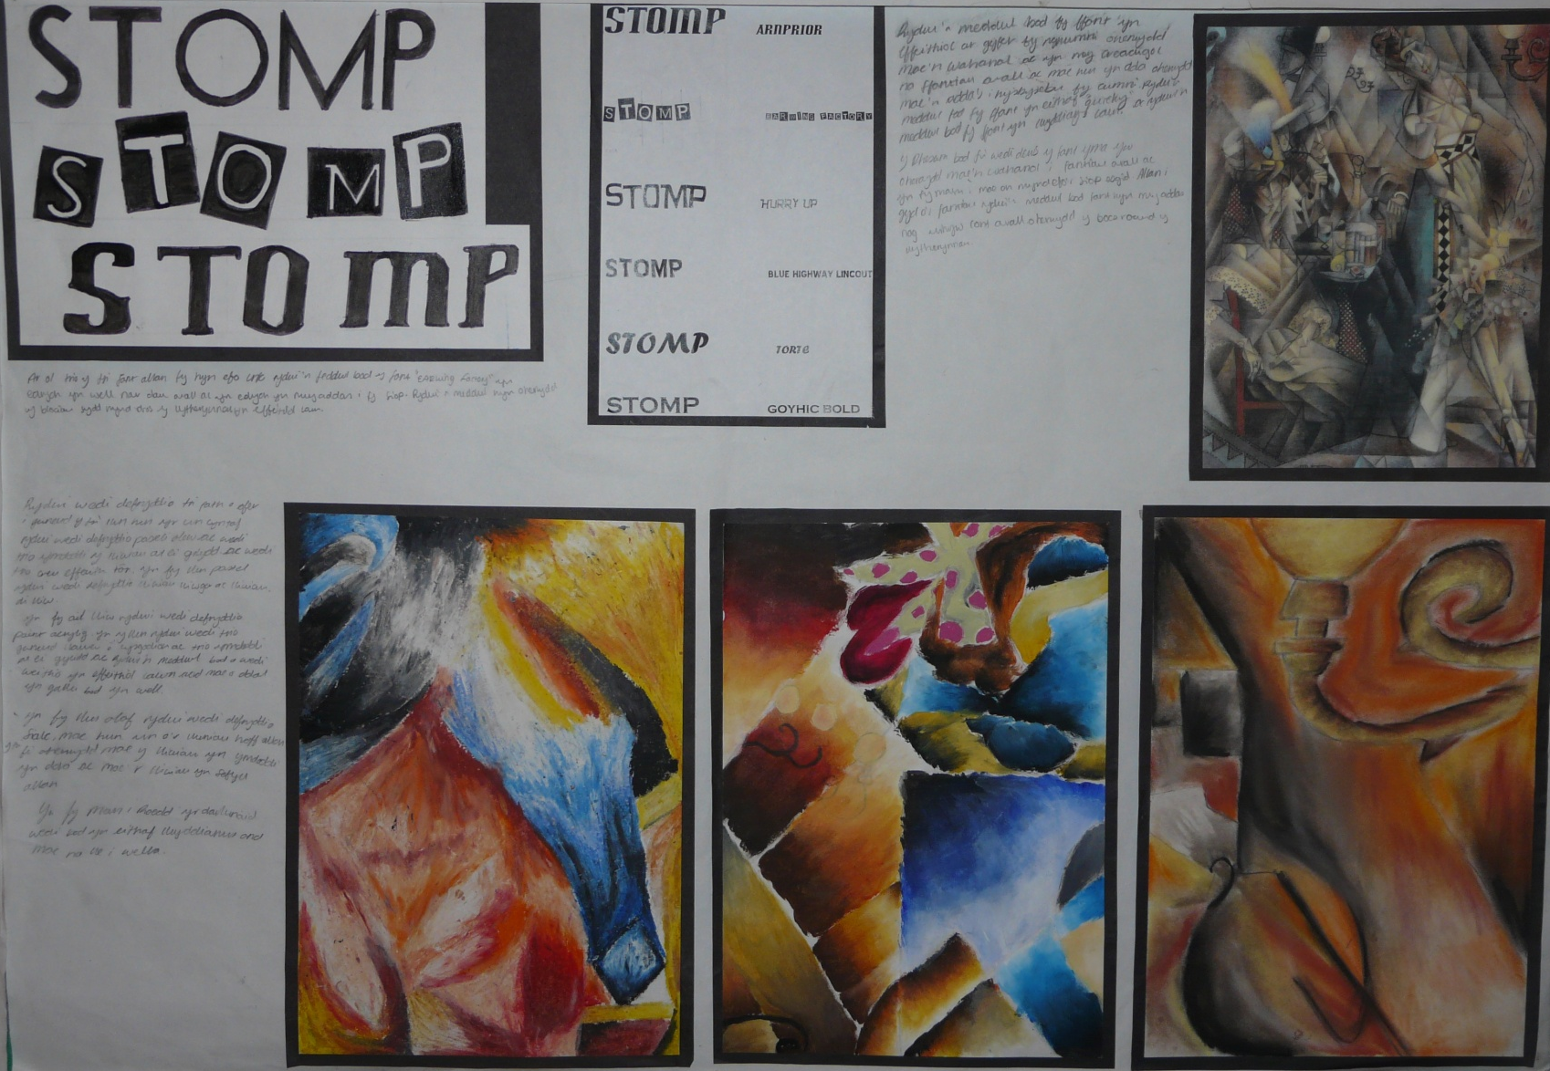
Candidate 1 Portfolio (Applied)

Slide 4
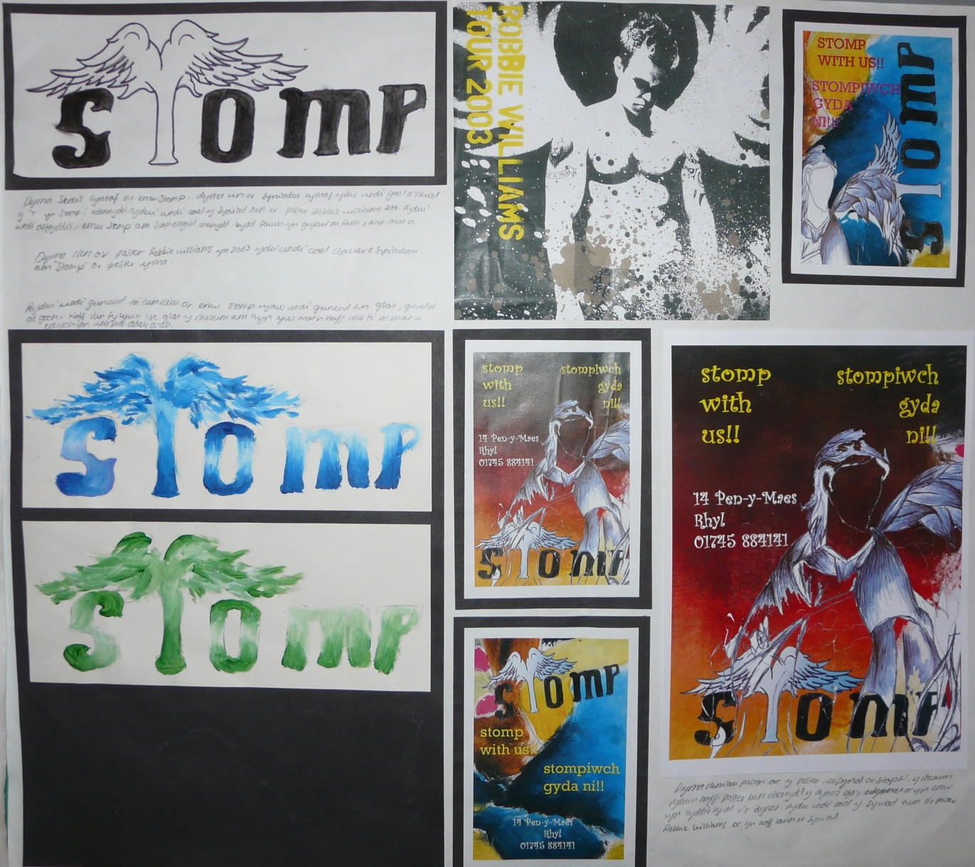
Candidate 1 Portfolio (Applied)

Slide 5
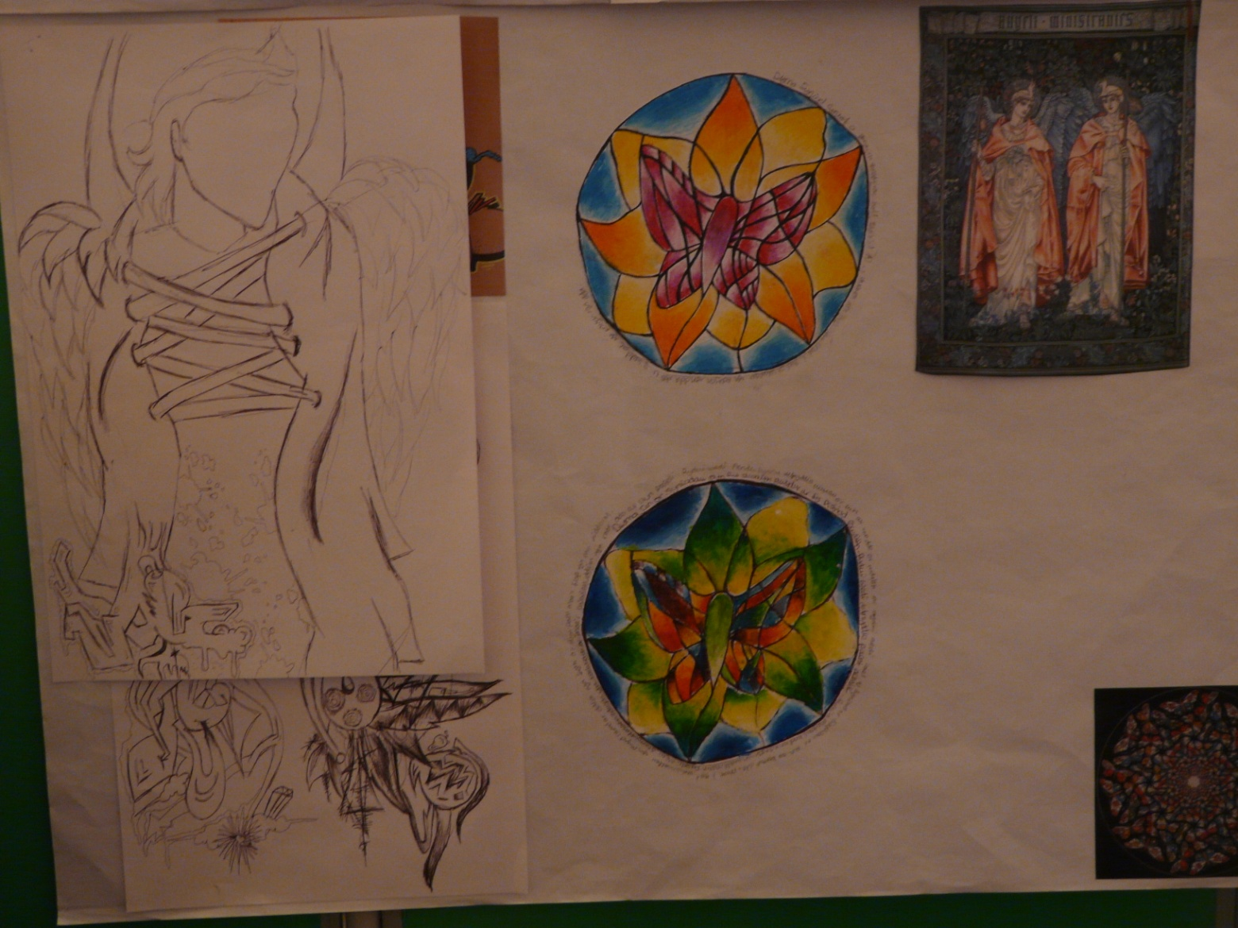
Candidate 1 Portfolio (Applied)
This portfolio provides a good example of an Applied Art & Design ( Single Award ) entry.

Slide 6
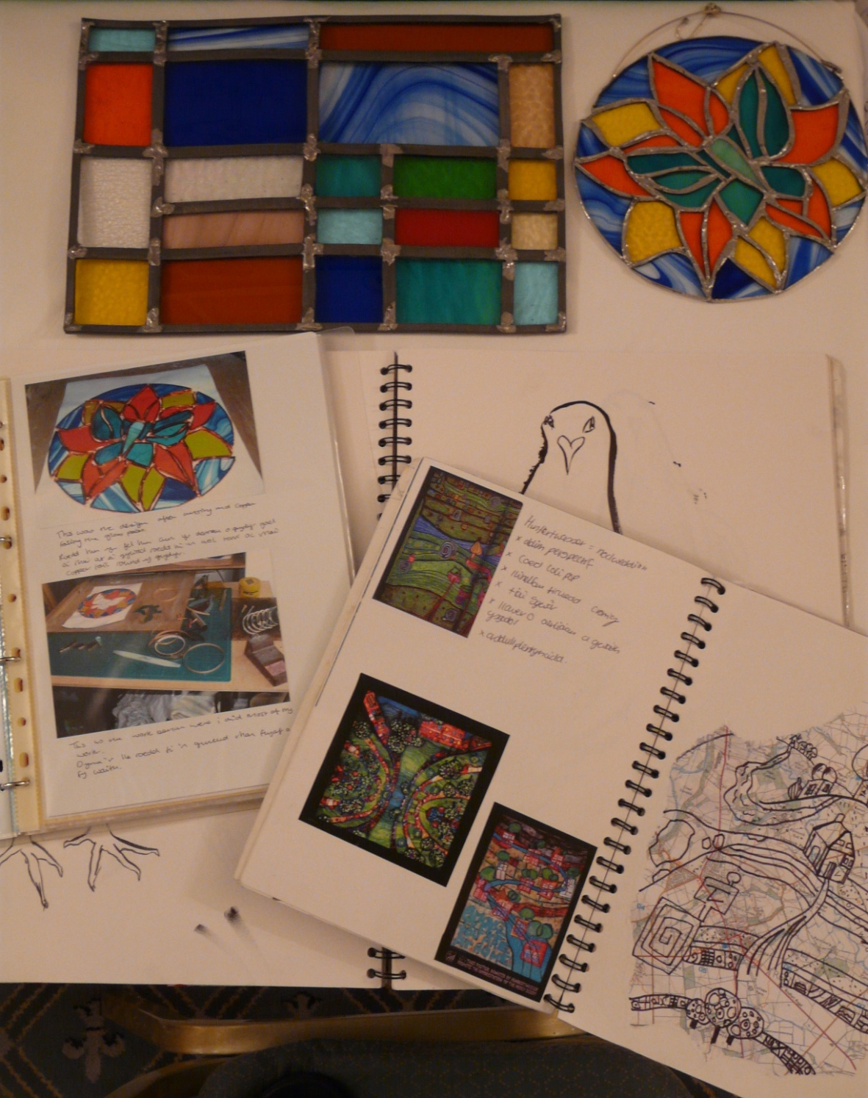
Candidate 1 Portfolio (Applied)
On first observation this may appear to be a typical Unendorsed submission and demonstrates that the Applied course can quite easily be run alongside other options that may be offered and at the same time fulfil possible requirement s for centres to contribute to the Vocational curriculum at Level 2.

Slide 7
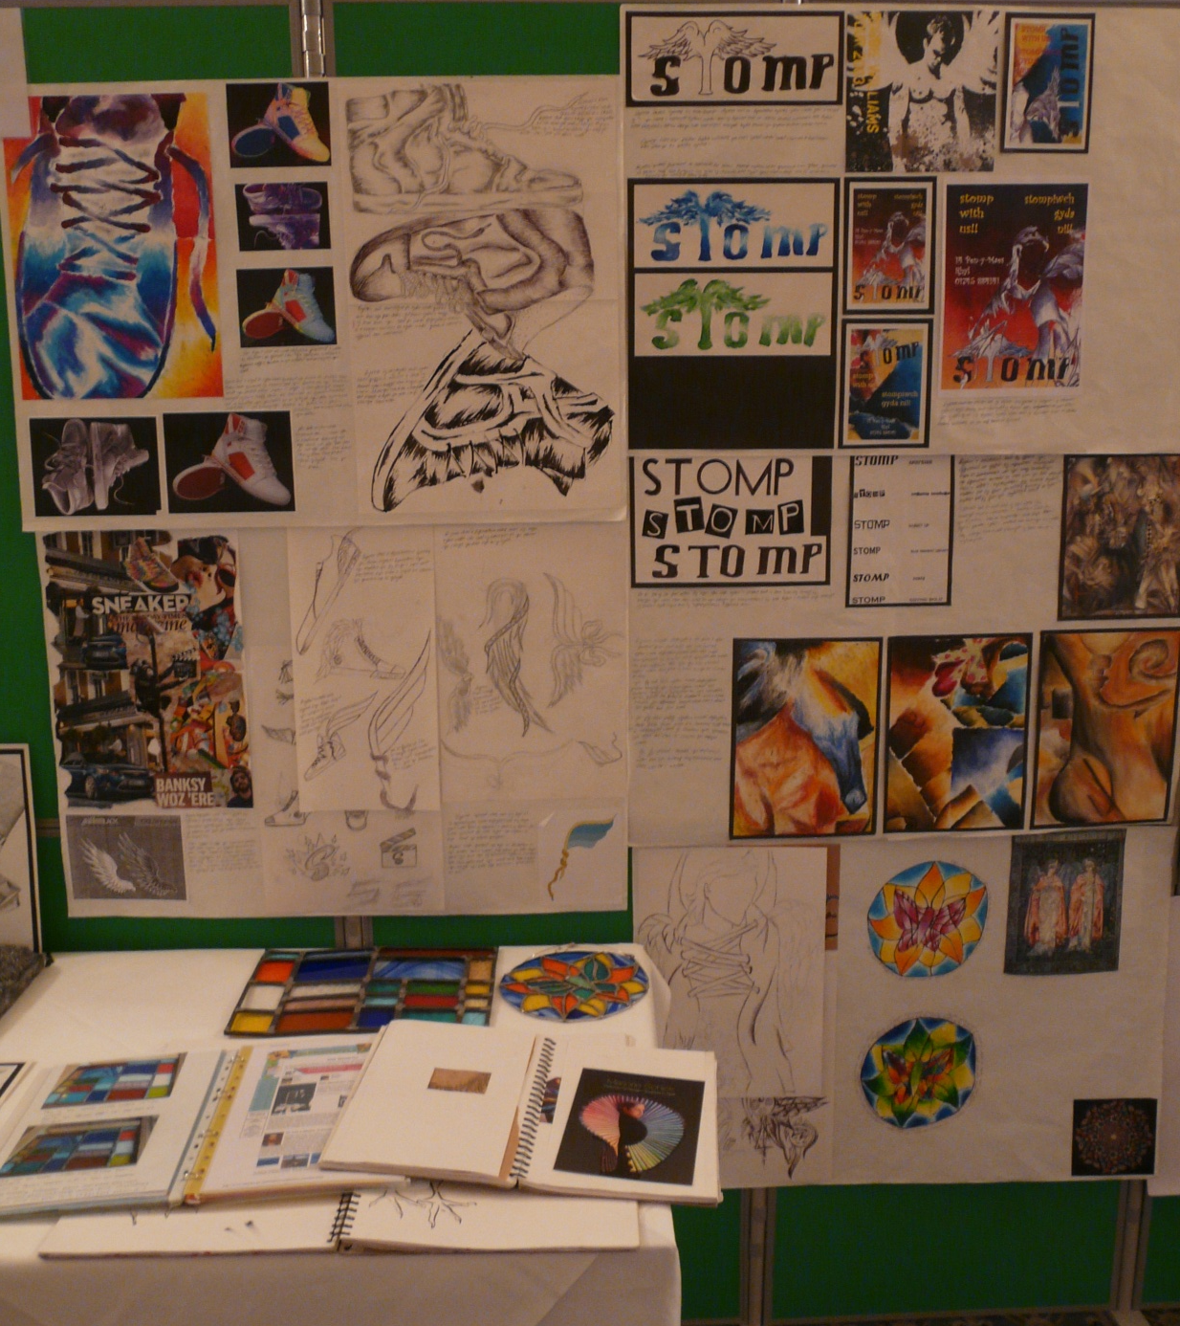
Candidate 1 Portfolio (Applied)
A01 – 24
A02 – 28
A03 – 26
AO4 - 26
Total – 104

Slide 8
Candidate 1 Portfolio (Applied)
The main criteria for running an Applied course would be to plan carefully thought out brief driven tasks, usually in the local community and to give candidates more opportunity to work with outside agencies, (hopefully art and design related).
In this example, from one of our Welsh speaking centres, the candidate has worked on a new design brief for a local shop selling sneakers, called ‘Stomp’.
Contextual Understanding is evident throughout the submission, with appropriate references to the work of designers and artists that have close connections to the style and ideas utilised in creative developments.
Creative Making is very strong and the candidate has benefitted from a work experience placement that allowed him to work with stained glass and extend the range of materials, that counted towards assessment.
Reflective Recording is equally strong, especially in the areas of research and working from first hand observation.
Finally, all elements of this diverse and varied portfolio are brought together by Personal Presentation that shows a highly personal response, imaginative ideas and clear intentions.

