Slide 1
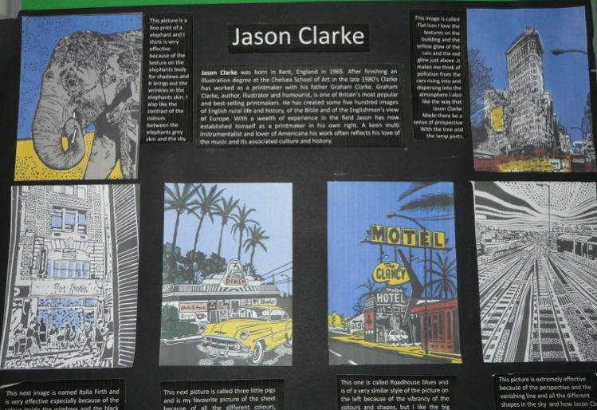
Candidate 1 Portfolio (Art & Design)

Slide 2
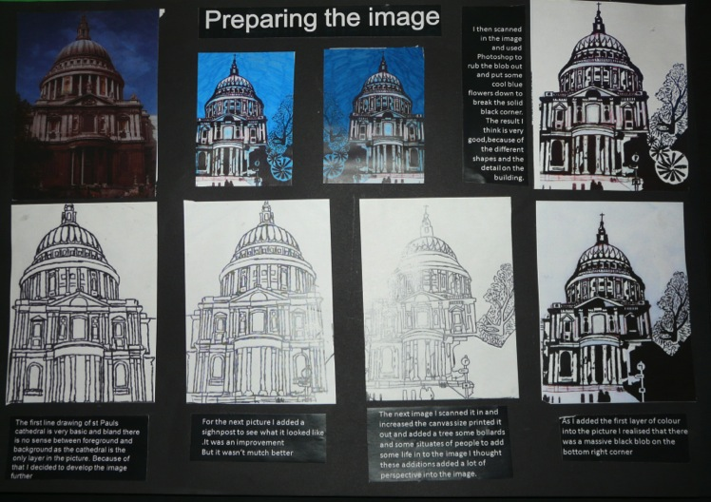
Candidate 1 Portfolio (Art & Design)

Slide 3
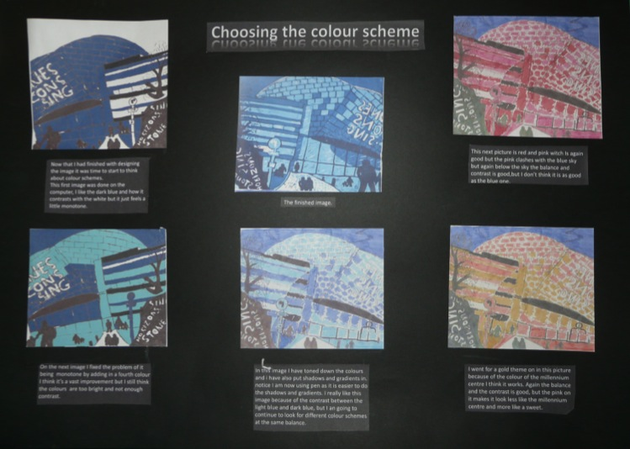
Candidate 1 Portfolio (Art & Design)

Slide 4
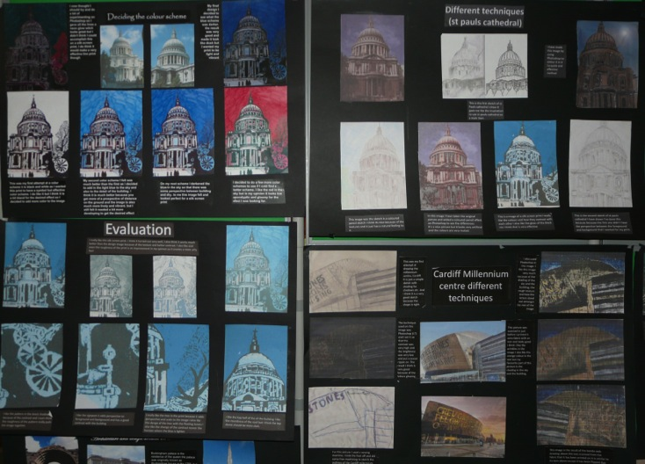
Candidate 1 Portfolio (Art & Design)

Slide 5
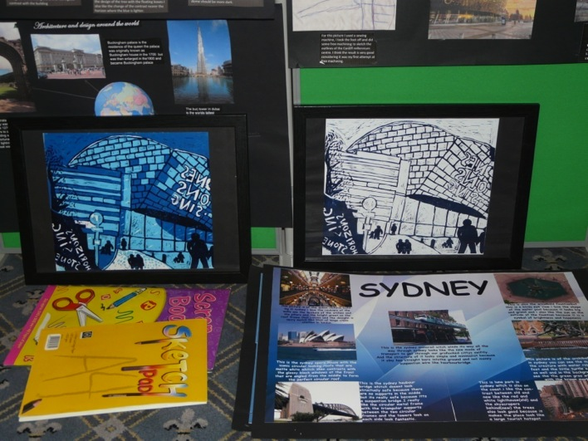
Candidate 1 Portfolio (Art & Design)

Slide 6
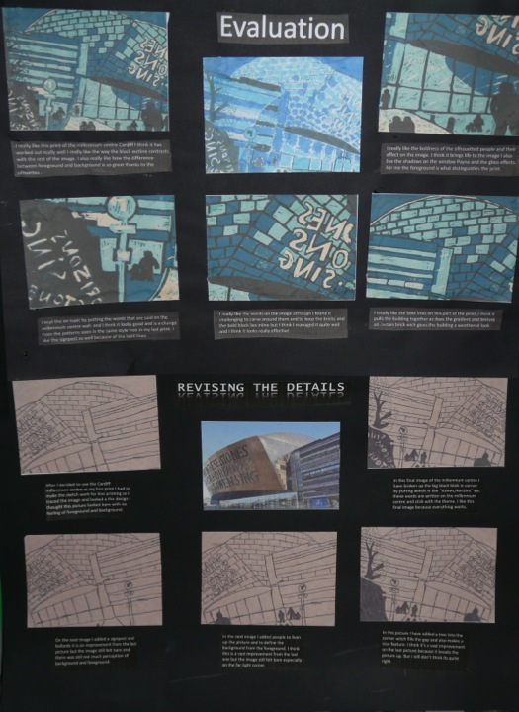
Candidate 1 Portfolio (Art & Design)

Slide 7
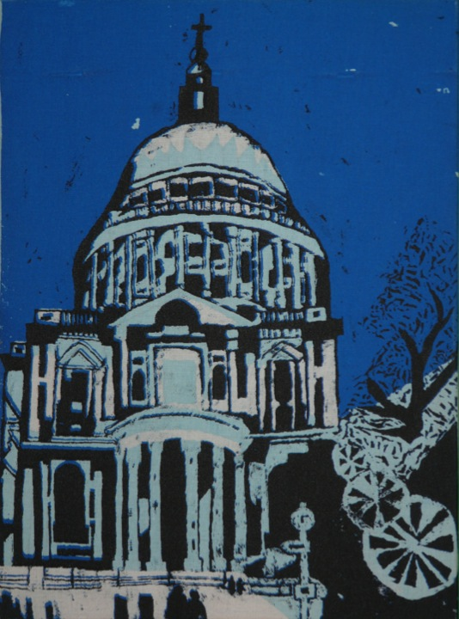
Candidate 1 Portfolio (Art & Design)

Slide 8
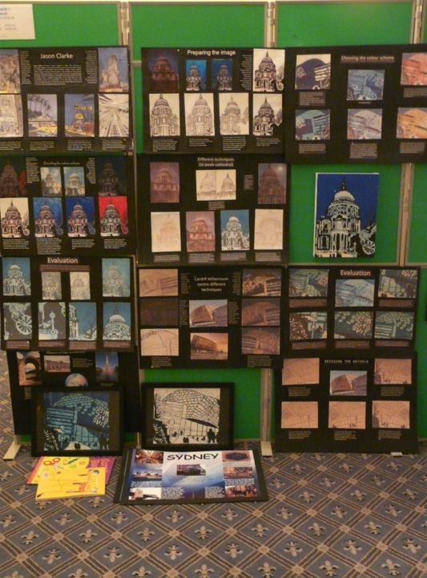
Candidate 1 Portfolio (Art & Design)
A01 – 27
A02 – 27
A03 – 28
AO4 - 29
Total – 111

Slide 9
Candidate 1 Portfolio (Art & Design)
This Art & Design submission could also have been entered as a Graphic Communication endorsement, as apart from some drawing work in the sketchbook and the printed outcome, the presentation is predominantly composed of Graphics related digital processes and techniques. Nevertheless, the quality of evidence for all the Assessment Objectives is very good, particularly in Personal Presentation and with the final print outcomes.
Contextual Understanding is strong, with the study of buildings and the investigation of artists clearly an overall influence on the development of ideas and outcomes presented by the candidate.
Creative Making is restricted to evidence of just printmaking, drawing and some photography, and experimentation with materials is limited as a result. However, this is to some degree compensated for by the high level of skill in, and quality of, the outcomes. On close inspection there is also some evidence on one sheet of the candidate having worked in textiles, using free-arm embroidery as a drawing tool. This evidence could have been more explicit if the actual piece , rather than a scanned image of it, had been submitted.
There was good evidence of Reflective Recording based on personal visits but more drawings, especially of buildings, from direct observation, rather than from photographs would have enhanced the submission and generated greater scope for originality and innovation.
Personal Presentation: The candidate has clearly realised intentions and made a very strong, in depth personal response to the thematic subject of Landmark Buildings. To some extent there is repetition throughout the development of ideas and with some careful selection across the overall submission the candidate could have accessed full marks in this AO.

Slide 10
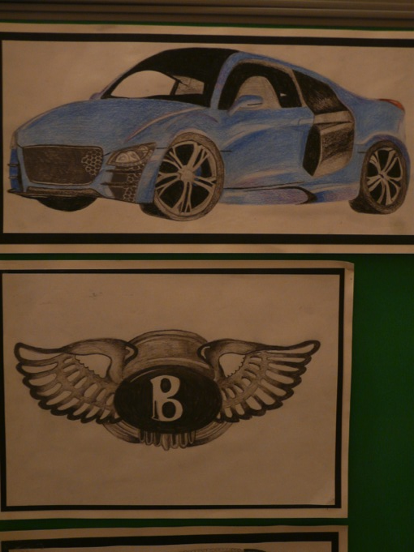
Candidate 2 Portfolio (Art & Design)

Slide 11
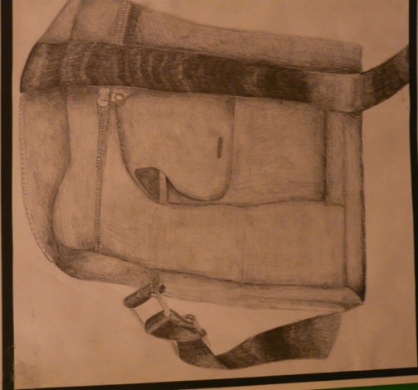
Candidate 2 Portfolio (Art & Design)

Slide 12
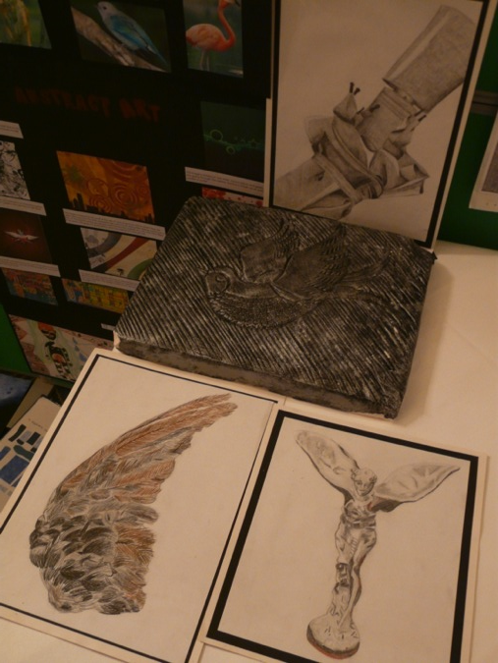
Candidate 2 Portfolio (Art & Design)

Slide 13
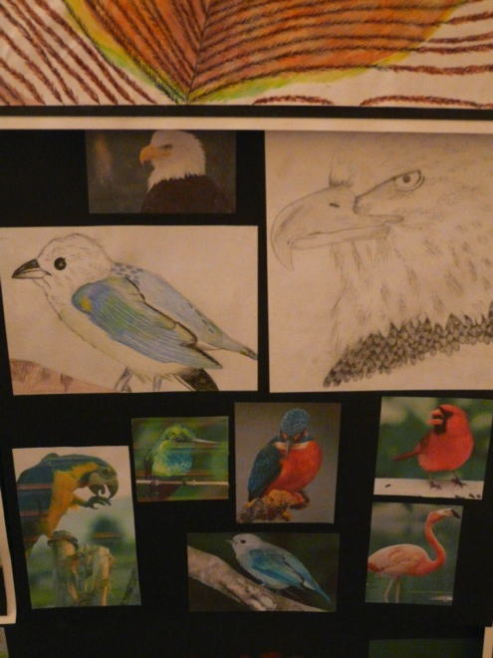
Candidate 2 Portfolio (Art & Design)

Slide 14
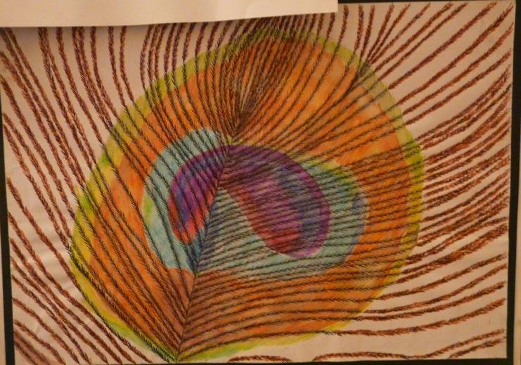
Candidate 2 Portfolio (Art & Design)

Slide 15
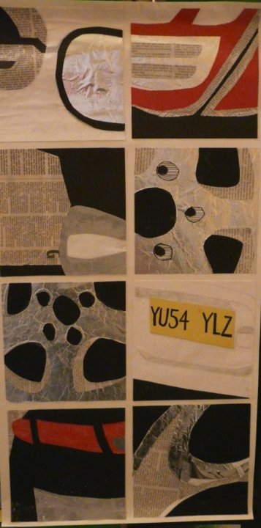
Candidate 2 Portfolio (Art & Design)

Slide 16
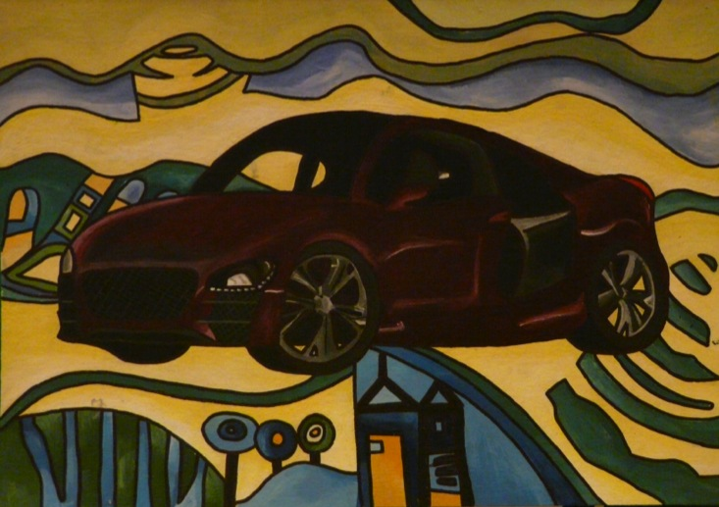
Candidate 2 Portfolio (Art & Design)

Slide 17
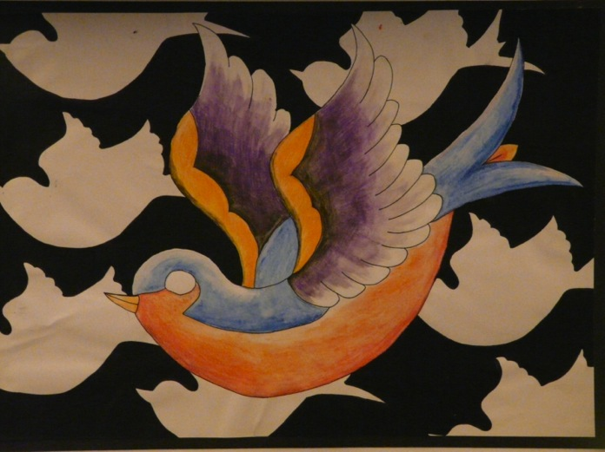
Candidate 2 Portfolio (Art & Design)

Slide 18
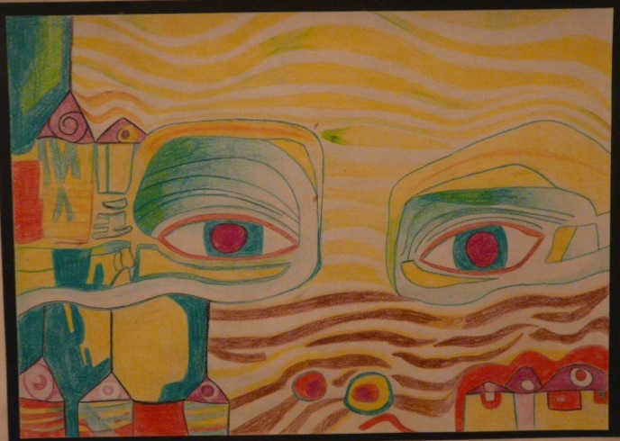
Candidate 2 Portfolio (Art & Design)

Slide 19
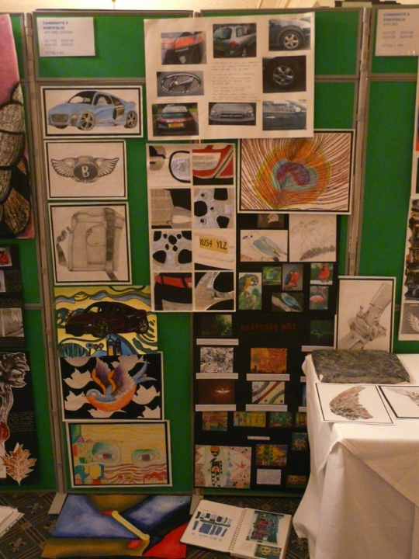
Candidate 2 Portfolio (Art & Design)
A01 – 22
A02 – 24
A03 – 23
AO4 - 23
Total – 92

Slide 20
Candidate 2 Portfolio (Art & Design)
With 2 distinct units evident in this Art & Design Unendorsed Candidate Portfolio, the entry appears to follow the structure seen in the legacy specification. Themes are based on the candidate’s own interests, namely cars and birds and this submission perfectly illustrates how a candidate’s own interests can provide an engaging starting point, with the potential to motivate and sustain focus and involvement throughout the course.
Contextual Understanding is limited. However, there is evidence of some understanding of Hundertwasser with a resulting development of ideas and outcomes.
Creative Making is well-addressed via use of a reasonable variety of materials; mostly drawing and painting, extended by some photography and a plaster cast bird. The quality of evidence is achieved by the candidate’s drawings from observation of cars and car details that reflect a strong personal interest and knowledge of the subject matter.
Reflective Recording is a relatively strong aspect of the submission , due to the competency of drawings from observation and the confident mixed media and collage studies of car features.
However, creative close up photography could have potentially progressed developments further and also enhanced Creative Making by extending the range of materials utilised.
Personal Presentation lacks imagination and any connection to Hundertwasser with the candidate’s own work is almost a token gesture, being used as background rather than influencing or inspiring the development of ideas. However, this is balanced by the strong personal response, stimulated by the candidate’s own interests in the themes studied.

Slide 21
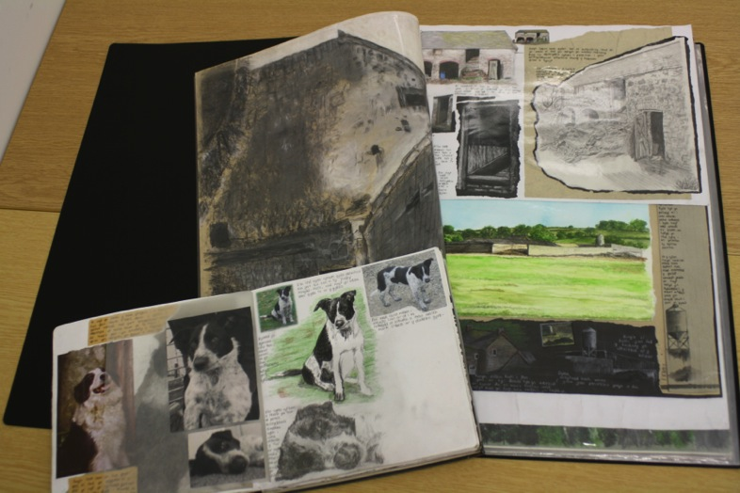
Candidate 3 Portfolio (Art & Design)

Slide 22
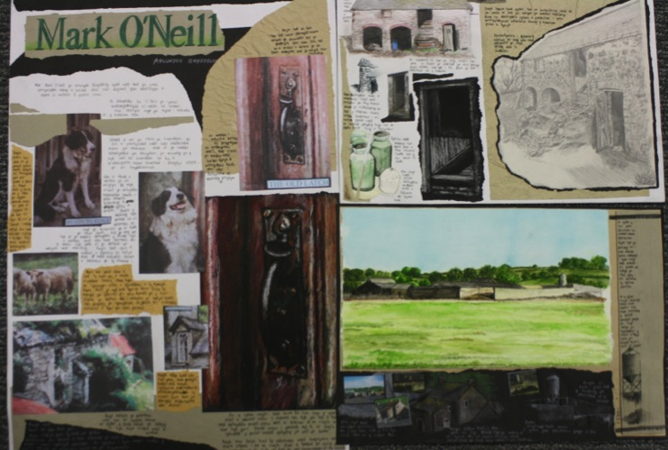
Candidate 3 Portfolio (Art & Design)

Slide 23
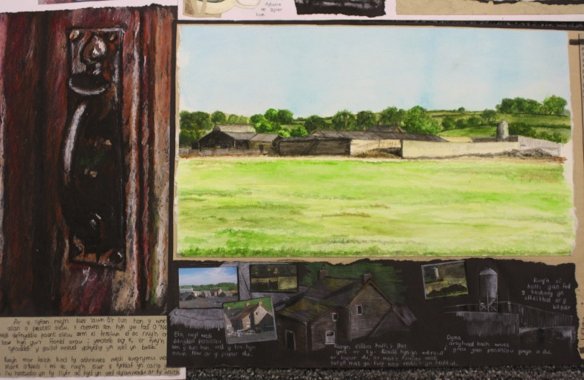
Candidate 3 Portfolio (Art & Design)

Slide 24
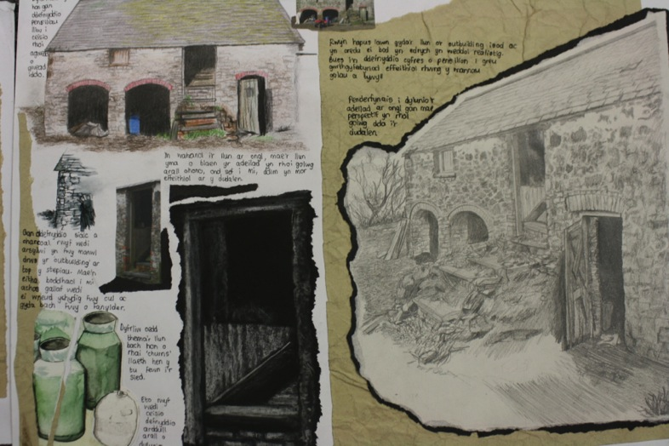
Candidate 3 Portfolio (Art & Design)

Slide 25
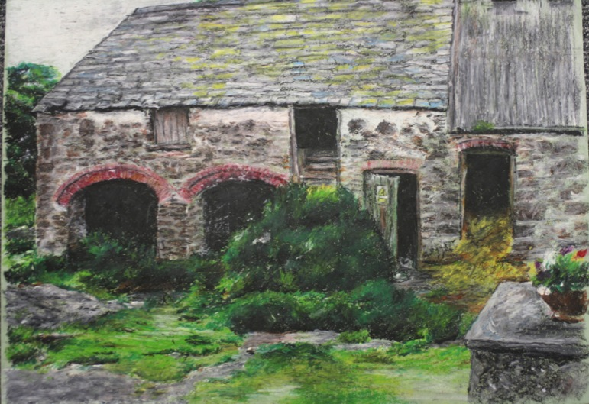
Candidate 3 Portfolio (Art & Design)

Slide 26
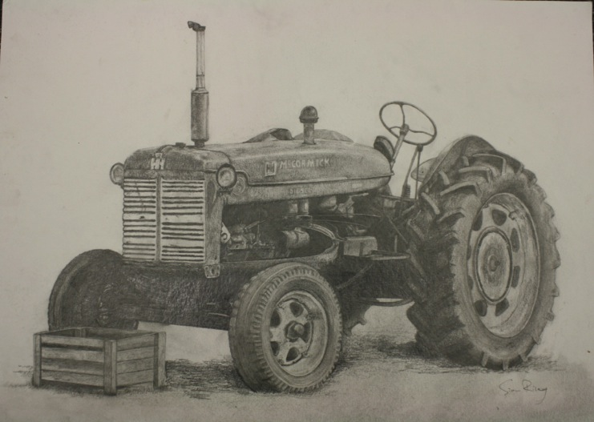
Candidate 3 Portfolio (Art & Design)

Slide 27
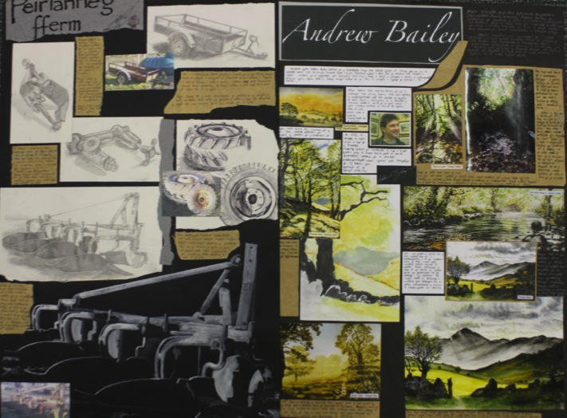
Candidate 3 Portfolio (Art & Design)

Slide 28
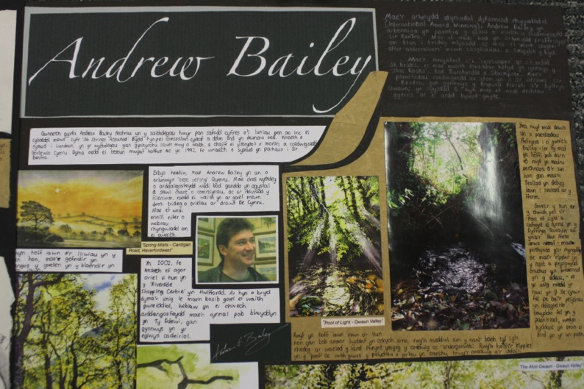
Candidate 3 Portfolio (Art & Design)

Slide 29
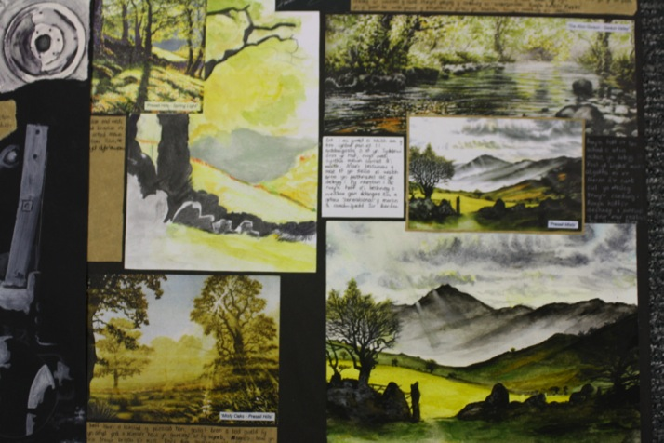
Candidate 3 Portfolio (Art & Design)

Slide 30
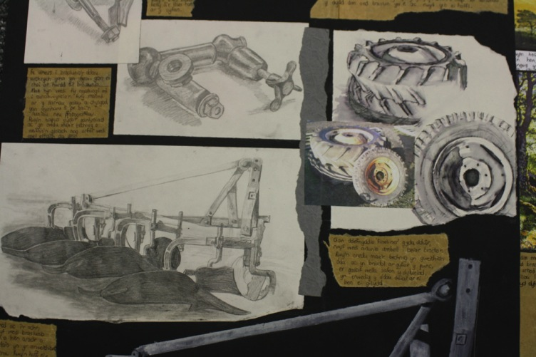
Candidate 3 Portfolio (Art & Design)

Slide 31
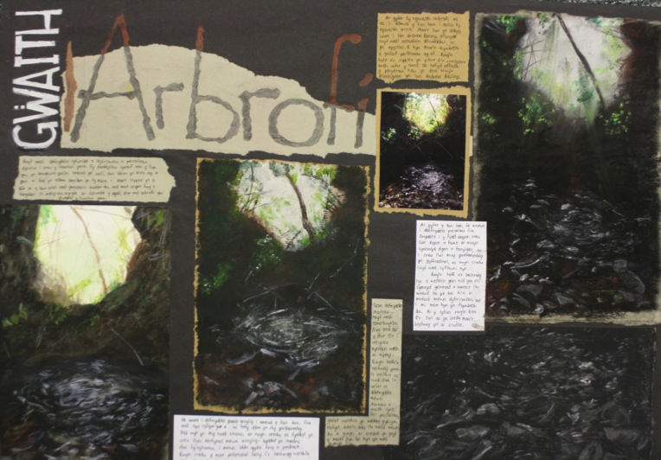
Candidate 3 Portfolio (Art & Design)

Slide 32
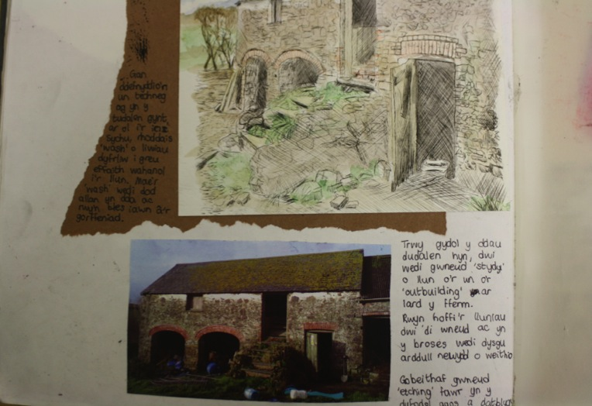
Candidate 3 Portfolio (Art & Design)

Slide 33
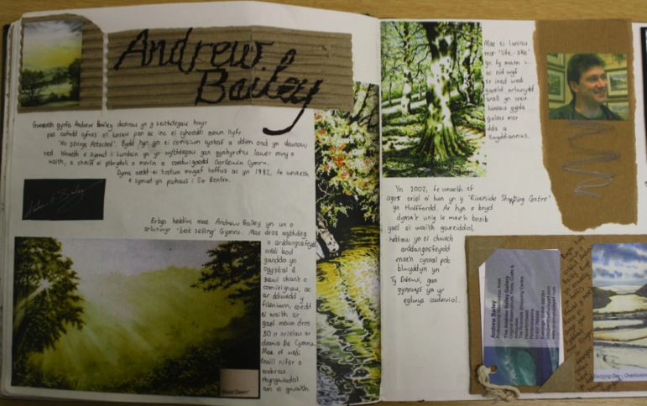
Candidate 3 Portfolio (Art & Design)

Slide 34
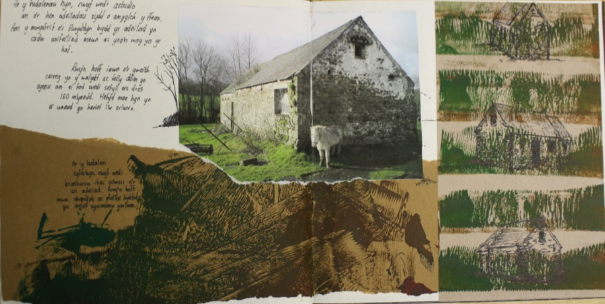
Candidate 3 Portfolio (Art & Design)

Slide 35
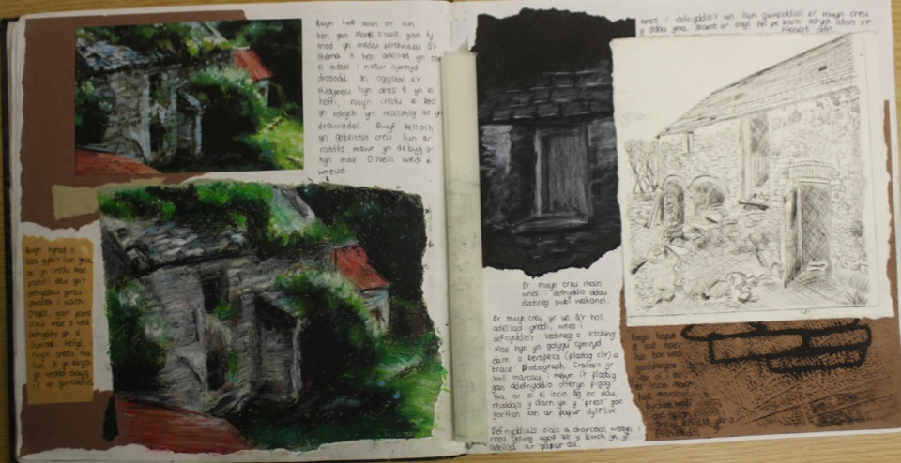
Candidate 3 Portfolio (Art & Design)

Slide 36
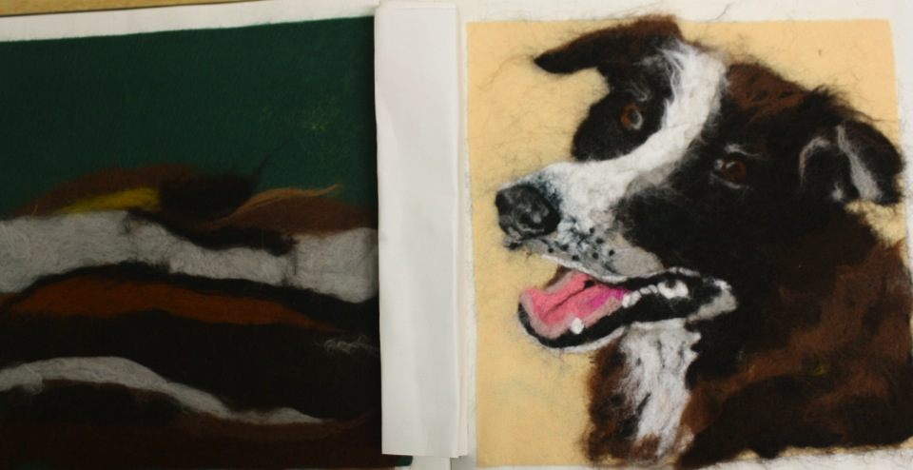
Candidate 3 Portfolio (Art & Design)

Slide 37
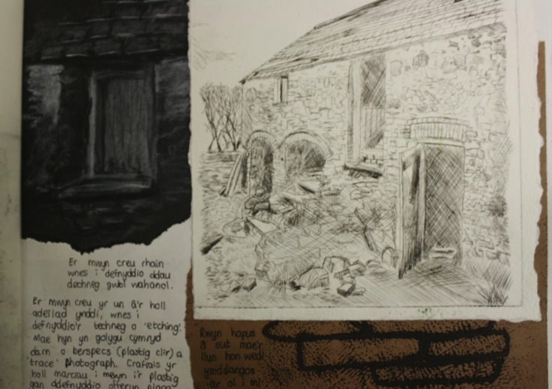
Candidate 3 Portfolio (Art & Design)
A01 – 30
A02 – 30
A03 – 30
AO4 - 30
Total – 120

Slide 38
Candidate 3 Portfolio (Art & Design)
Presentation of this candidate’s work consisted of a sketchbook full of relevant imagery, skills, techniques, artist references and inspirations, together with an A2 Flip File of larger outcomes. The utilisation of his home, a farm, and its surrounding environment, animals and objects, combine to create a personal and relevant line of enquiry. The Assessment Objectives are equally met throughout, with clear evidence for each.
Contextual Understanding is strong. The candidate has investigated the work of other artists thoroughly and appropriately, undertaking primary source research that has aided a variety of explorations of media and the development of ideas. There is also clear visual and written evidence of understanding of the work of creative practitioners as a source of inspiration for quality outcomes.
In Creative Making the candidate has made excellent use of media, with which he has experimented effectively and purposefully in rural studies of buildings, surrounding fields, farmyard machinery and animals. The use of oil pastels, pencils, paint, pen, printing and felting demonstrates his competent and confident application of such media as the work progressed.
In Reflective Recording first hand studies recorded from direct observation, combined with photographs, support and enhance skilful outcomes.
The strongest aspect of Personal Presentation is apparent in the way in which the candidate has proposed and realised his intentions in a comprehensive, well-considered and focused manner showing personal direction and engagement.

Slide 39
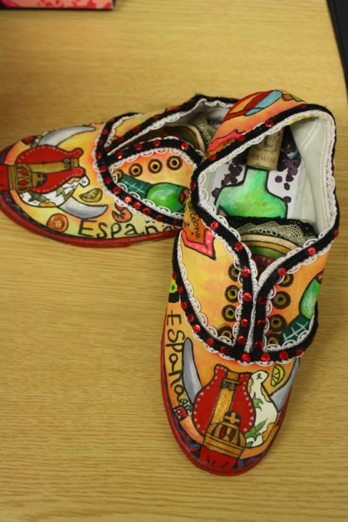
Candidate 4 Portfolio (Art & Design)

Slide 40
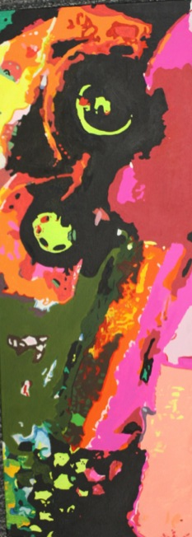
Candidate 4 Portfolio (Art & Design)

Slide 41
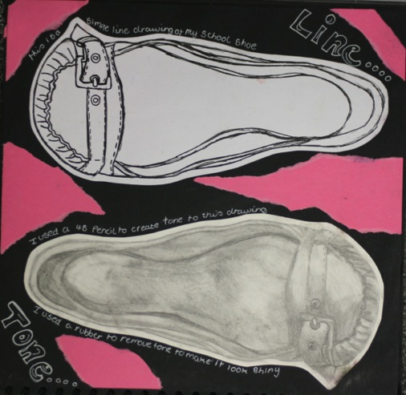
Candidate 4 Portfolio (Art & Design)

Slide 42
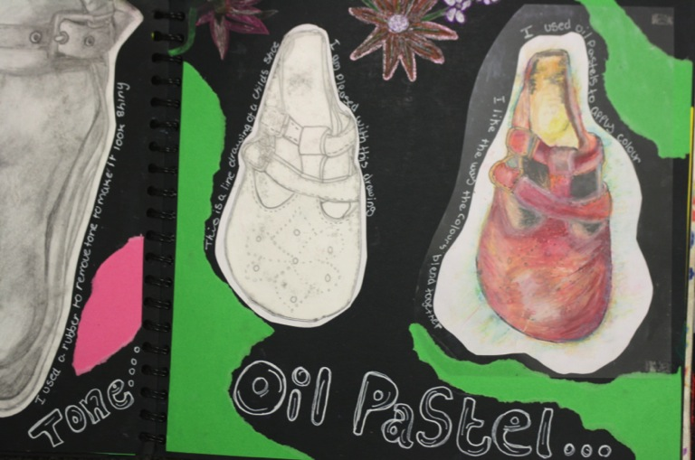
Candidate 4 Portfolio (Art & Design)

Slide 43
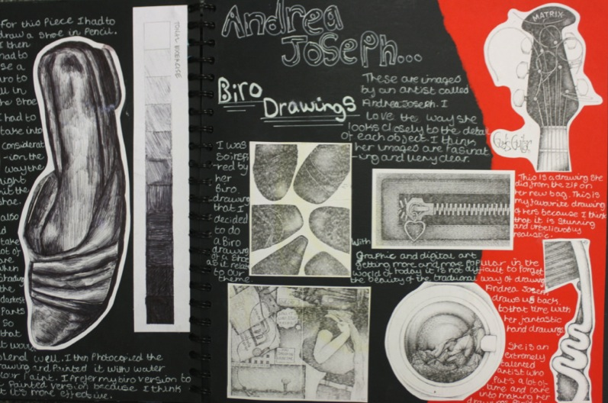
Candidate 4 Portfolio (Art & Design)

Slide 44
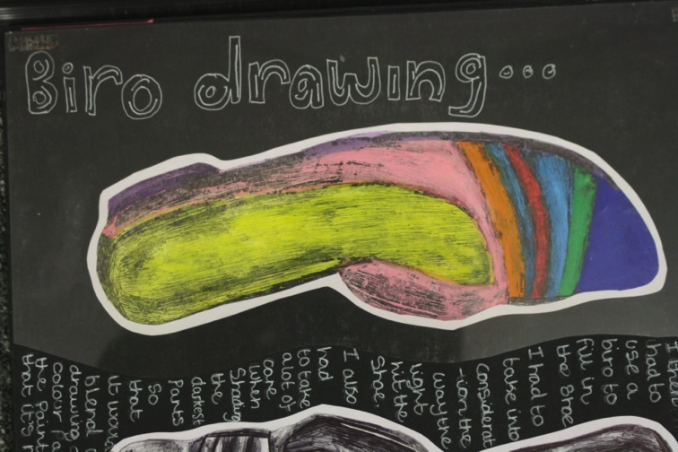
Candidate 4 Portfolio (Art & Design)

Slide 45
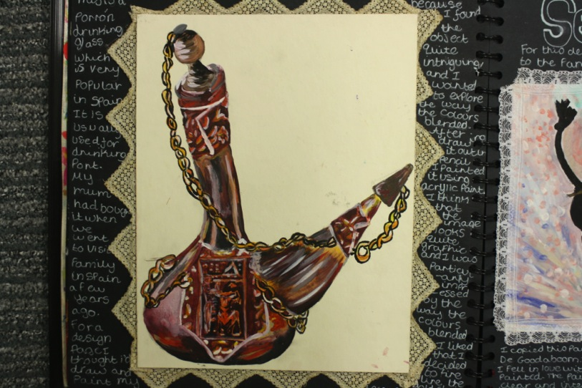
Candidate 4 Portfolio (Art & Design)

Slide 46
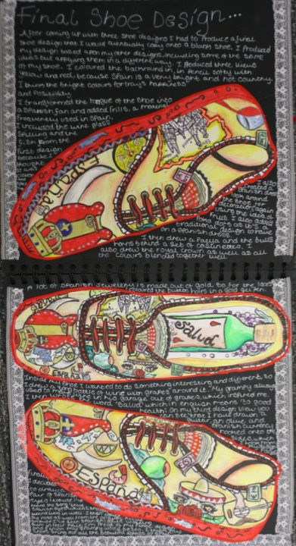
Candidate 4 Portfolio (Art & Design)

Slide 47
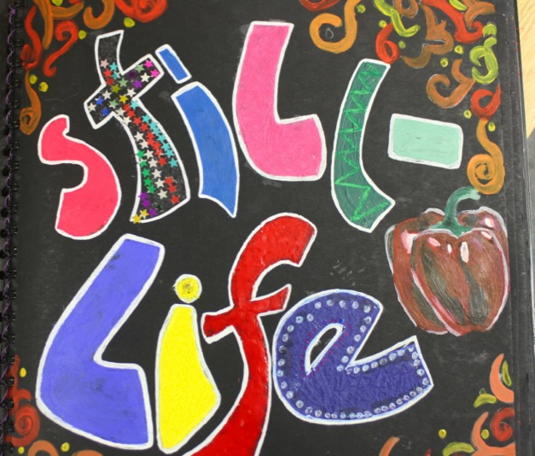
Candidate 4 Portfolio (Art & Design)

Slide 48
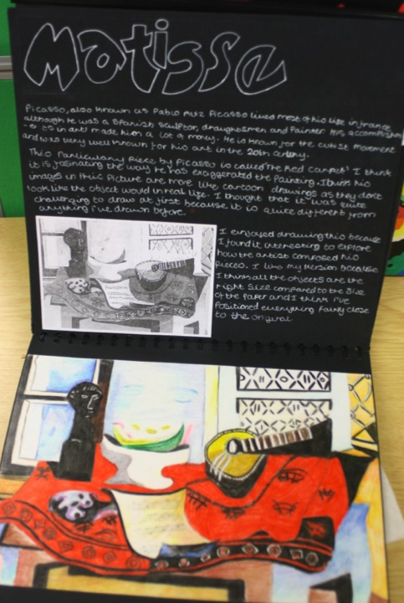
Candidate 4 Portfolio (Art & Design)

Slide 49
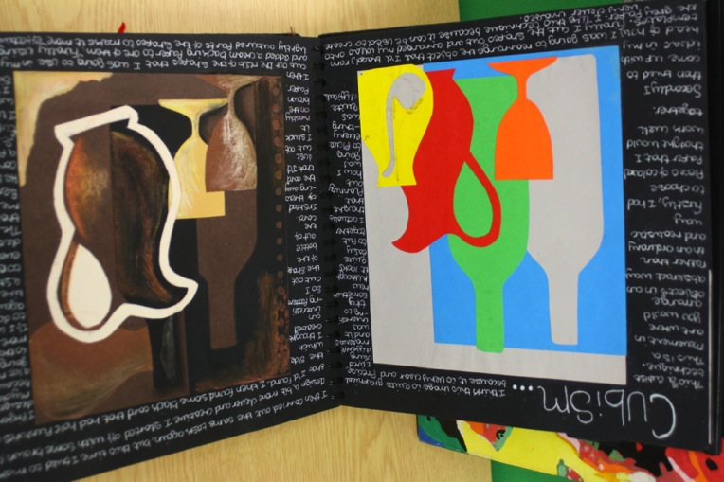
Candidate 4 Portfolio (Art & Design)

Slide 50
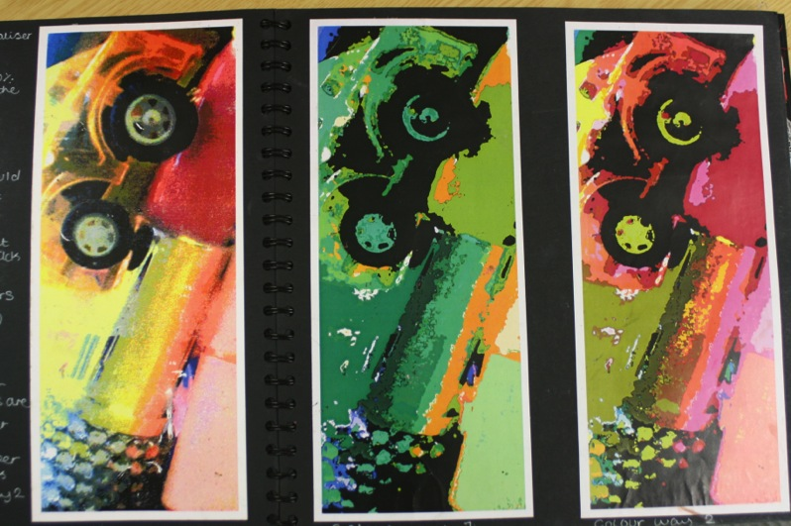
Candidate 4 Portfolio (Art & Design)

Slide 51
Candidate 4 Portfolio (Art & Design)

Slide 52
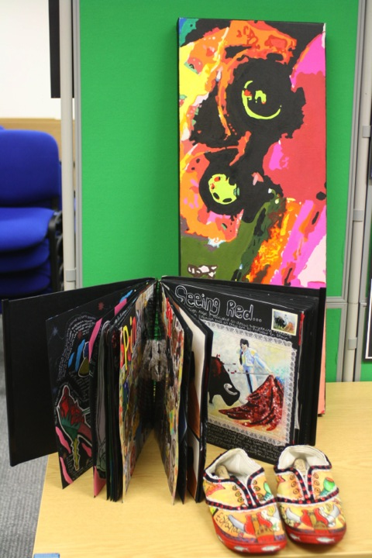
Candidate 4 Portfolio (Art & Design)
A01 – 30
A02 – 28
A03 – 28
AO4 - 29
Total – 115

Slide 53
Candidate 4 Portfolio (Art & Design)
The majority of work for this Candidates’ Portfolio is contained within one compact and succinct book, with a painting and shoe design as outcomes. The starting point of the course has been constructed around skills and techniques based workshop studies under a general theme that also allows for her own personal lines of enquiry.
Contextual Understanding: Within the CP1 book, there is clear evidence of investigating the work of artists and cultures in particular, aiding exploration and in turn, widening the range of possible ideas. Her written and visual annotation demonstrates understanding of how and why the works of these artists were produced and are appropriate to her creative practice.
Creative Making: There is good evidence of experimentation with techniques and purposeful developments support the progression of ideas. The handling of media such as paint, pencil, pen and pastel is very strong, as is the selection and use of other materials, including new media.
Reflective Recording: The candidate has commendably utilised opportunities to work with first hand experiences, including drawing from direct observation, as part of her research and recording of ideas. Her final outcomes of shoes and a canvas have been produced showing clear development from initial research and ideas.
Personal presentation: The candidate has clearly realised intentions and made an innovative, highly individual and personal response with explicit and appropriate connections between her work and that of other artists and designers

Slide 54
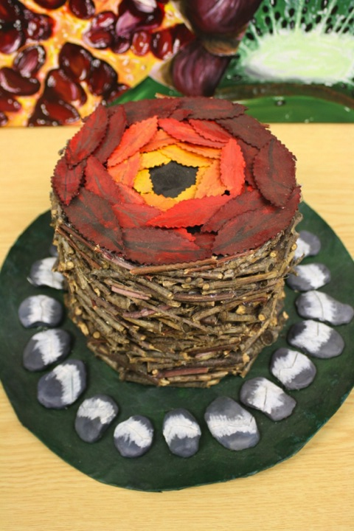
Candidate 5 Portfolio (Art & Design)

Slide 55
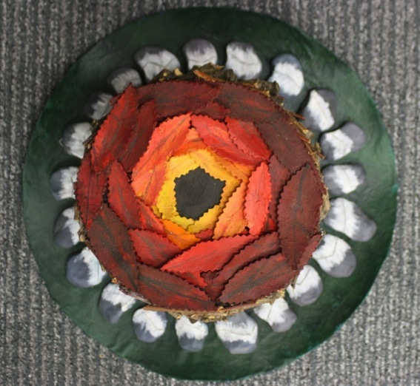
Candidate 5 Portfolio (Art & Design)

Slide 56
Candidate 5 Portfolio (Art & Design)

Slide 57
Candidate 5 Portfolio (Art & Design)

Slide 58
Candidate 5 Portfolio (Art & Design)

Slide 59
Candidate 5 Portfolio (Art & Design)

Slide 60
Candidate 5 Portfolio (Art & Design)

Slide 61
Candidate 5 Portfolio (Art & Design)

Slide 62
Candidate 5 Portfolio (Art & Design)

Slide 63
Candidate 5 Portfolio (Art & Design)

Slide 64
Candidate 5 Portfolio (Art & Design)

Slide 65
Candidate 5 Portfolio (Art & Design)

Slide 66
Candidate 5 Portfolio (Art & Design)

Slide 67
Candidate 5 Portfolio (Art & Design)

Slide 68
Candidate 5 Portfolio (Art & Design)

Slide 69
Candidate 5 Portfolio (Art & Design)

Slide 70
Candidate 5 Portfolio (Art & Design)

Slide 71
Candidate 5 Portfolio (Art & Design)

Slide 72
Candidate 5 Portfolio (Art & Design)

Slide 73
Candidate 5 Portfolio (Art & Design)

Slide 74
Candidate 5 Portfolio (Art & Design)
A01 – 30
A02 – 30
A03 – 30
AO4 - 30
Total – 120

Slide 75
Candidate 5 Portfolio (Art & Design)
This extensive presentation of an Art and Design Candidate Portfolio consists of a number of high quality canvas outcomes inspired by a response to ‘Natural forms’ as a theme. There is also a well designed and constructed 3D hat inspired by and clearly linked to the work of an artist that fully complements their personal lines of enquiry. All of this work is supported by a presentation of A2 sheets incorporating studies, experimentation and annotation with further extension work in a sketchbook comprised of artwork, ideas, and plans.
The four Assessment Objectives are fully covered with refined, well-executed examples in evidence and, perhaps, a quantity of work that could be considered as above and beyond what is required to warrant full marks. This is not intended to be a critical or negative comment, as the candidate is to be congratulated for their output; but as a guide to indicate to Centres and candidates that a Portfolio of less quantity can still achieve full marks. However, it should be noted that the immersive and highly motivated approach seen here has undoubtedly cultivated the fluency and command of technique associated with higher levels/qualifications.
Photography has been used sensitively, and in conjunction with other forms of recording from direct observation, has supported the development of ideas. Experimentation with media, including paint, pencil and collage is purposeful and innovative. The journey from theme and initial concepts through to outcomes is clear and comprehensive, with intentions and connections between the candidates’ work and that of others fully explained.

Slide 76
Candidate 6 Portfolio (Art & Design)

Slide 77
Candidate 6 Portfolio (Art & Design)

Slide 78
Candidate 6 Portfolio (Art & Design)

Slide 79
Candidate 6 Portfolio (Art & Design)

Slide 80
Candidate 6 Portfolio (Art & Design)

Slide 81
Candidate 6 Portfolio (Art & Design)

Slide 82
Candidate 6 Portfolio (Art & Design)

Slide 83
Candidate 6 Portfolio (Art & Design)

Slide 84
Candidate 6 Portfolio (Art & Design)

Slide 85
Candidate 6 Portfolio (Art & Design)

Slide 86
Candidate 6 Portfolio (Art & Design)

Slide 87
Candidate 6 Portfolio (Art & Design)

Slide 88
Candidate 6 Portfolio (Art & Design)

Slide 89
Candidate 6 Portfolio (Art & Design)

Slide 90
Candidate 6 Portfolio (Art & Design)

Slide 91
Candidate 6 Portfolio (Art & Design)

Slide 92
Candidate 6 Portfolio (Art & Design)

Slide 93
Candidate 6 Portfolio (Art & Design)

Slide 94
Candidate 6 Portfolio (Art & Design)

Slide 95
Candidate 16 Portfolio (Art & Design)

Slide 96
Candidate 16 Portfolio (Art & Design)

Slide 97
Candidate 16 Portfolio (Art & Design)

Slide 98
Candidate 16 Portfolio (Art & Design)

Slide 99
Candidate 6 Portfolio (Art & Design)

Slide 100
Candidate 6 Portfolio (Art & Design)
A01 – 30
A02 – 30
A03 – 30
AO4 - 30
Total – 120

Slide 101
Candidate 6 Portfolio (Art & Design)
This example of an Art and Design Candidate Portfolio showcases exemplary work in both quantity and quality within a GCSE submission. It consists of four CP books, (each with a personally selected starting point), that contain all the evidence required across the Assessment Objectives equally and to the highest standard. Each outcome is the result of developed and selected work from each sketchbook, all reflecting maturity and strong command of technique in media; which includes: painting, photography, printing, pencil and the use of digital software as a exploratory/planning tool for paintings.
Contextual Understanding is clearly demonstrated within each CP book that includes investigations into artists’ works that are explored and developed within a wide range of ideas. A major strength in Creative Making is the experimentation with media, with the strongest techniques and processes subsequently selected and utilised to achieve a quality outcome. The large canvas depicting a figure in action is a prime example of this practice. The skill and maturity in the handling of paint to capture balance and movement is exceptional.
Reflective Recording: A wide variety of inspirational objects and studies of birds, fish and the human form, together with primary source visits, have informed the work. Each process and modification is thoroughly explained and annotated. Observational drawing throughout the submission has instilled confidence and originality in responses.
Personal Presentation: The journey from theme and initial concepts through to outcomes is clear and comprehensive, with intentions and connections between the candidate’s work and that of others fully explained. Outcomes are highly refined and reflect maturity and exceptional levels of skill. The quantity of Portfolio work could be viewed as proportionate to that of more than one candidate and, provided quality and balance is achieved at each assessment objective, then half of this amount of work would be an acceptable quantity, whilst still maintaining the capacity to achieve maximum marks.

