Slide 1
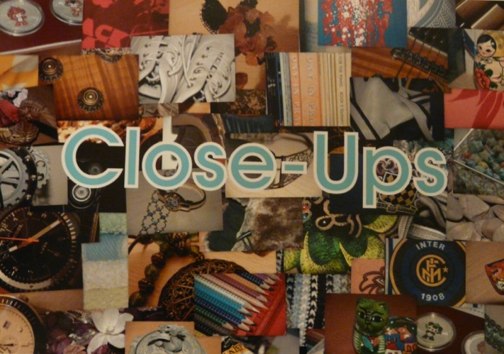
Candidate 1 Portfolio (Fine Art)

Slide 2
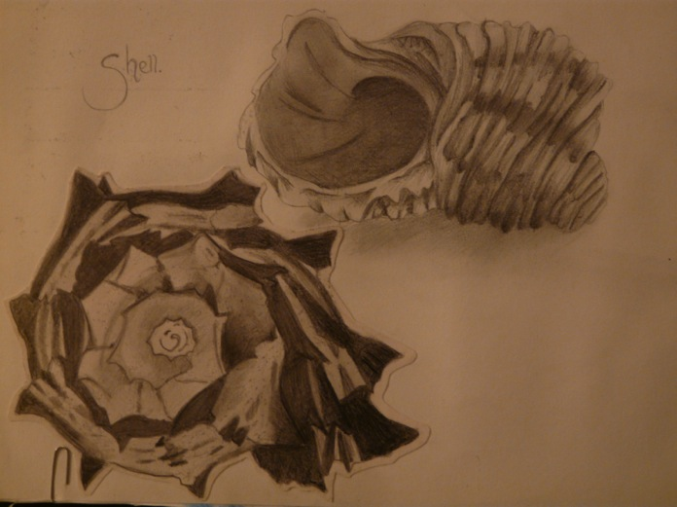
Candidate 1 Portfolio (Fine Art)

Slide 3
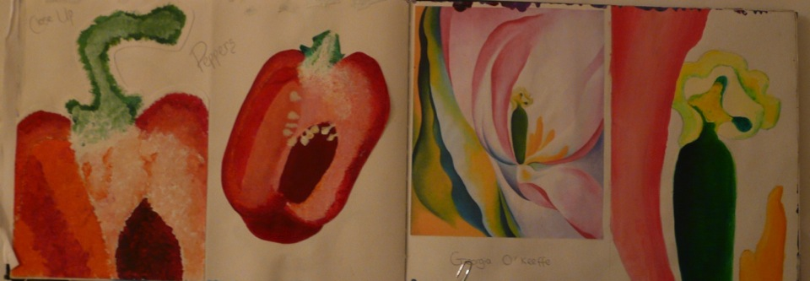
Candidate 1 Portfolio (Fine Art)

Slide 4
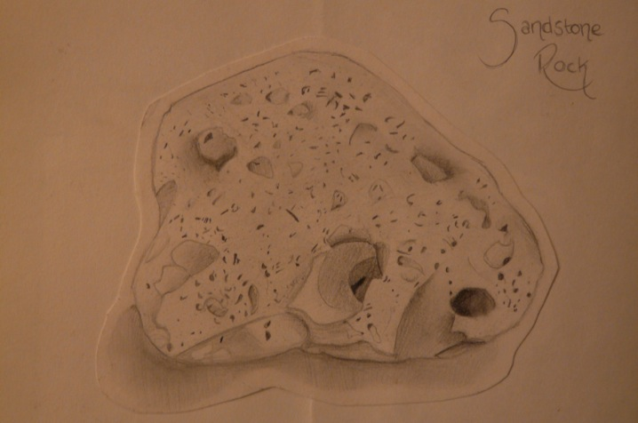
Candidate 1 Portfolio (Fine Art)

Slide 5
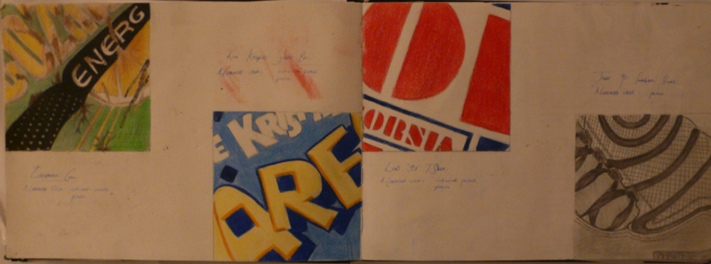
Candidate 1 Portfolio (Fine Art)

Slide 6
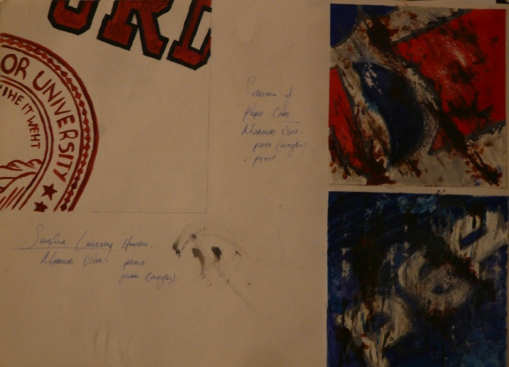
Candidate 1 Portfolio (Fine Art)

Slide 7
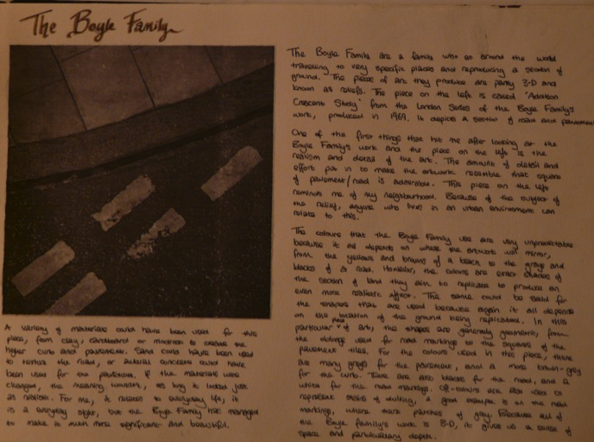
Candidate 1 Portfolio (Fine Art)

Slide 8
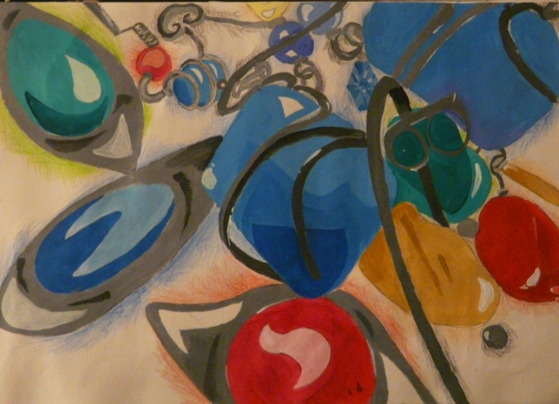
Candidate 1 Portfolio (Fine Art)

Slide 9
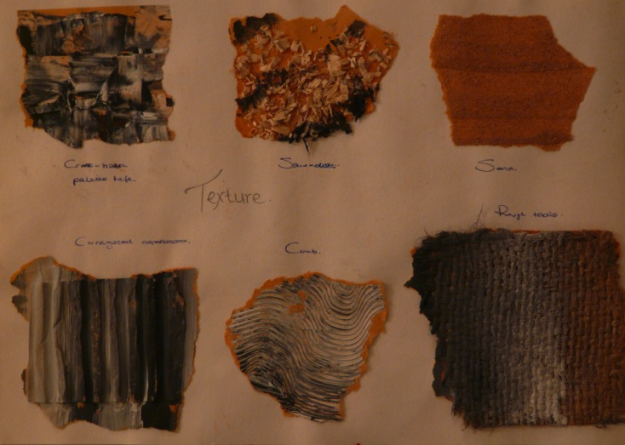
Candidate 1 Portfolio (Fine Art)

Slide 10
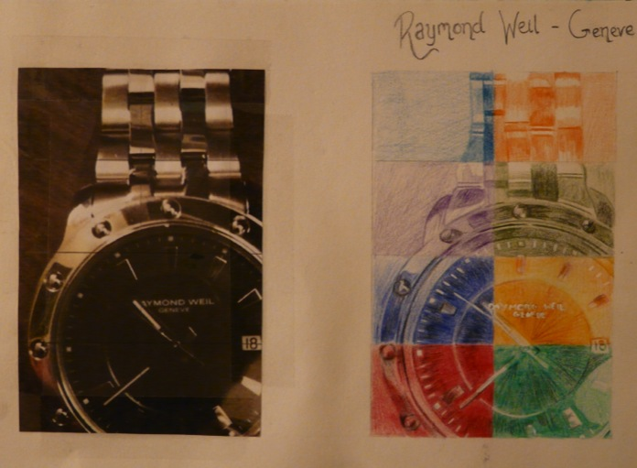
Candidate 1 Portfolio (Fine Art)

Slide 11
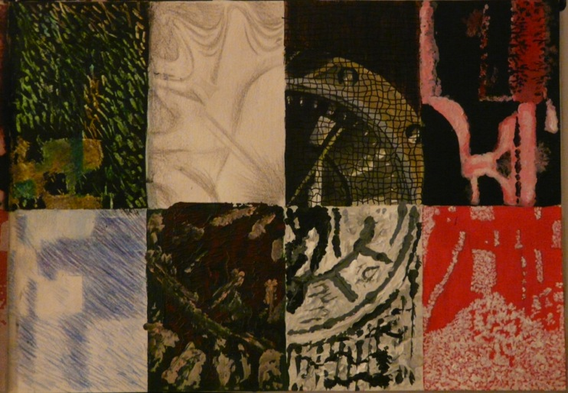
Candidate 1 Portfolio (Fine Art)

Slide 12
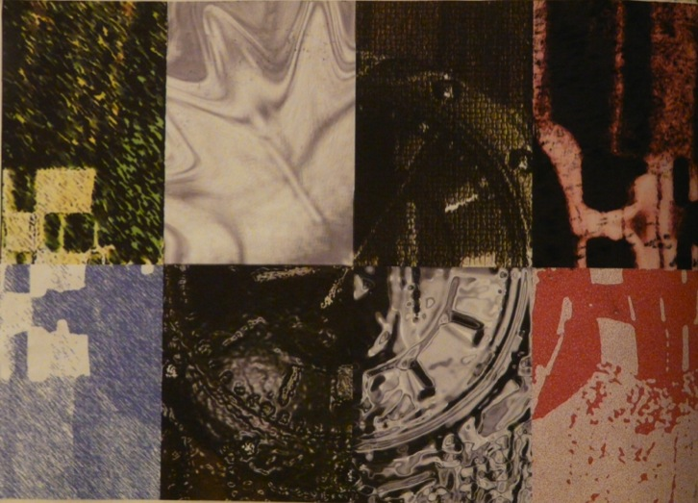
Candidate 1 Portfolio (Fine Art)

Slide 13
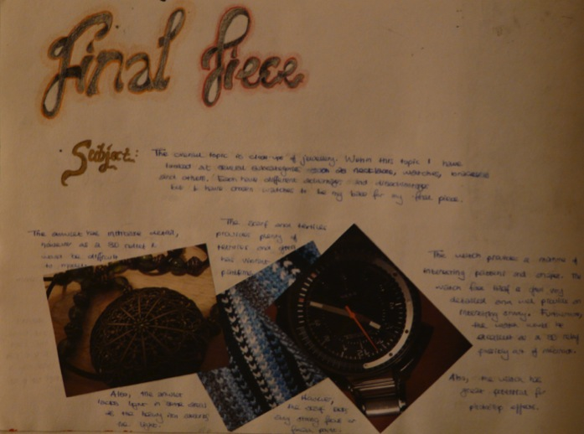
Candidate 1 Portfolio (Fine Art)

Slide 14
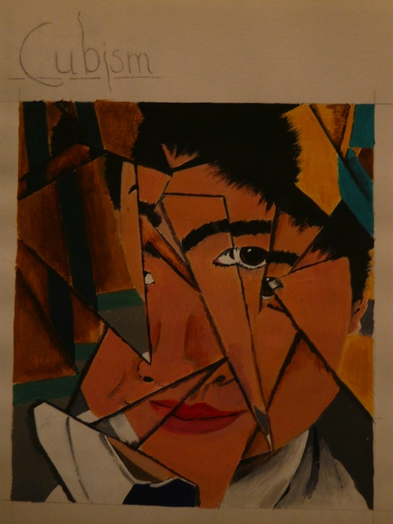
Candidate 1 Portfolio (Fine Art)

Slide 15
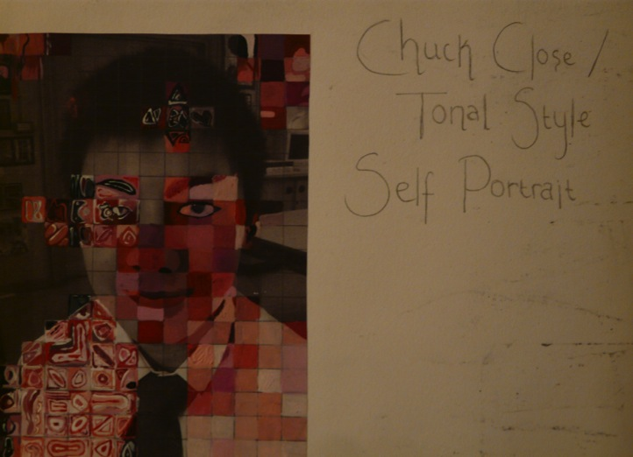
Candidate 1 Portfolio (Fine Art)

Slide 16
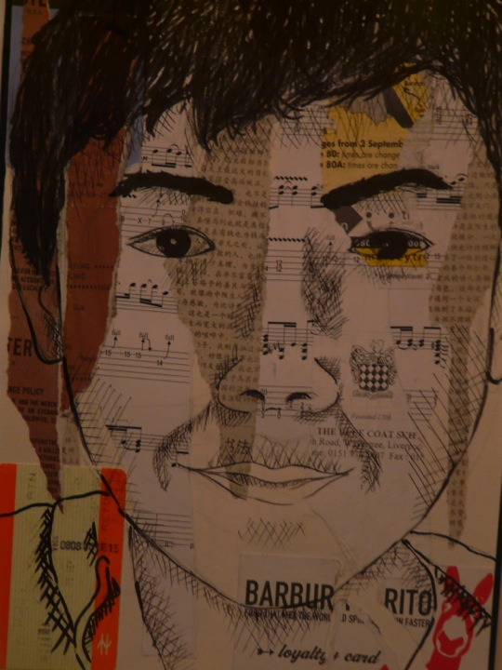
Candidate 1 Portfolio (Fine Art)

Slide 17
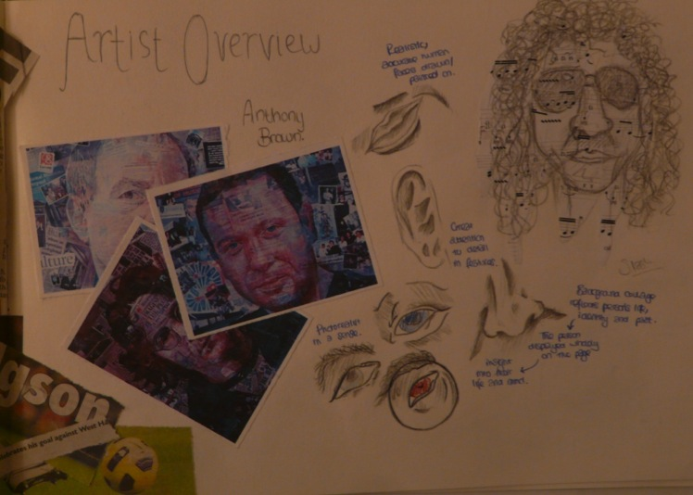
Candidate 1 Portfolio (Fine Art)

Slide 18
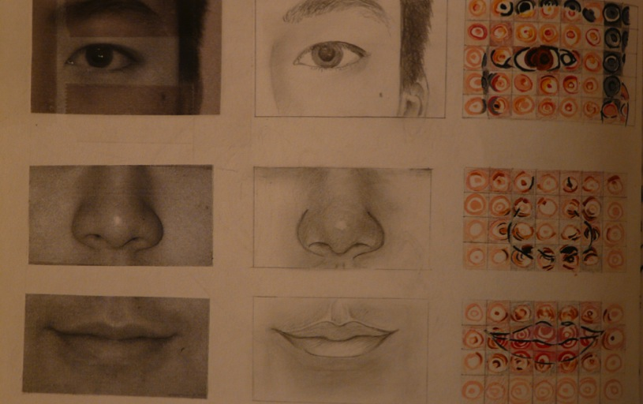
Candidate 1 Portfolio (Fine Art)

Slide 19
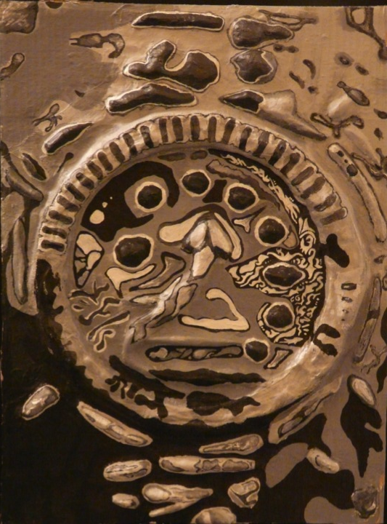
Candidate 1 Portfolio (Fine Art)

Slide 20
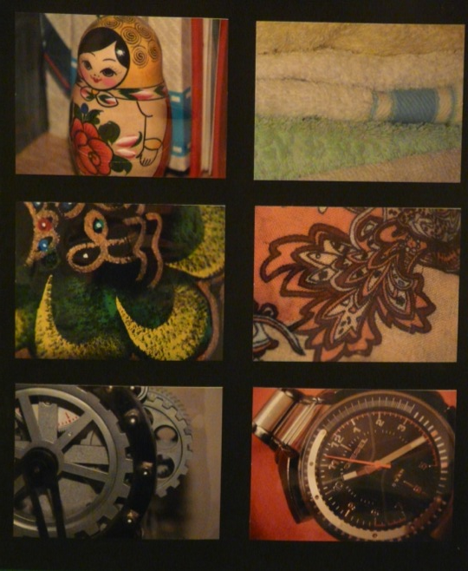
Candidate 1 Portfolio (Fine Art)

Slide 21
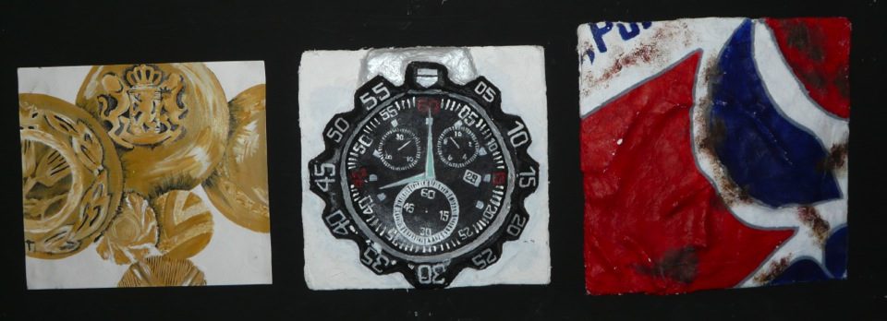
Candidate 1 Portfolio (Fine Art)

Slide 22
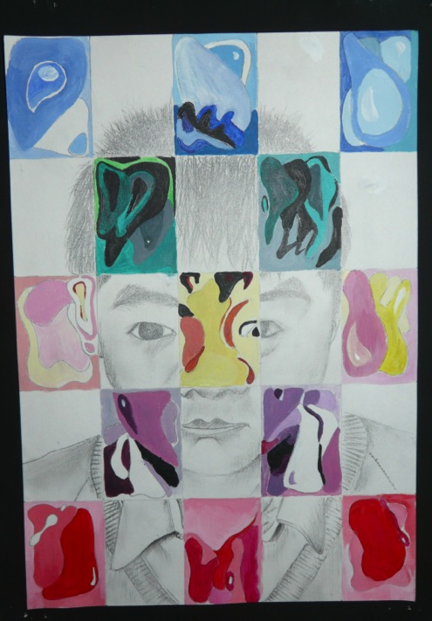
Candidate 1 Portfolio (Fine Art)

Slide 23
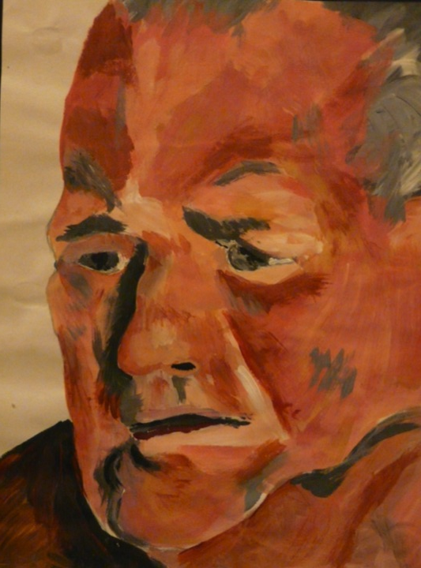
Candidate 1 Portfolio (Fine Art)

Slide 24
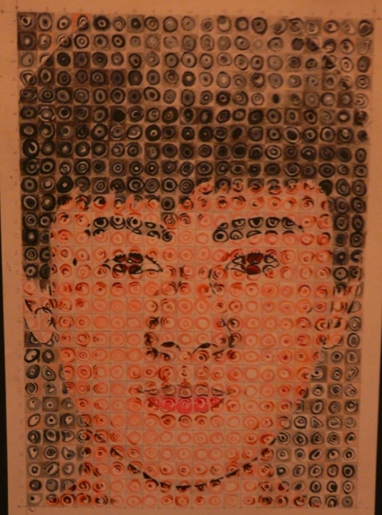
Candidate 1 Portfolio (Fine Art)

Slide 25
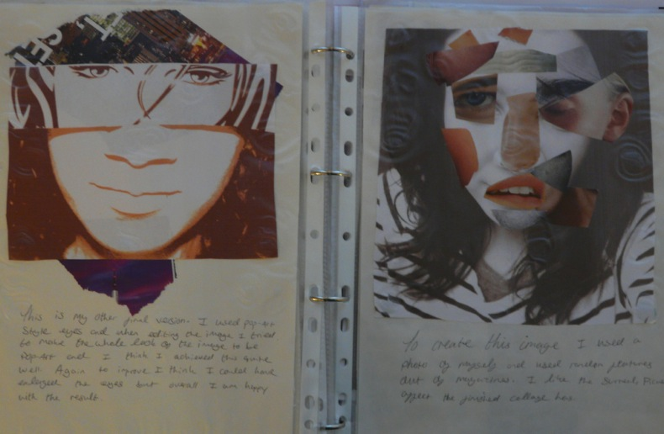
Candidate 1 Portfolio (Fine Art)

Slide 26
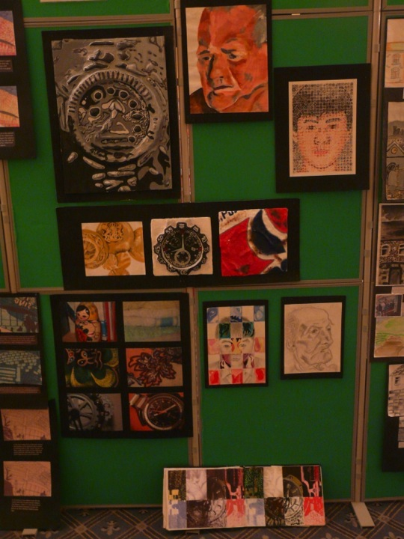
Candidate 1 Portfolio (Fine Art)
A01 – 28
A02 – 28
A03 – 28
AO4 - 28
Total – 112

Slide 27
Candidate 1 Portfolio (Fine Art)
Although submitted as a Fine Art endorsed entry, this Portfolio could also represent an Art & Design Unendorsed submission. It is comprised of a collection of high quality outcomes, mostly based on the theme of ‘Close – Up’s and a supporting sketchbook/workbook.
All Assessment Objectives are equally well met with very good evidence for each.
Contextual Understanding is clearly shown at various points throughout the book with a relevant choice of artists, accompanied by mature personal opinion and linked to a variety of coursework tasks, with clear influences upon the development of ideas and final outcomes.
Creative Making: The candidate has experimented with a wide range of materials and processes and shows a clear improvement in the quality of work as it has progressed, particularly in the book.
Reflective Recording: There is very good evidence of the use of various methods of recording, mainly from first hand observation as research for development of ideas, with quality of drawing and use of photography being a key feature.
The strongest aspects of Personal Presentation are the candidate’s own imaginative ideas and outcomes, with very strong connections to the work of chosen artists and also the final selection of work for the Portfolio submission. It is clear that there was much more supporting work that could potentially have been submitted. However, sensitive and effective selection has enhanced the Portfolio, enabling the viewer to clearly understand how the candidate has realised his intentions, whilst representing an ideal quantity of work from a typical four term course.

Slide 28
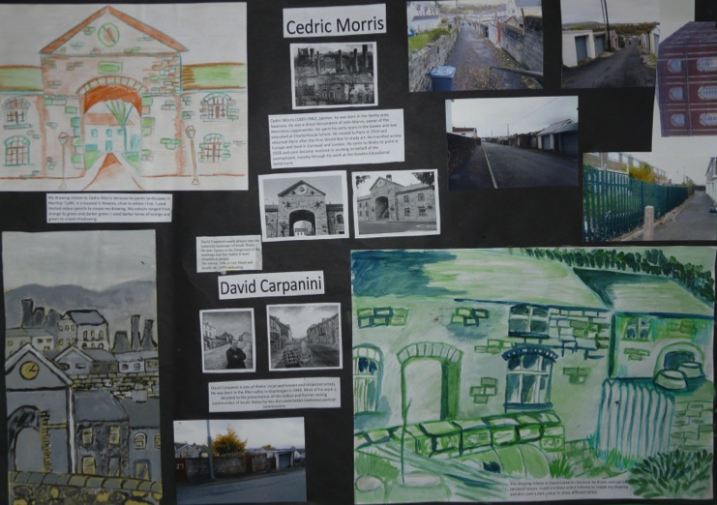
Candidate 2 Portfolio (Fine Art)

Slide 29
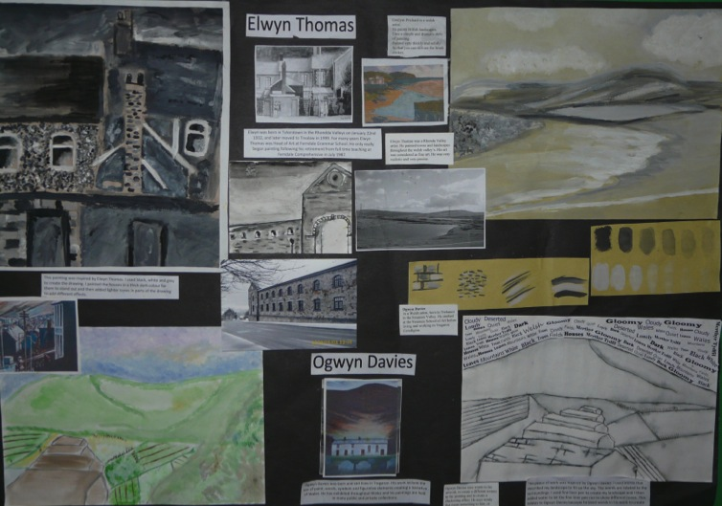
Candidate 2 Portfolio (Fine Art)

Slide 30
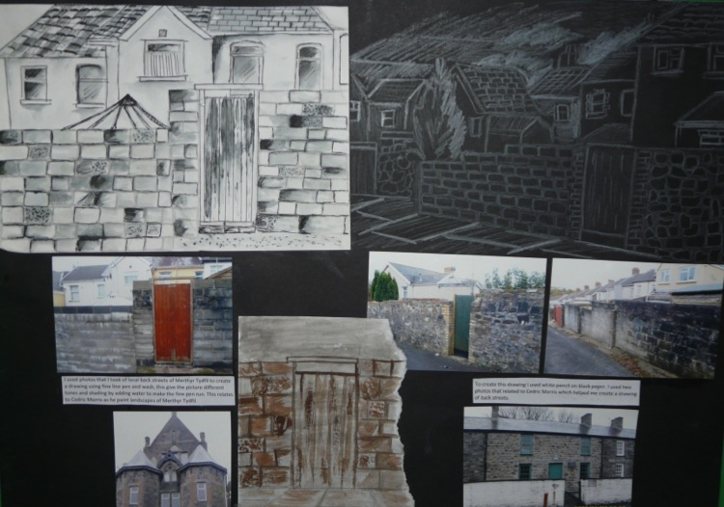
Candidate 2 Portfolio (Fine Art)

Slide 31
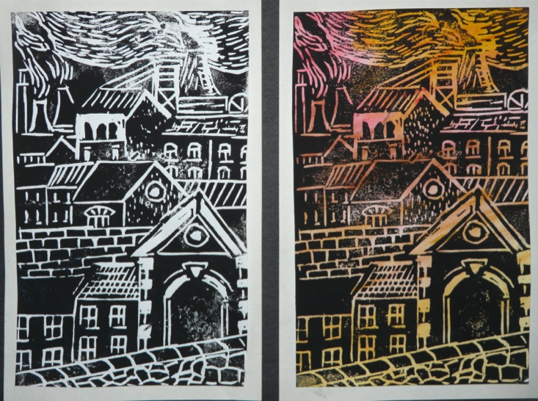
Candidate 2 Portfolio (Fine Art)

Slide 32
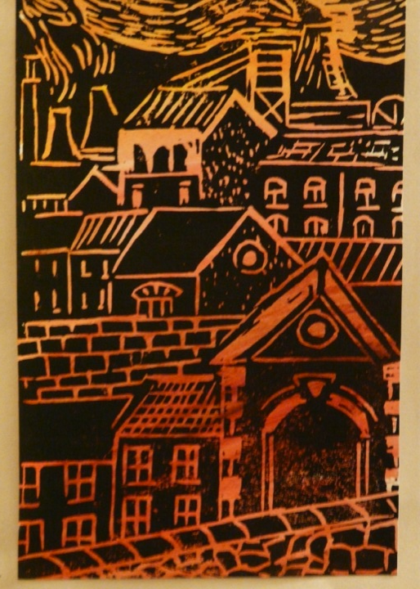
Candidate 2 Portfolio (Fine Art)

Slide 33
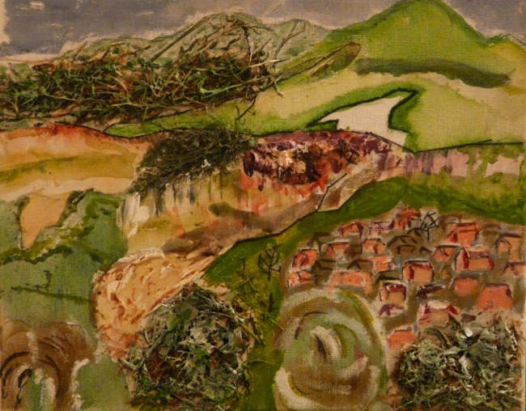
Candidate 2 Portfolio (Fine Art)

Slide 34
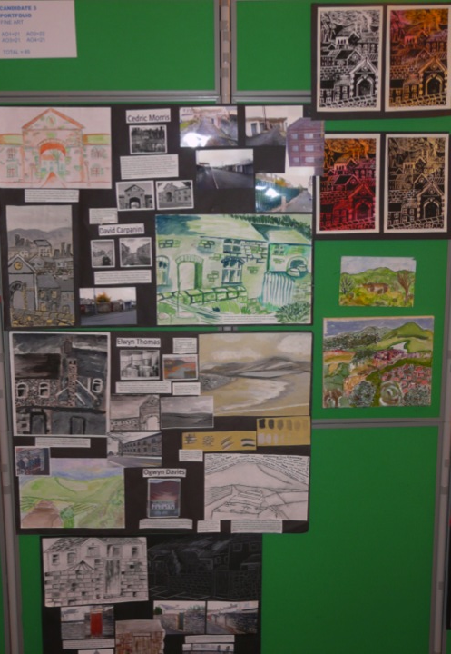
Candidate 2 Portfolio (Fine Art)
A01 – 21
A02 – 22
A03 – 21
AO4 - 21
Total – 85

Slide 35
Candidate 2 Portfolio (Fine Art)
A Fine Art submission based on the theme of buildings and landscapes in the local environment, presented as mounted sheets with some separate small scale outcomes.
Contextual Understanding: Although a succinct body of work, the candidate has shown clear evidence of investigation into the creative practice of Welsh landscape artists and has been able to express some valid personal opinions relating to context and influence on his own work.
The range of materials used in Creative Making is reasonable at this level, with evidence of the use of different painting processes, drawing, photography and printmaking. There is some repetition of outcomes, mostly of the same level and perhaps more time could have spent been on improving the quality of one or two rather than producing duplicate images of the same quality.
Some sheets demonstrate good evidence of Reflective Recording with some drawing from first hand observation and the candidate’s own photographs presented. Photographs on other sheets could have contributed to a greater extent to assessment for Creative Making if they had been more considered and interesting.
In Personal Presentation a good response to the local environment was demonstrated and clear connections to the work of the selected artists were in evidence. If ideas and outcomes had shown more imagination and originality the submission might have been rewarded with further marks.

Slide 36
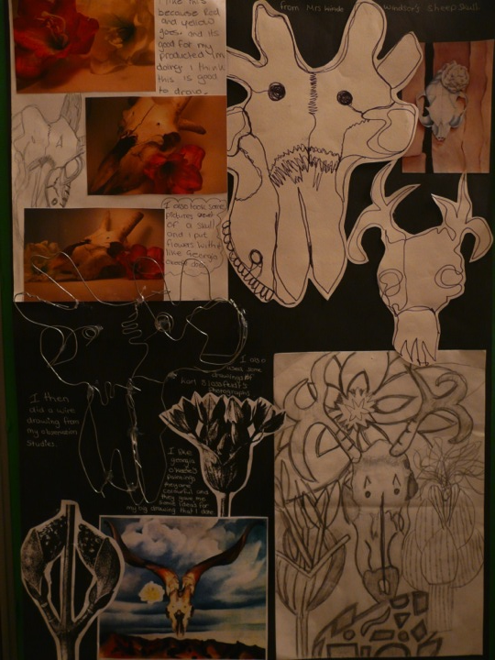
Candidate 3 Portfolio (Fine Art)

Slide 37
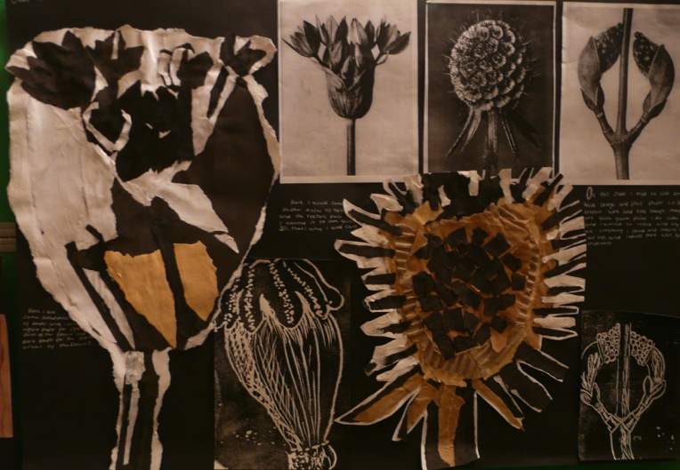
Candidate 3 Portfolio (Fine Art)

Slide 38
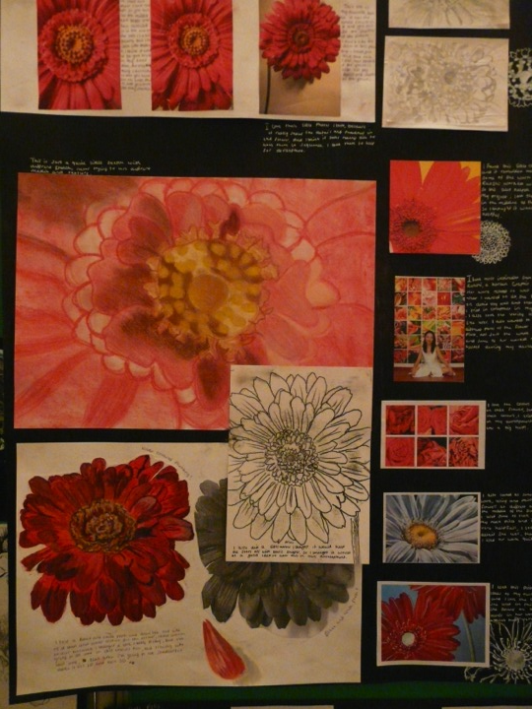
Candidate 3 Portfolio (Fine Art)

Slide 39
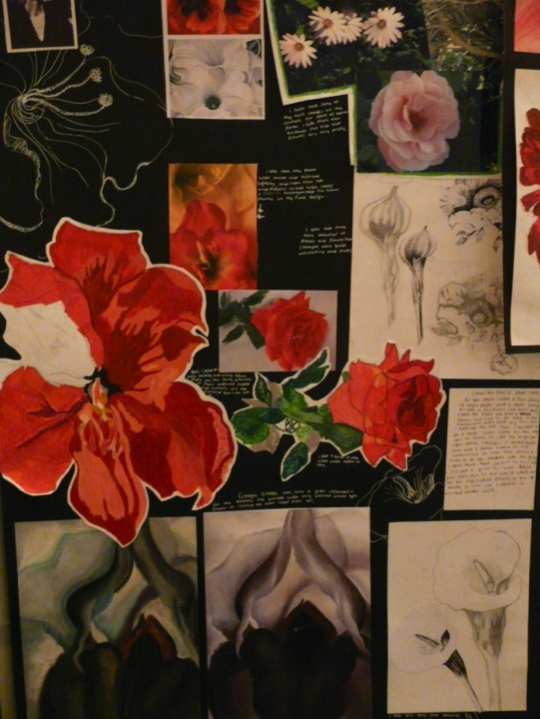
Candidate 3 Portfolio (Fine Art)

Slide 40
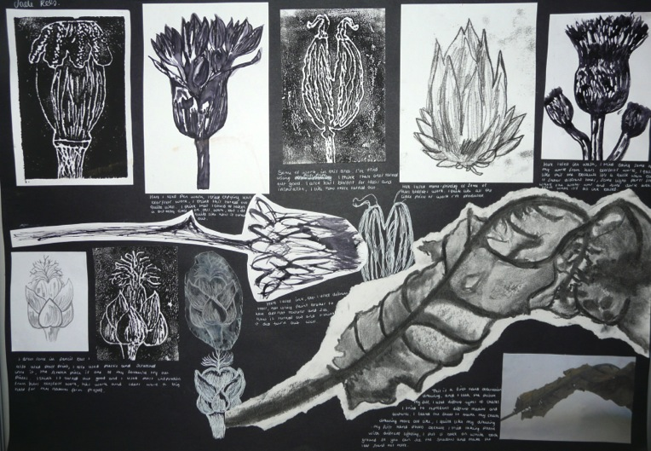
Candidate 3 Portfolio (Fine Art)

Slide 41
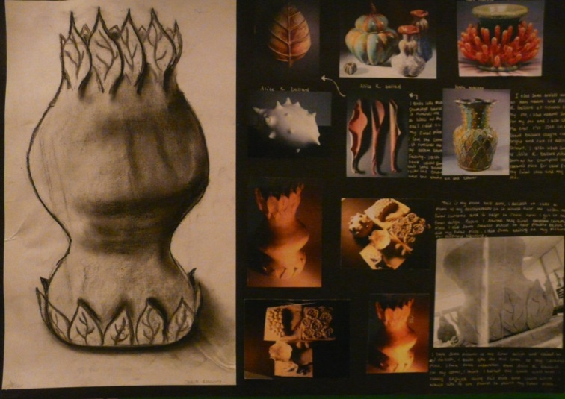
Candidate 3 Portfolio (Fine Art)

Slide 42
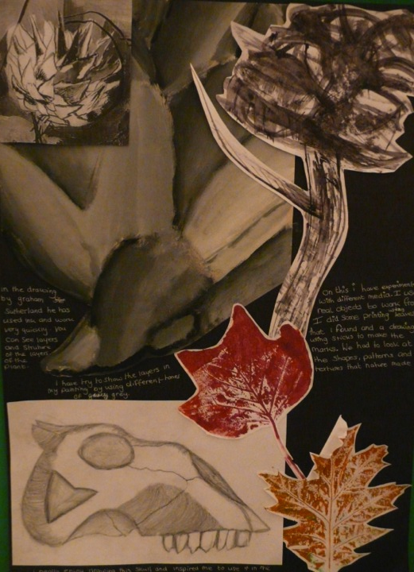
Candidate 3 Portfolio (Fine Art)

Slide 43
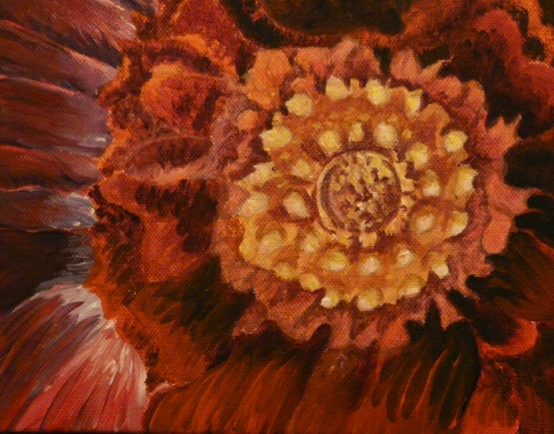
Candidate 3 Portfolio (Fine Art)

Slide 44
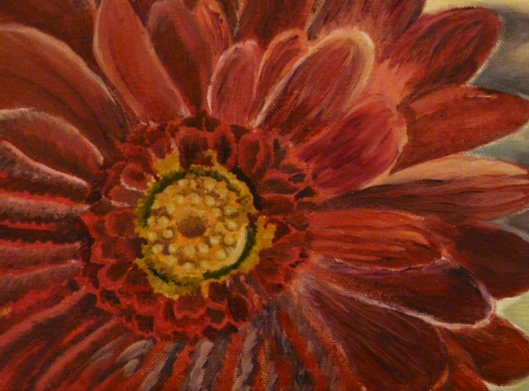
Candidate 3 Portfolio (Fine Art)

Slide 45
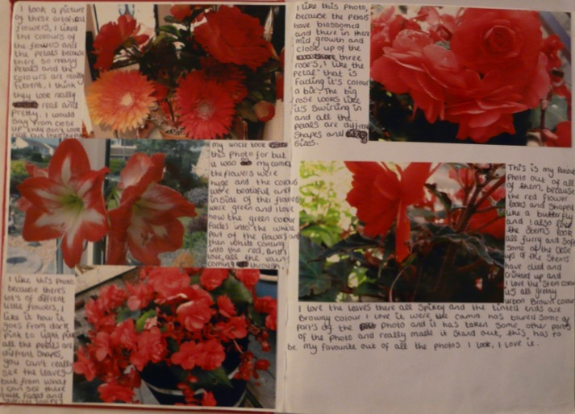
Candidate 3 Portfolio (Fine Art)

Slide 46
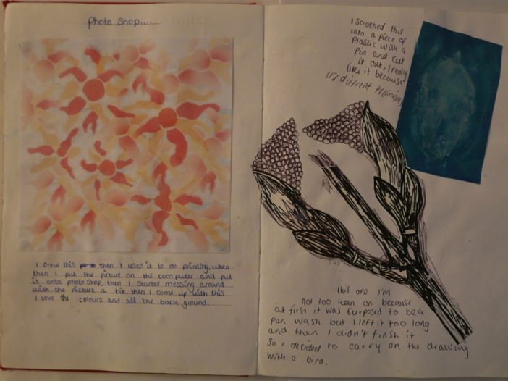
Candidate 3 Portfolio (Fine Art)

Slide 47
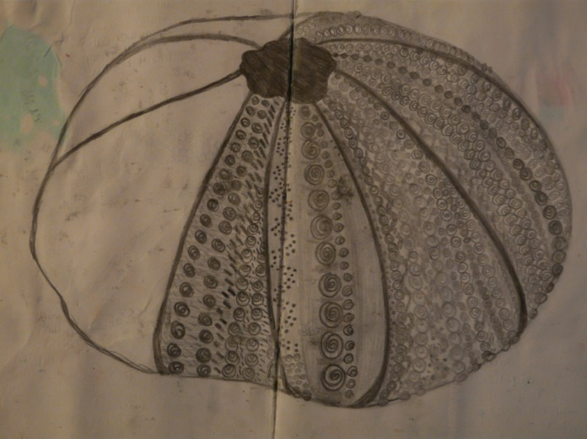
Candidate 3 Portfolio (Fine Art)

Slide 48
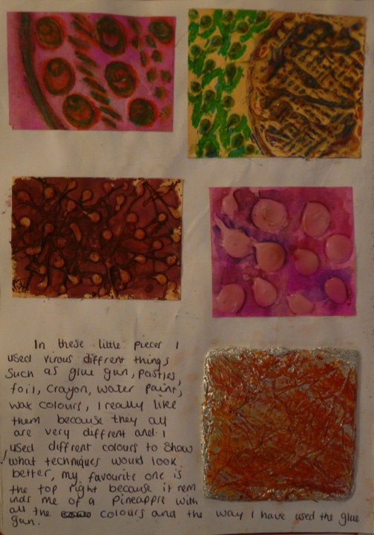
Candidate 3 Portfolio (Fine Art)

Slide 49
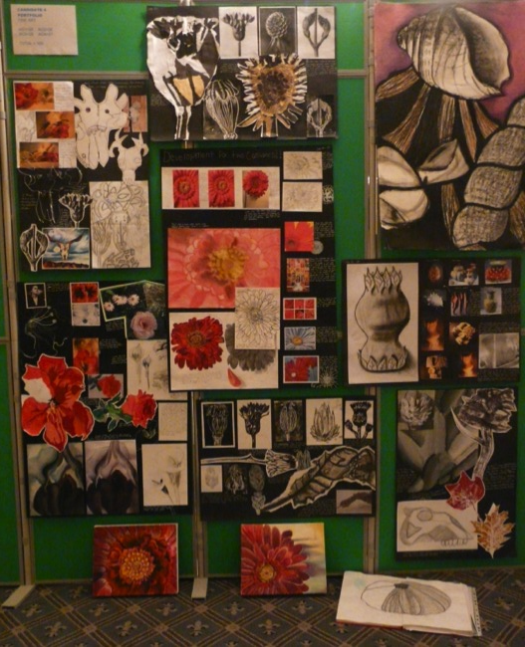
Candidate 3 Portfolio (Fine Art)
A01 – 26
A02 – 26
A03 – 26
AO4 - 27
Total – 105

Slide 50
Candidate 3 Portfolio (Fine Art)
A vibrant and visually exciting display of work based on flowers and other natural forms, presented as mounted sheets, with a sketchbook, two small well-painted outcomes on canvas and a ceramic pot.
All Assessment Objectives are equally well met and evidence for each is pleasingly interwoven throughout the whole submission.
Contextual Understanding: There is good, clear evidence of investigation into the work of other artists, such as Georgia O’Keefe and Graham Sutherland and this has helped the candidate to explore and develop a range of wider ideas, supported with some valid personal opinion.
Overall, there is good evidence of using a variety of materials for Creative Making with good skills shown in the production of monotone drawings in pen and ink, pencil and charcoal; balancing out any apparent differences in standard across other outcomes, although the two small canvases are very well painted.
Drawing from first hand observation is a very strong feature of Reflective Recording and perhaps could have been extended to other methods and processes more effectively. Although the outcomes are well produced, some more evidence of development from original ideas would have made this aspect of assessment even stronger.
Personal response is very strong throughout the whole presentation and the carefully selected collection of work shows imagination and sensitivity. The candidate’s intentions are clearly realised and explicit connections to the work of the chosen artists are in evidence.

