Slide 1
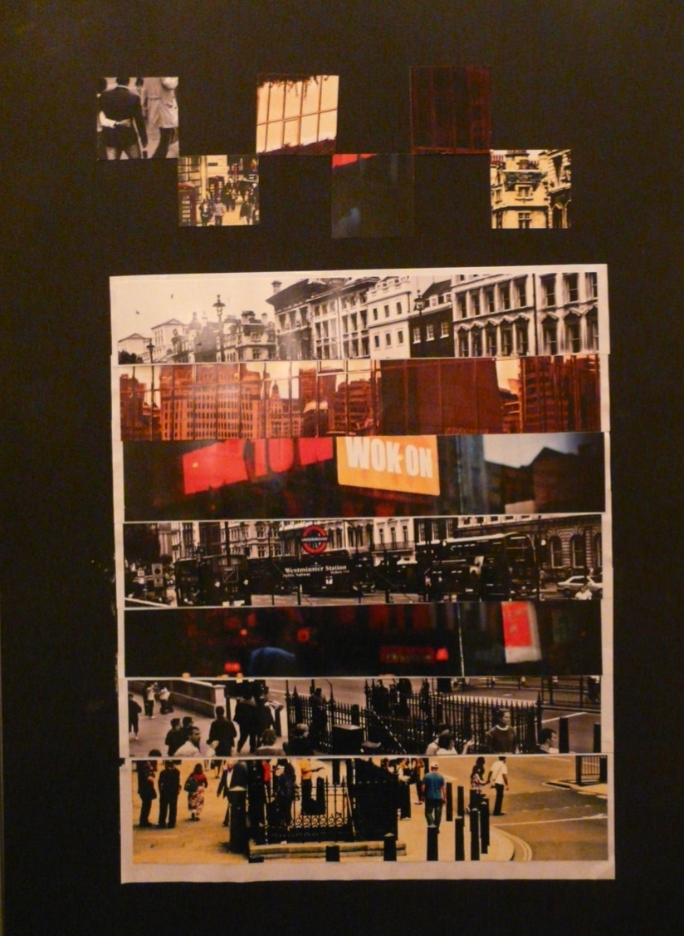
Candidate 1 Portfolio (Photography)

Slide 2
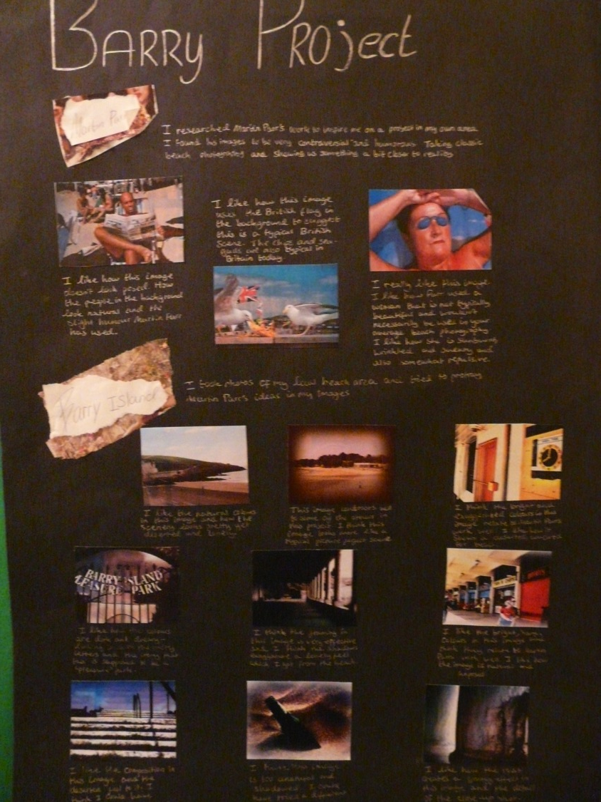
Candidate 1 Portfolio
(Photography)

Slide 3
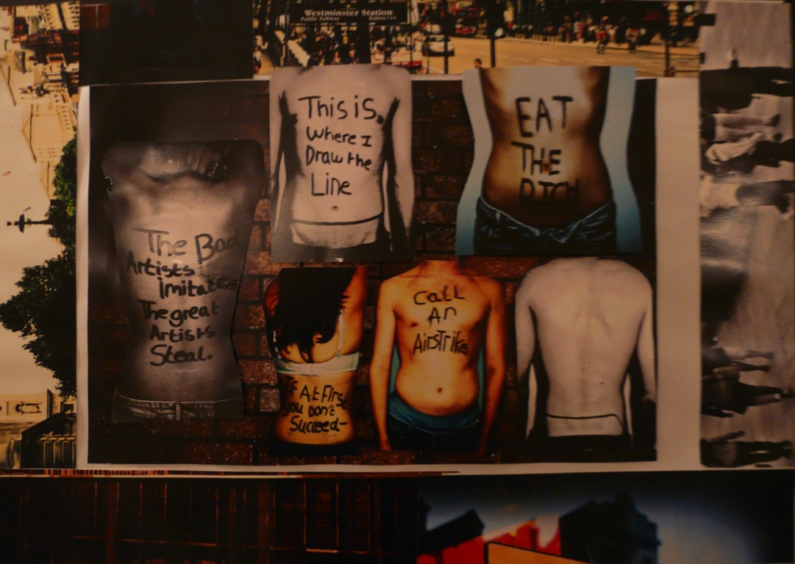
Candidate 1 Portfolio (Photography)

Slide 4
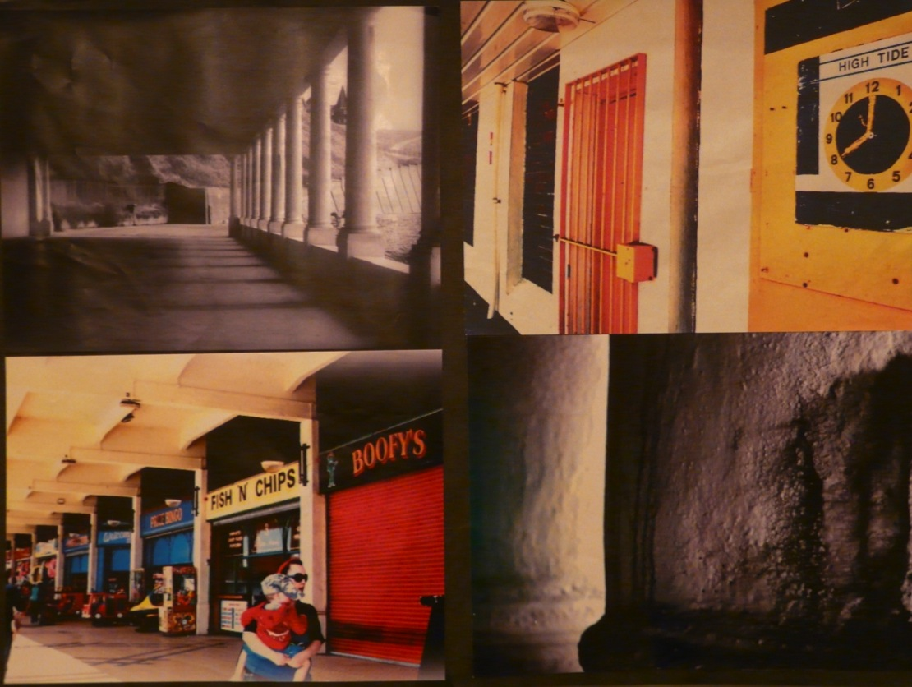
Candidate 1 Portfolio (Photography)

Slide 5
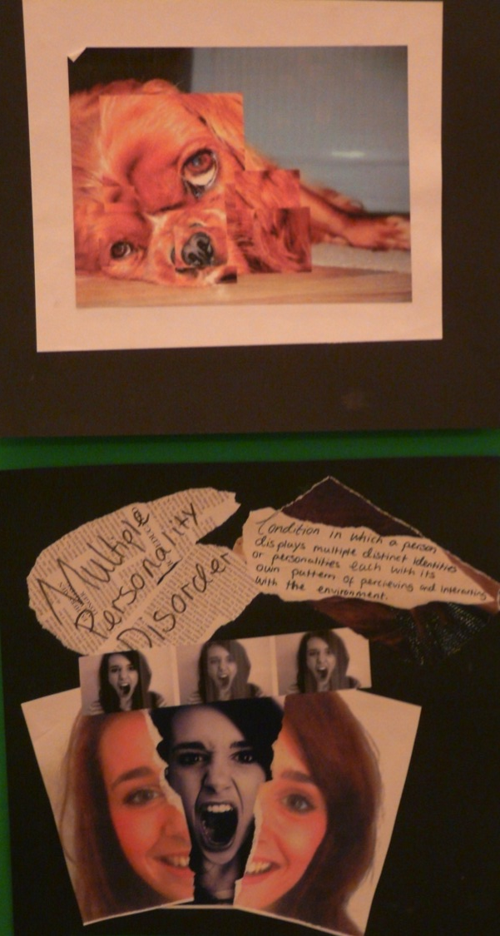
Candidate 1 Portfolio (Photography)

Slide 6
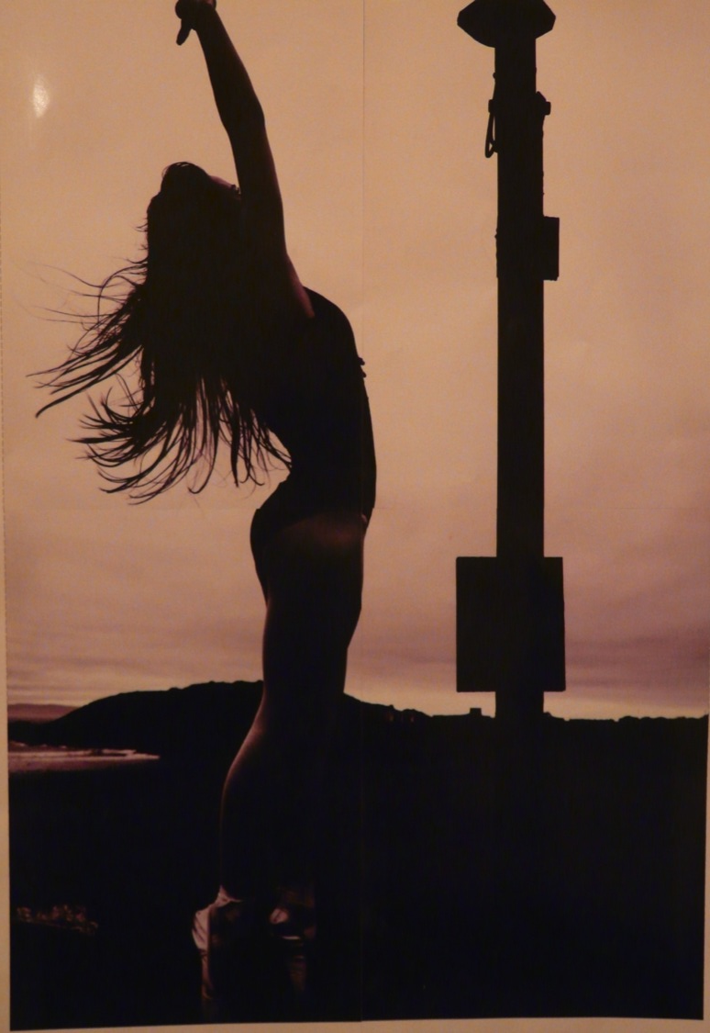
Candidate 1 Portfolio (Photography)

Slide 7
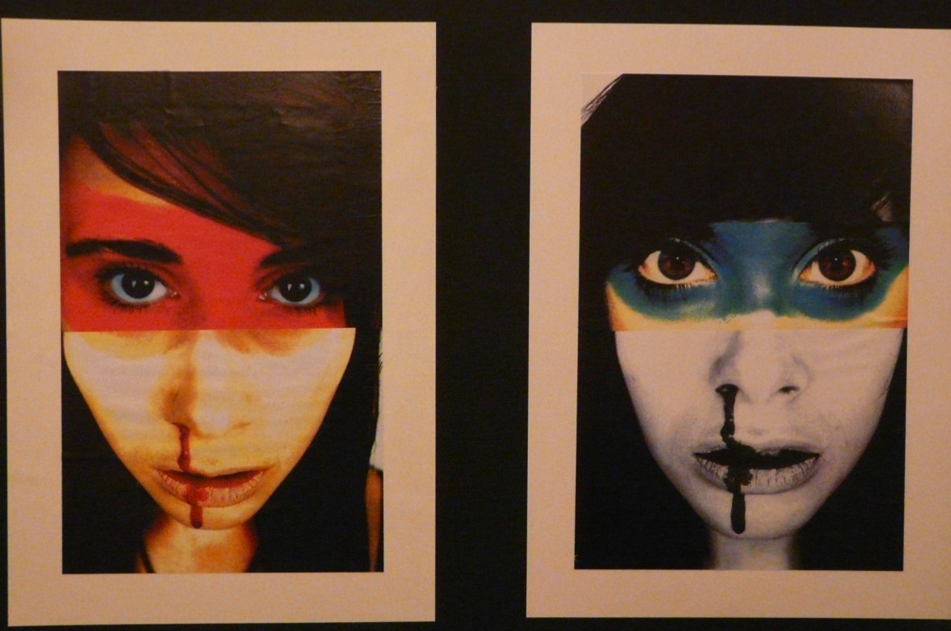
Candidate 1 Portfolio (Photography)

Slide 8
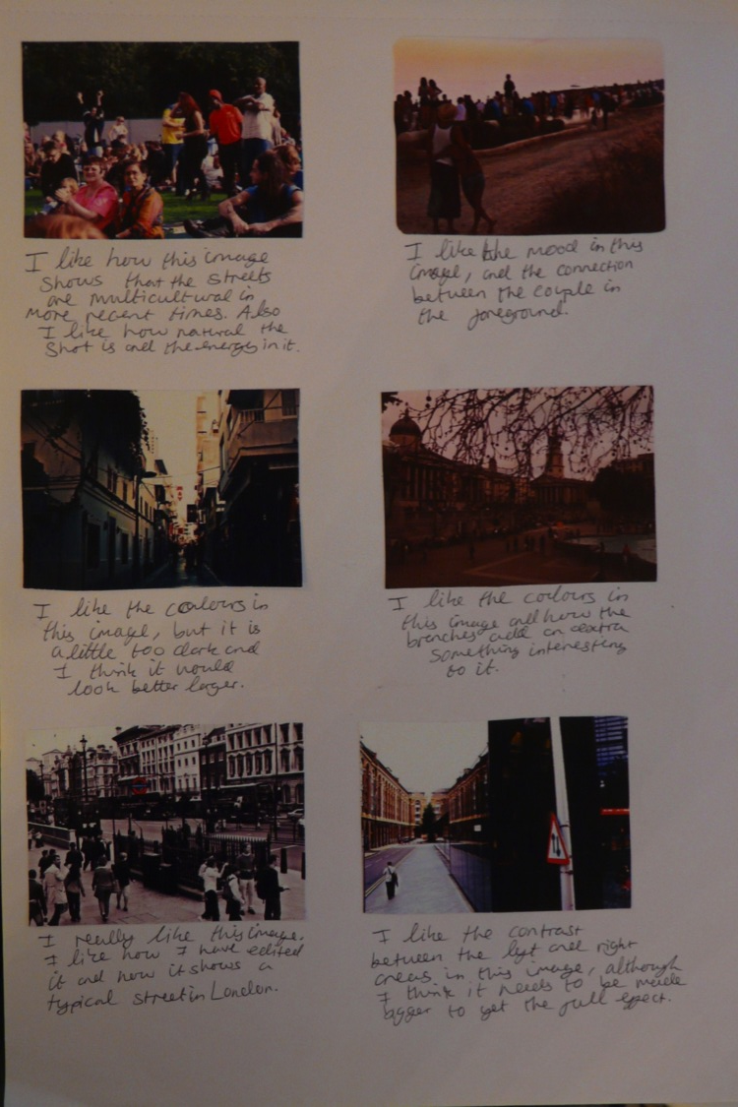
Candidate 1 Portfolio (Photography)

Slide 9
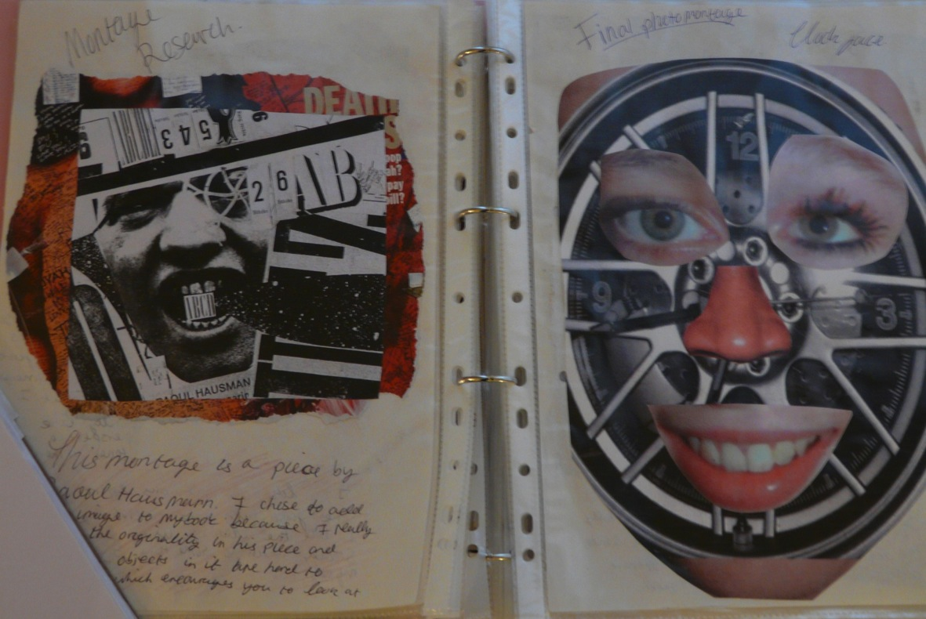
Candidate 1 Portfolio (Photography)

Slide 10
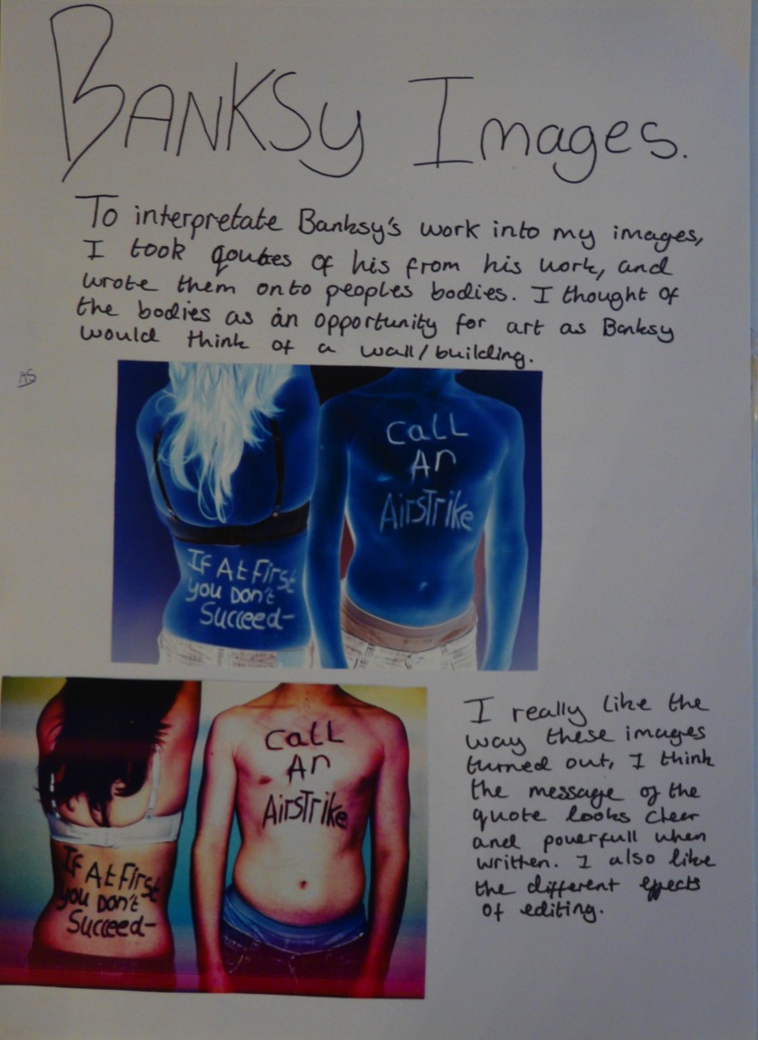
Candidate 1 Portfolio (Photography)

Slide 11
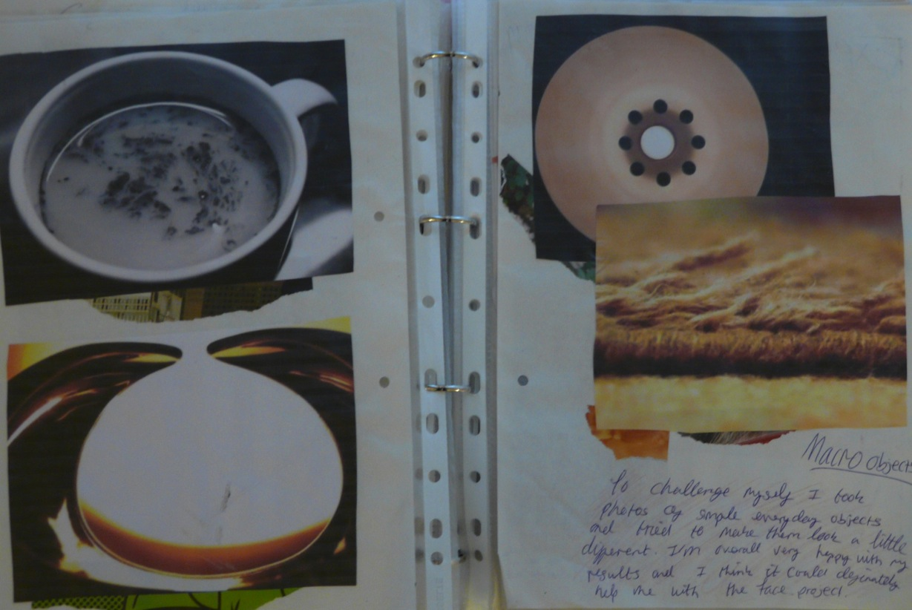
Candidate 1 Portfolio (Photography)

Slide 12
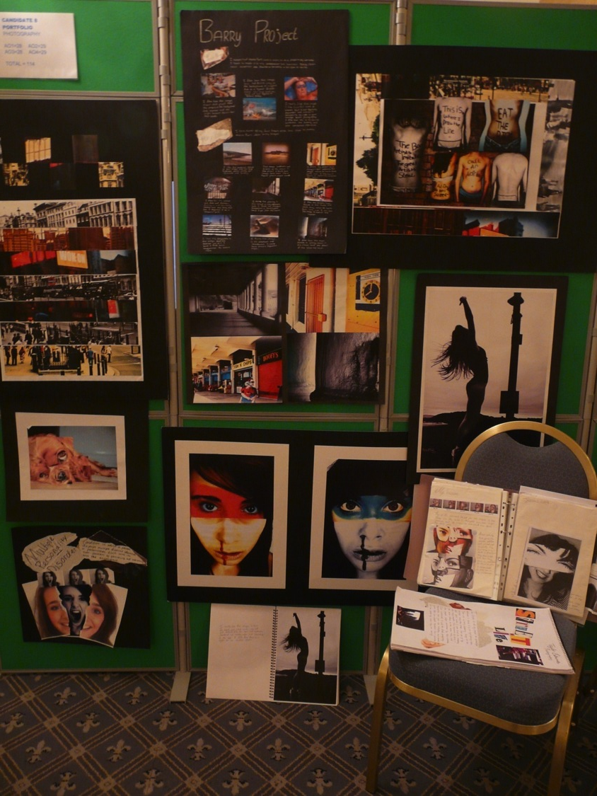
Candidate 1 Portfolio
(Photography)
A01 – 28
A02 – 29
A03 – 28
AO4 - 29
Total – 114

Slide 13
Candidate 1 Portfolio (Photography)
An endorsed Photography submission, showing a variety of creative processes, experimentation and quality outcomes. There is no obvious theme running throughout the work but all ideas and outcomes have been influenced by the candidate’s local environment, (which has been easily accessible), or using her friends as models.
Overall continuous experimentation and exploring ideas is in evidence, resulting in a number of outcomes rather than one or two outcomes being clearly defined in conclusion of the main content.
Contextual Understanding: The candidate has investigated the work of other artists and photographers to stimulate ideas and support attempts at new processes. She has been able to make strong personal judgements and relate opinions about the work, demonstrating a good understanding of context.
Experimentation and competent technical skills are the key features of Creative Making, with interesting, high quality images produced as a result. There is good use of Photoshop, especially where it has aided experimentation and supported the development process.
Reflective Recording has mostly been based on research in the local environment and although there has been some drawing, mainly to communicate ideas, the camera has been used very effectively, to capture images from a variety of primary sources. All outcomes show clear development from initial ideas.
Personal Presentation: is again a strong aspect for assessment, with some very imaginative and original thinking and clear connections between the candidate’s work and that of other artists and photographers.

Slide 14
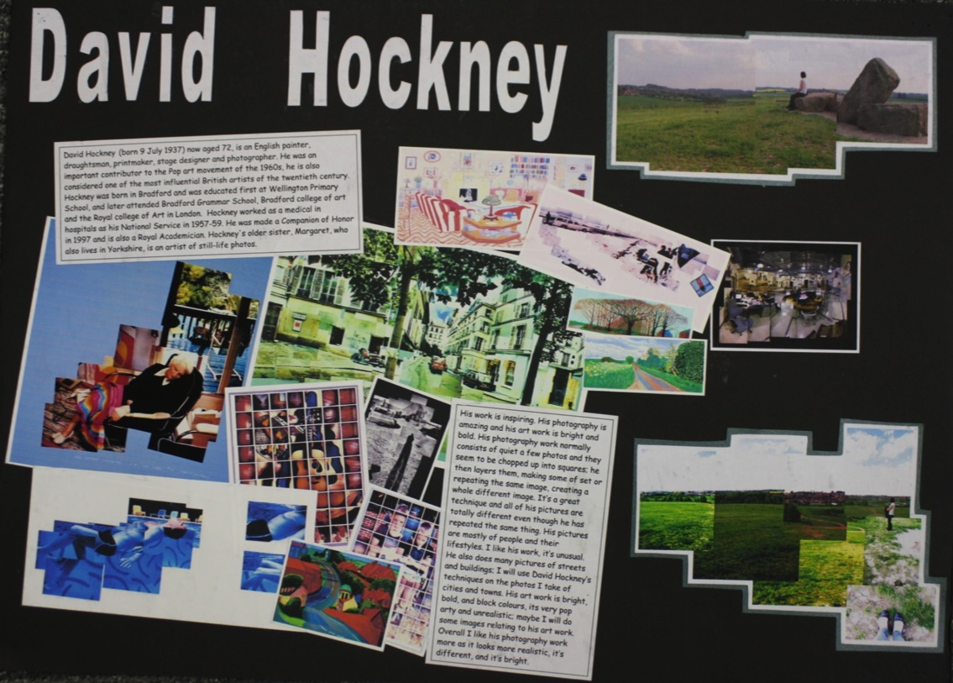
Candidate 2 Portfolio (Photography)

Slide 15
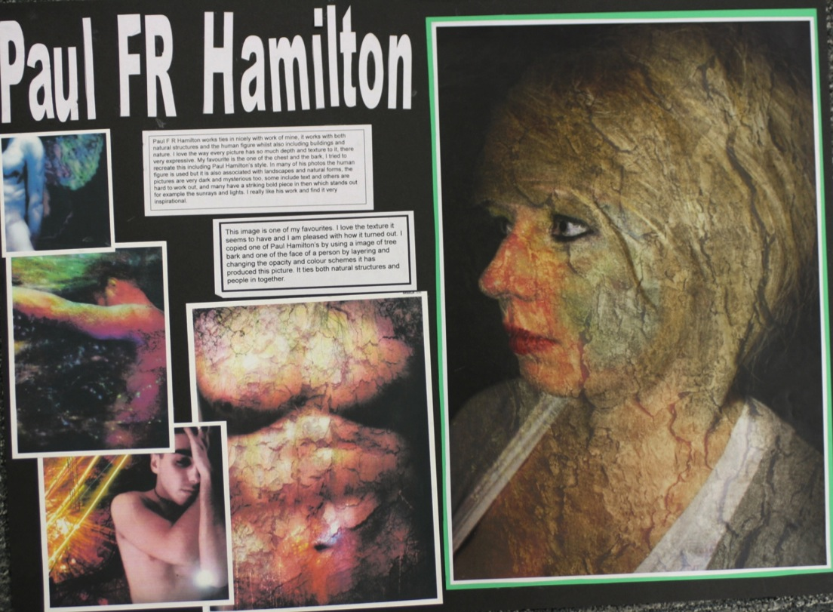
Candidate 2 Portfolio (Photography)

Slide 16
Candidate 2 Portfolio (Photography)

Slide 17
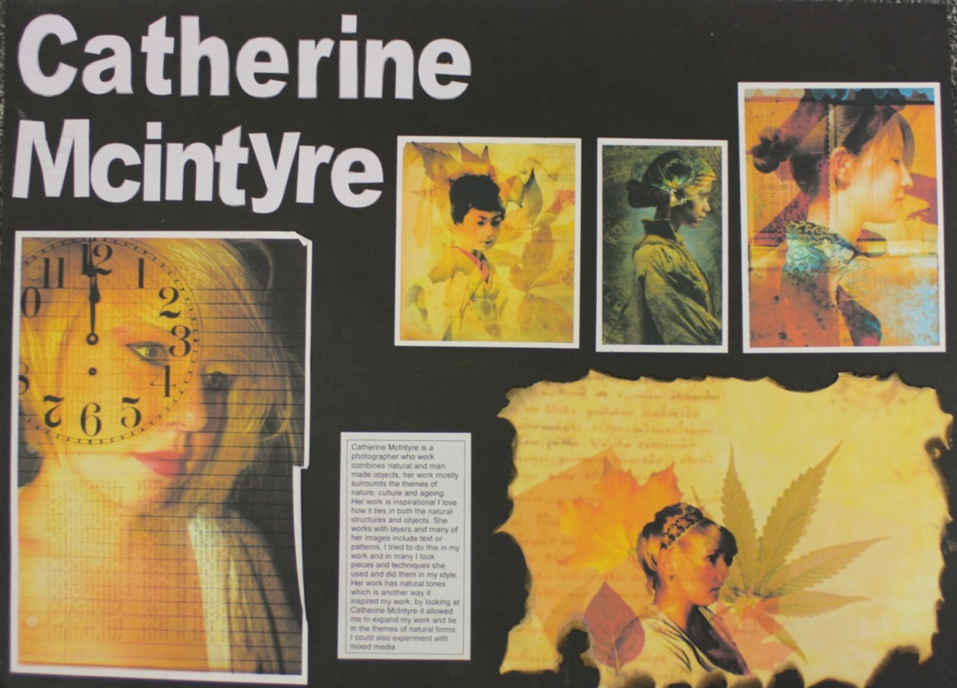
Candidate 2 Portfolio (Photography)

Slide 18
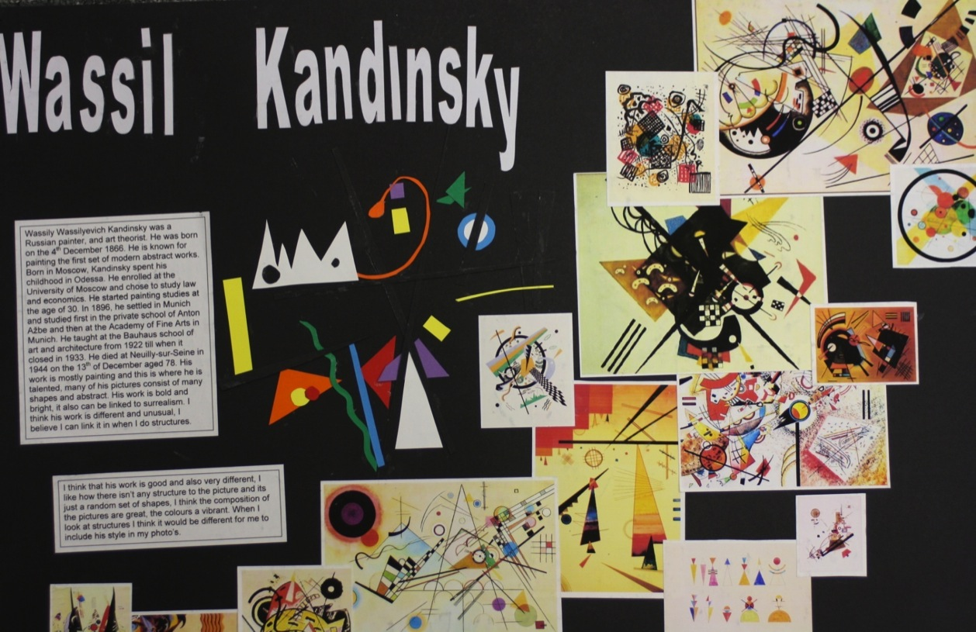
Candidate 2 Portfolio (Photography)

Slide 19
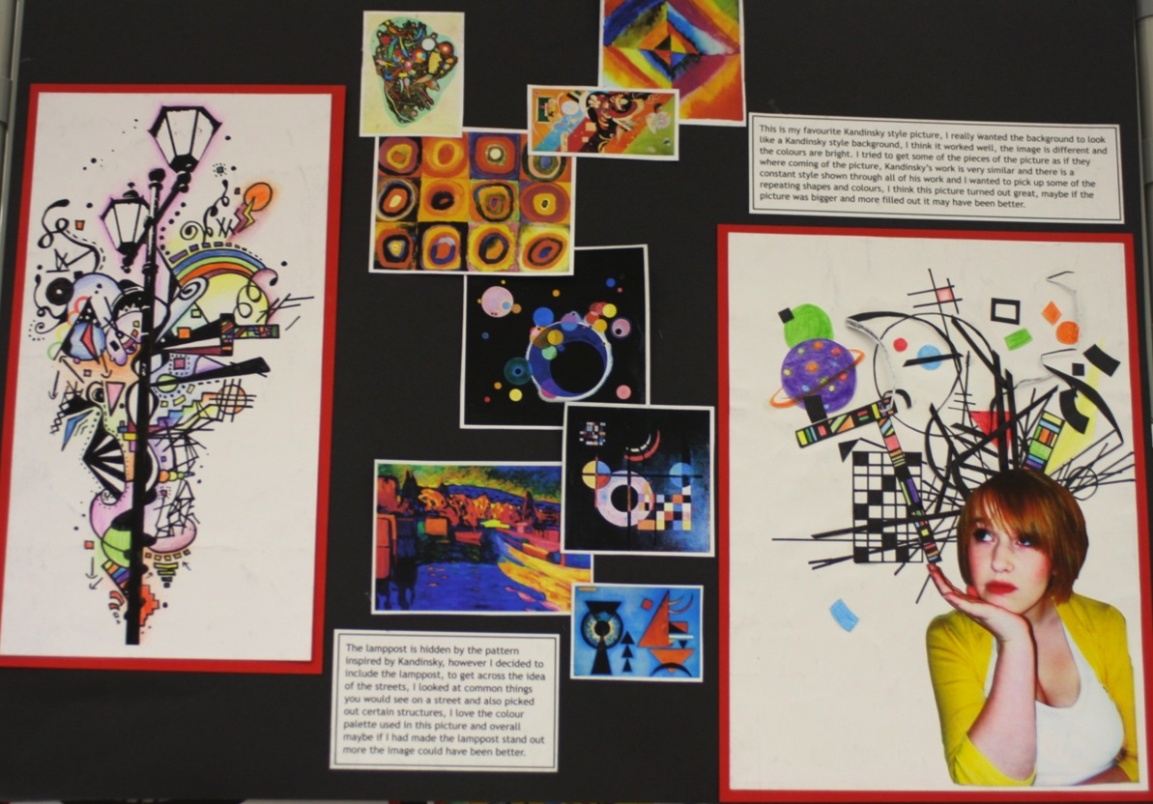
Candidate 2 Portfolio (Photography)

Slide 20
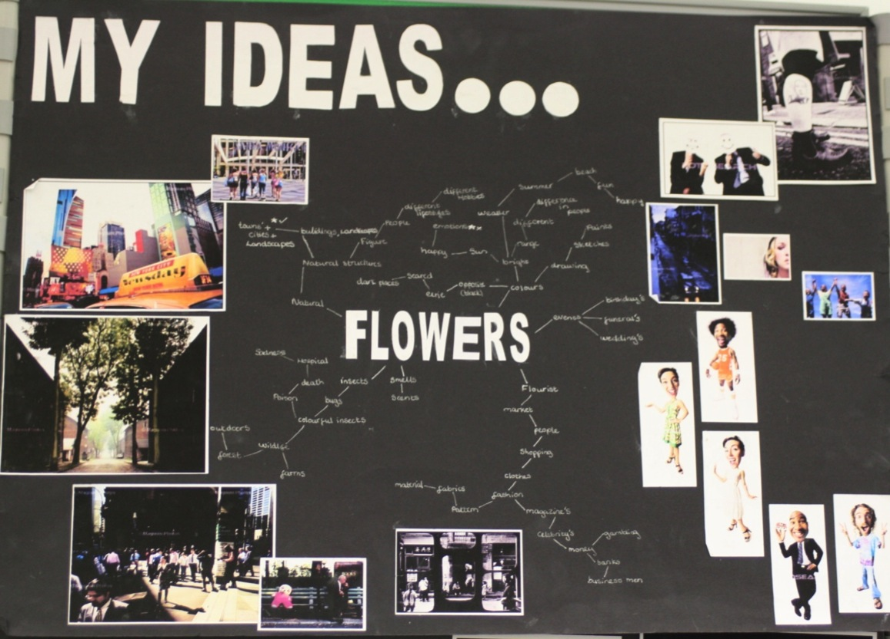
Candidate 2 Portfolio (Photography)

Slide 21
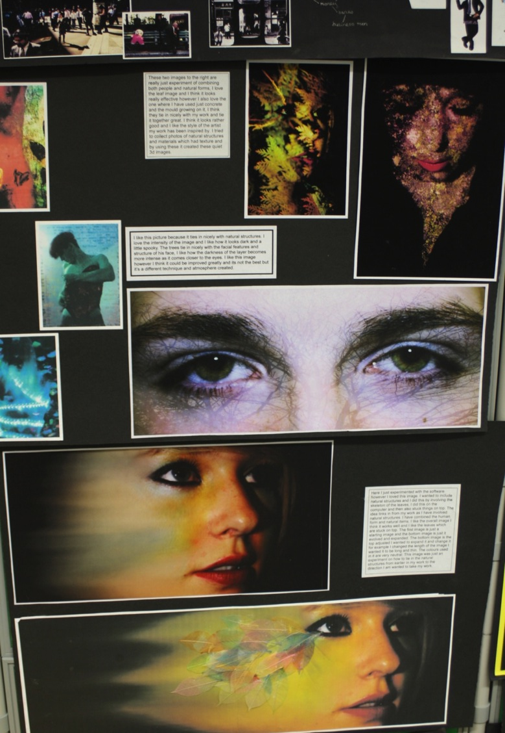
Candidate 2 Portfolio (Photography)

Slide 22
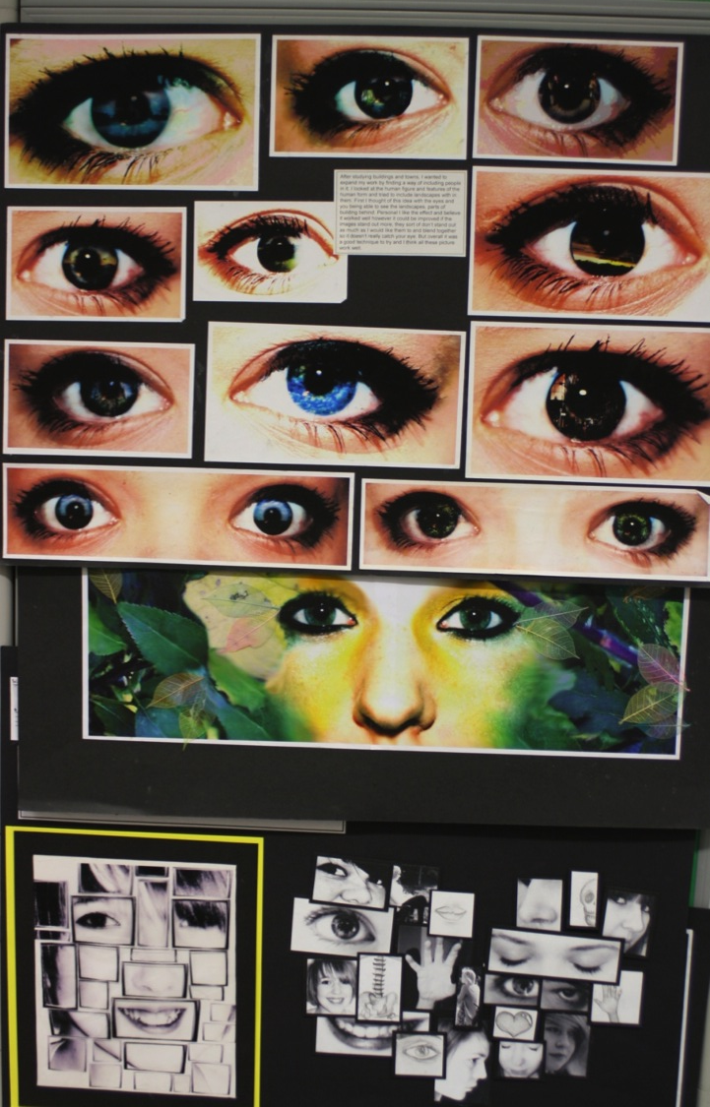
Candidate 2 Portfolio (Photography)

Slide 23
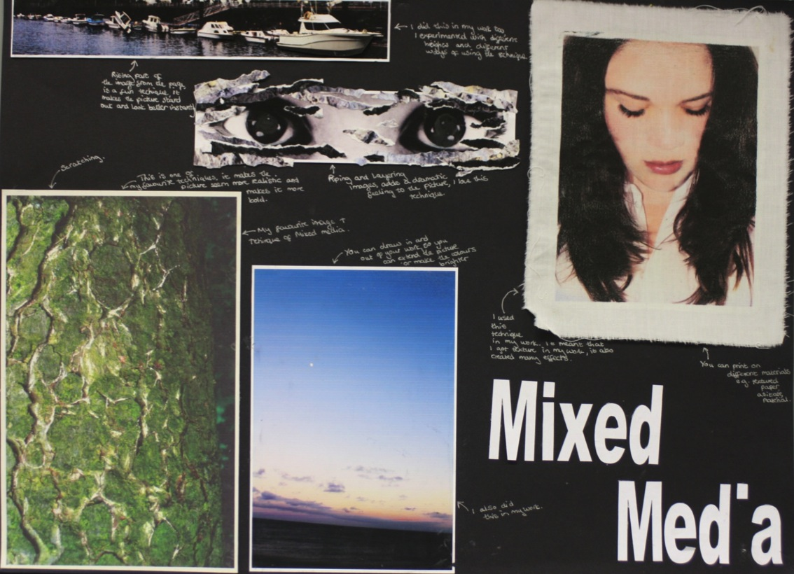
Candidate 2 Portfolio (Photography)

Slide 24
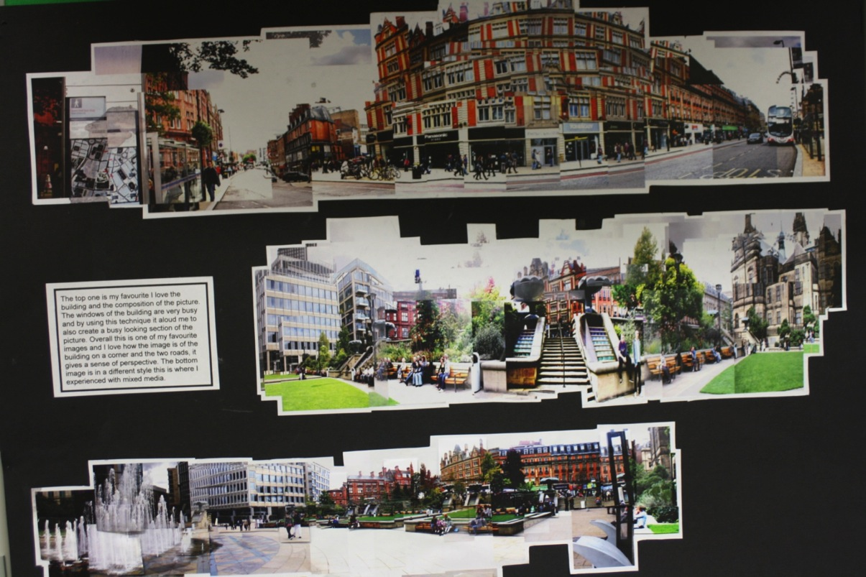
Candidate 2 Portfolio (Photography)

Slide 25
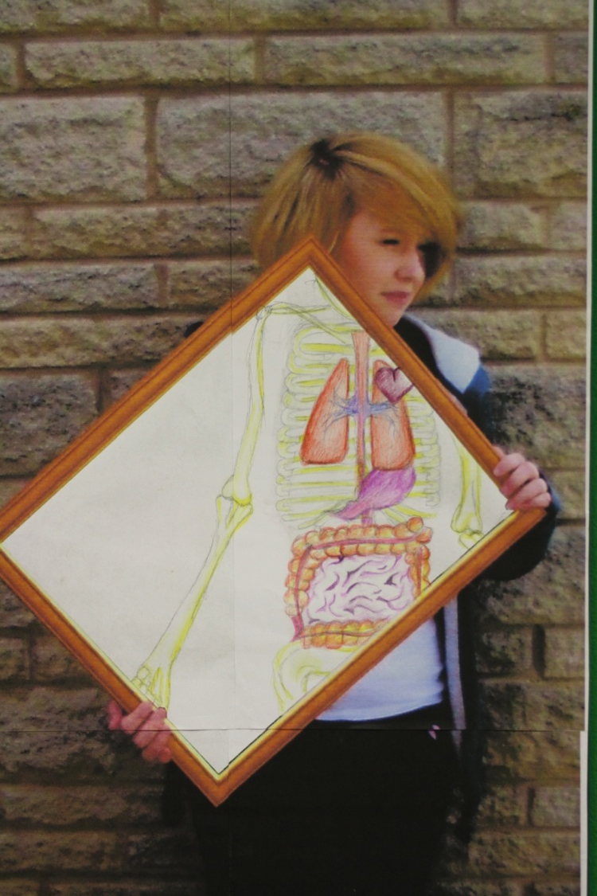
Candidate 2 Portfolio (Photography)

Slide 26
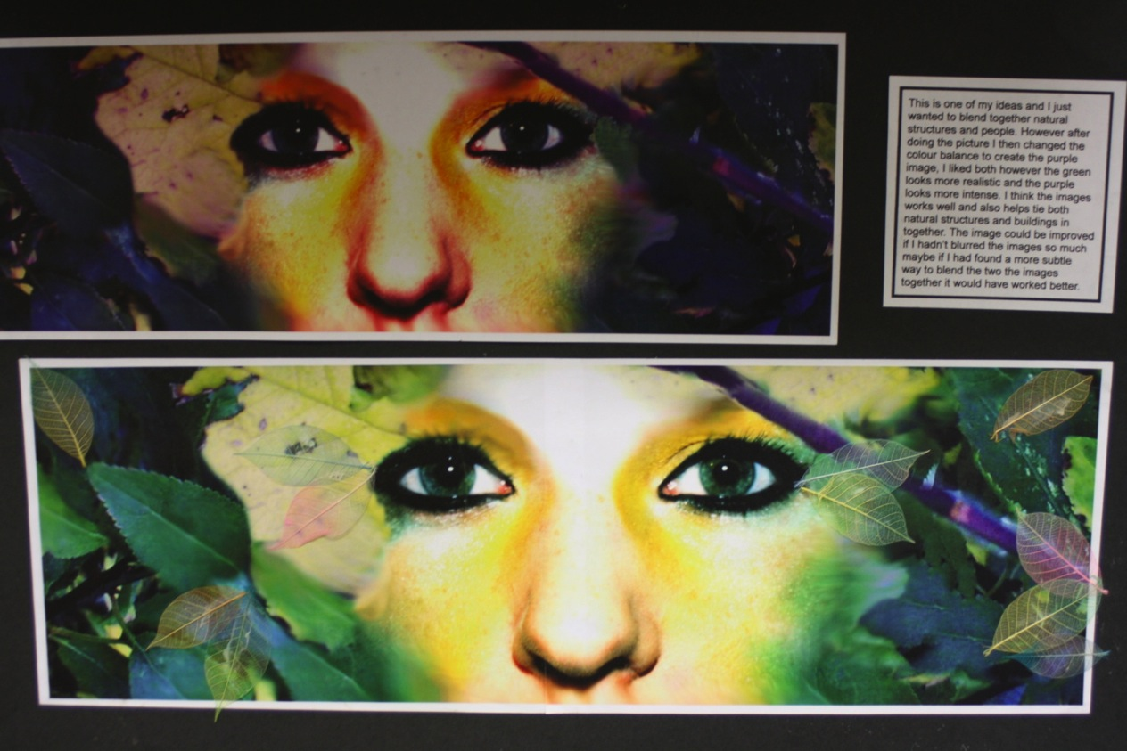
Candidate 2 Portfolio (Photography)

Slide 27
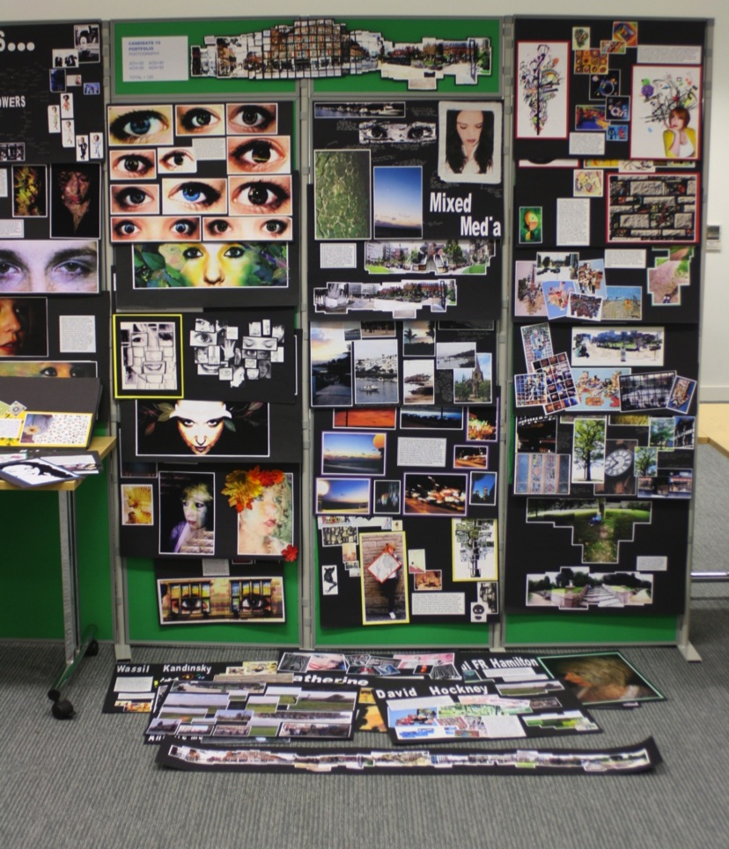
Candidate 2 Portfolio
(Photography)
A01 – 30
A02 – 30
A03 – 30
AO4 - 30
Total – 120

Slide 28
Candidate 2 Portfolio (Photography)
This Photography Endorsed submission is composed of images, annotation, ideas and outcomes that have clear links to artists and photographers, presented on A2 sheets. The Portfolio demonstrates personal lines of enquiry and in depth evidence of work covering all the Assessment Objectives fully.
Contextual Understanding is clearly demonstrated via investigations into the work of appropriate artists and photographers, with a clear understanding of context and an appreciation of their artworks aiding the exploration of themes or personal lines of enquiry; namely: self and the local environment.
Creative Making: From these initial investigations, the candidate has shown strong use of creative experimentation and making. In Reflective Recording, sensitive and refined image manipulation is inspired by ‘self’, and the incorporation of other photographic techniques in response to the city buildings.
Personal Presentation is another strong feature of the submission. Several highly finished outcomes were presented and these had commendably been developed from primary sources, and were supported by comprehensive written annotation to explain responses and ideas. The outcomes were inspired by others, and it is encouraging to see a broad scope of influences, which include artists as well as photographers.

