Slide 1
Candidate 1 Portfolio (Textiles)

Slide 2
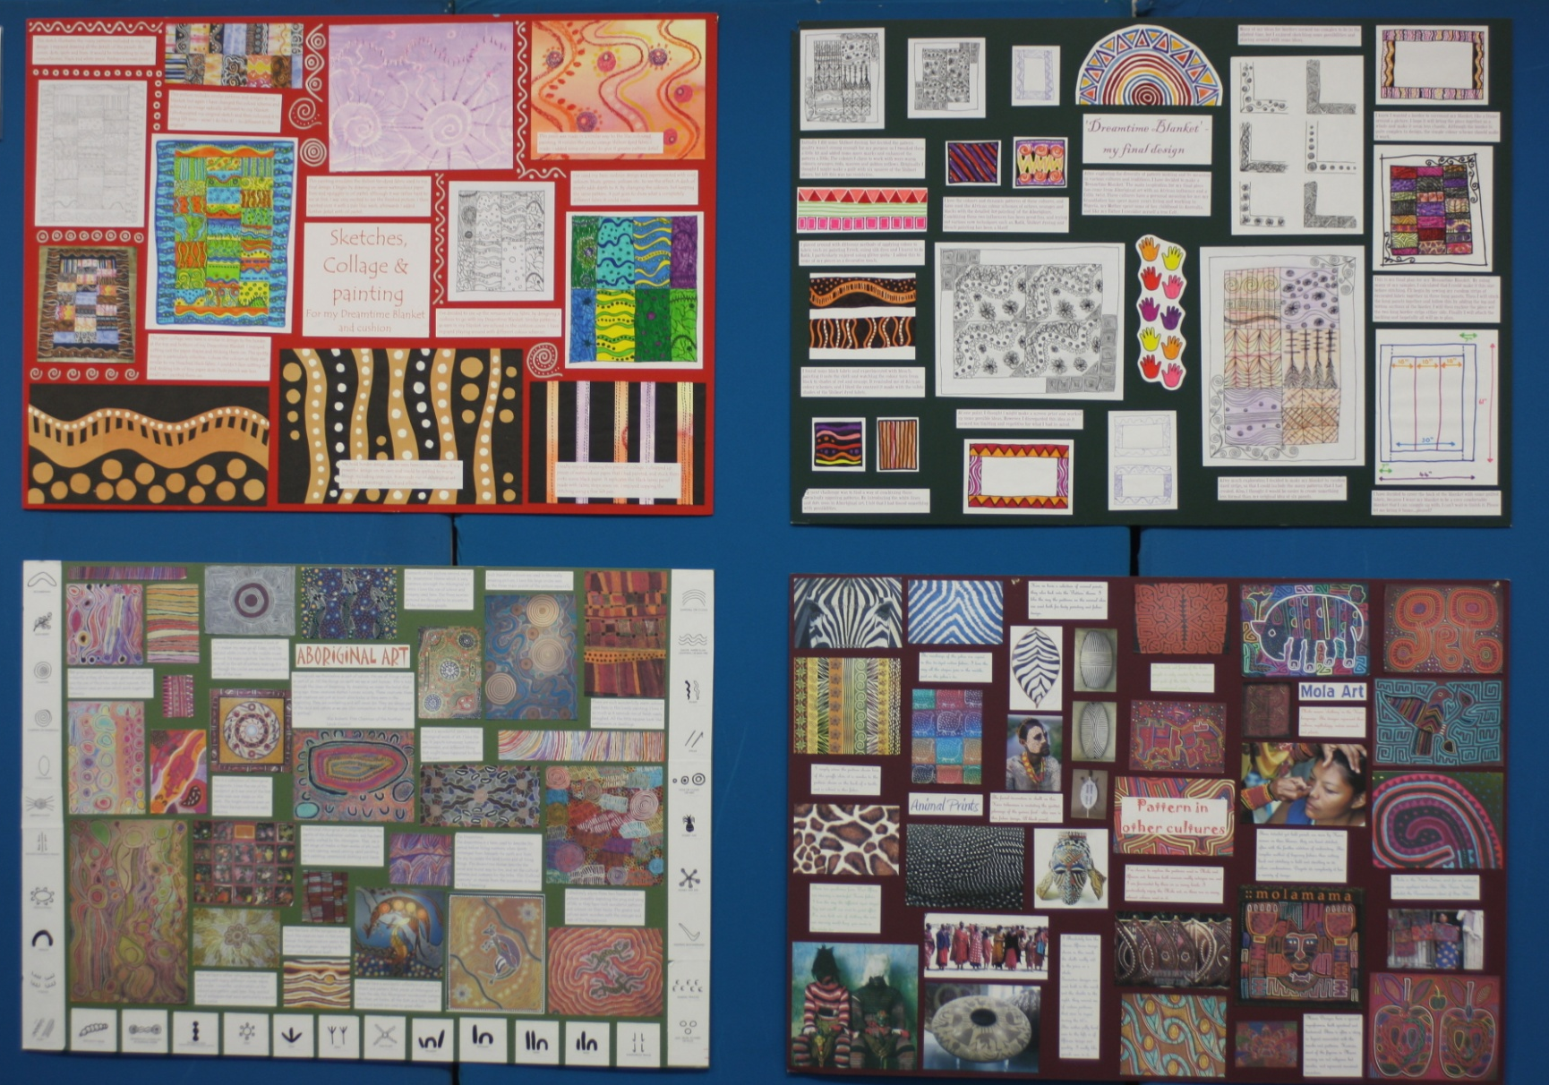
Candidate 1 Portfolio (Textiles)

Slide 3
Candidate 1 Portfolio (Textiles)

Slide 4
Candidate 1 Portfolio (Textiles)

Slide 5
Candidate 1 Portfolio (Textiles)

Slide 6
Candidate 1 Portfolio (Textiles)

Slide 7
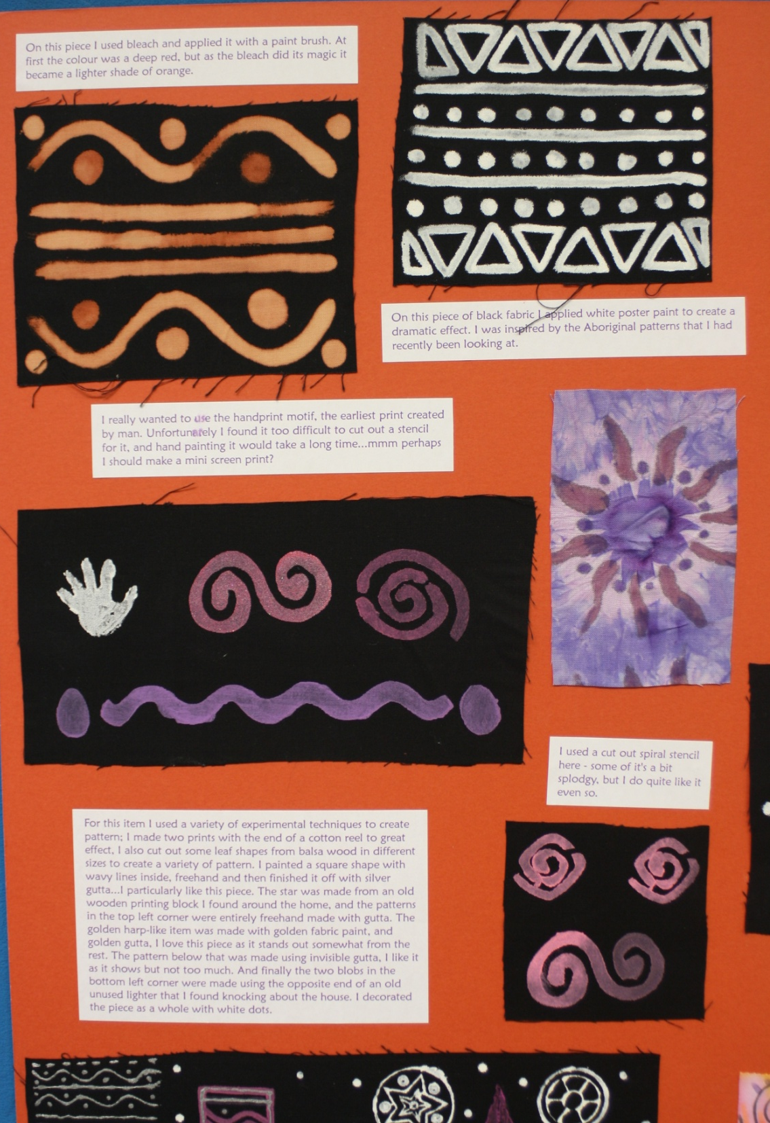
Candidate 1 Portfolio (Textiles)

Slide 8
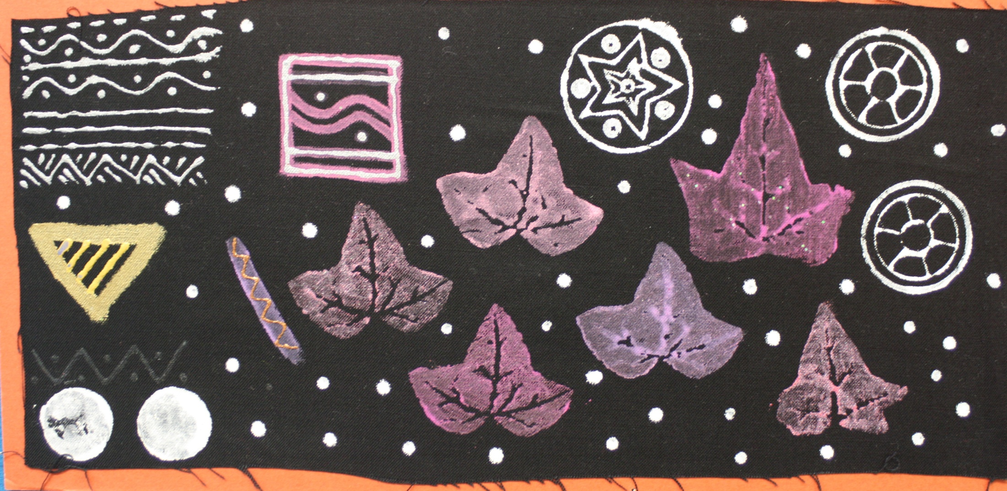
Candidate 1 Portfolio (Textiles)

Slide 9
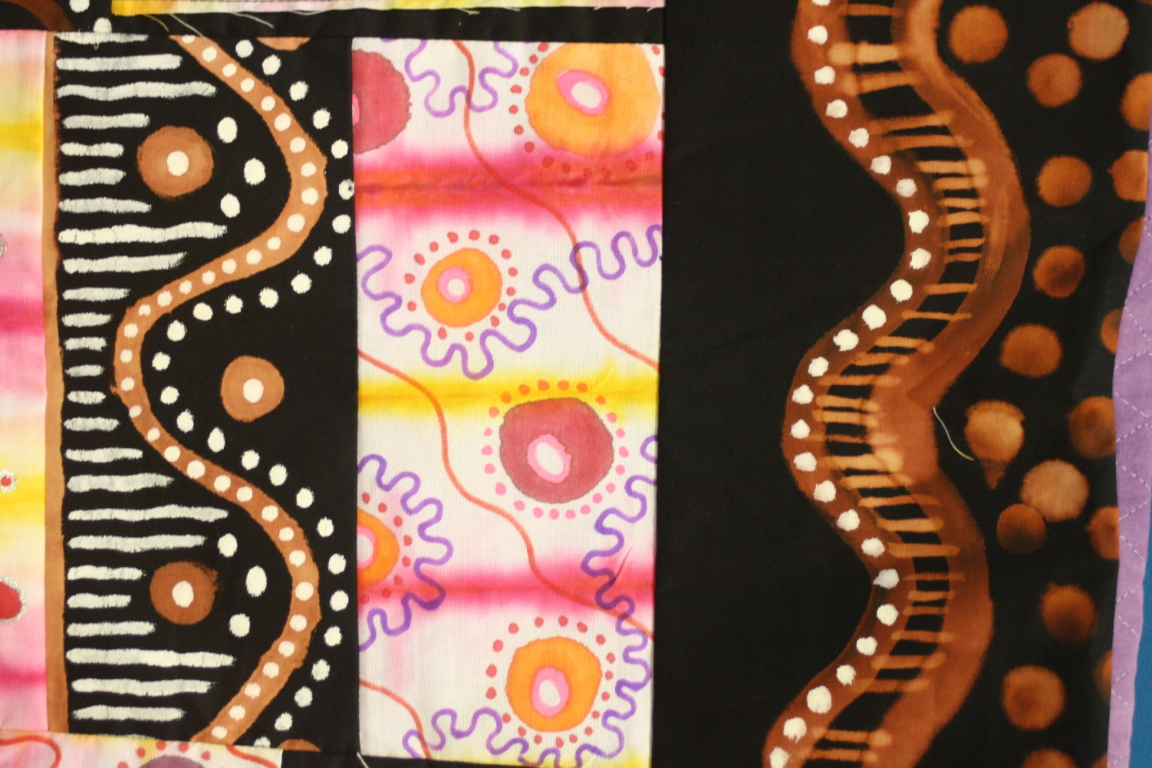
Candidate 1 Portfolio (Textiles)

Slide 10
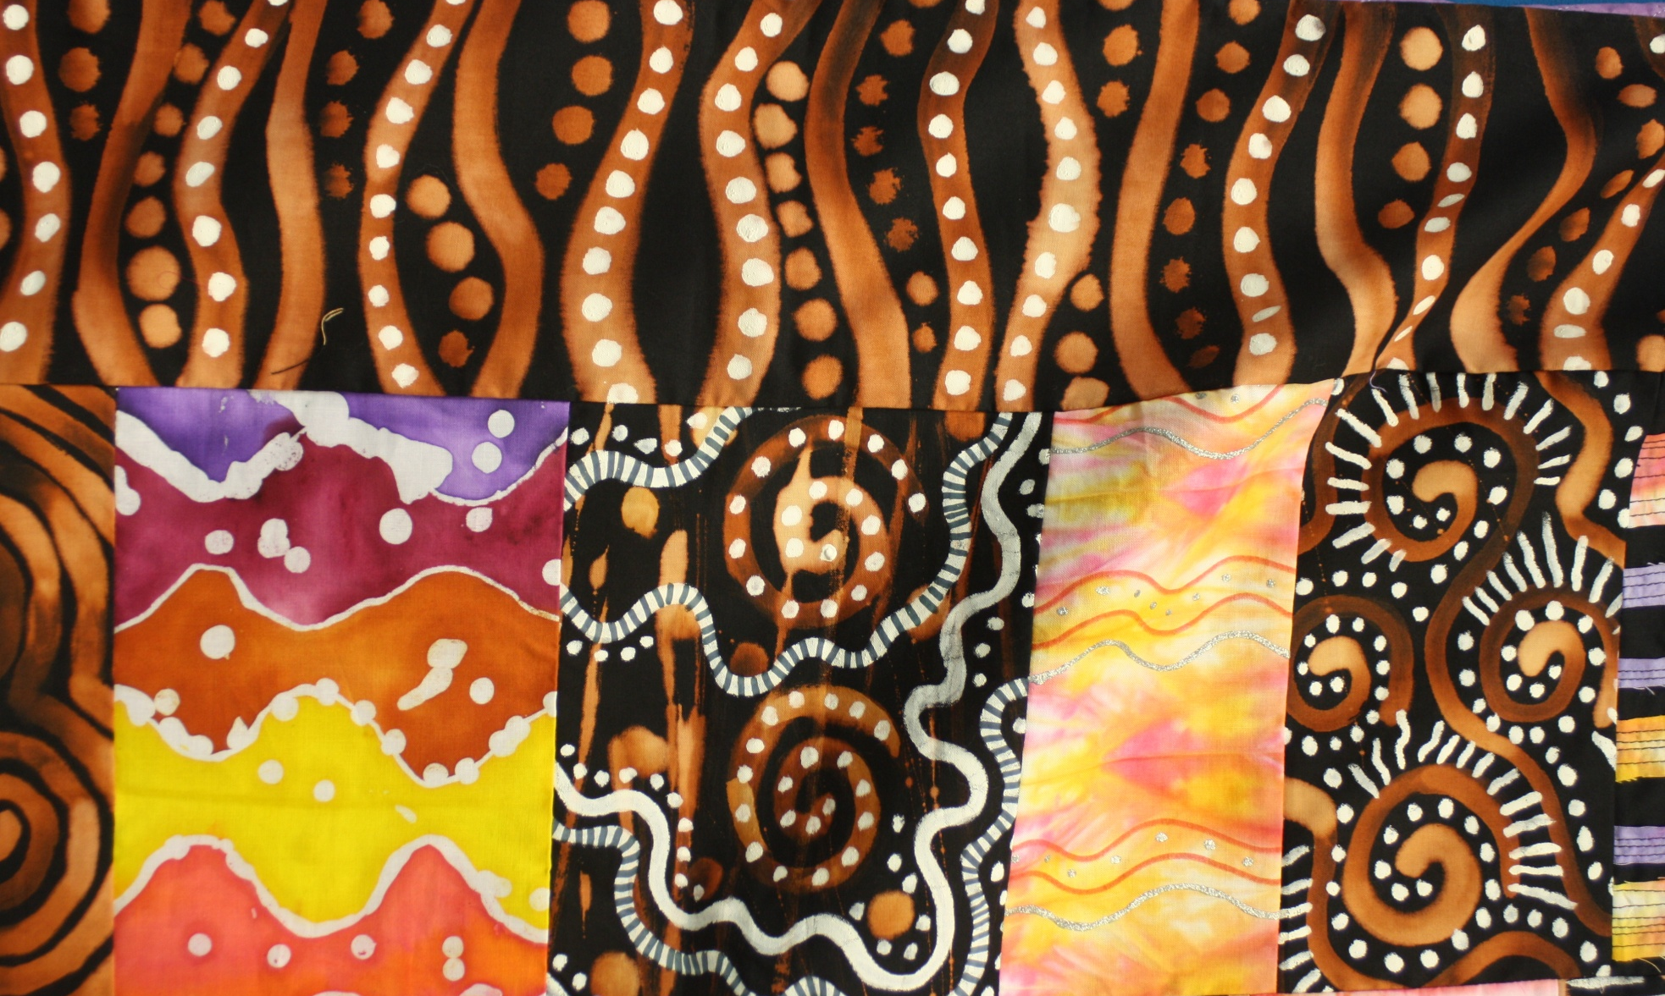
Candidate 1 Portfolio (Textiles)

Slide 11
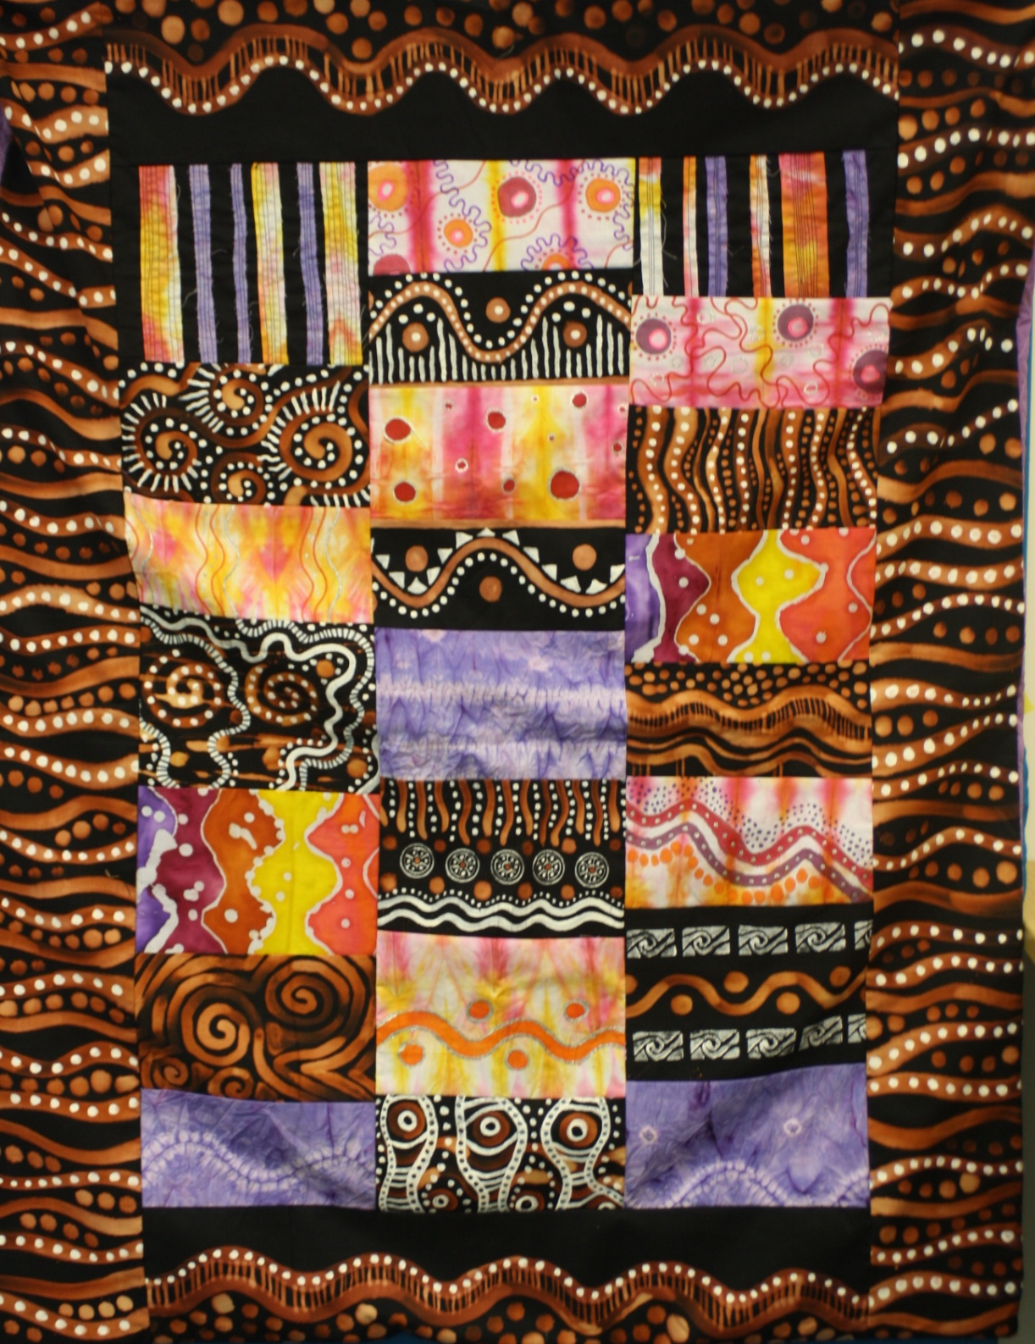
Candidate 1 Portfolio (Textiles)
A01 – 30
A02 – 30
A03 – 30
AO4 - 30
Total – 120

Slide 12
Candidate 1 Portfolio (Textiles)
This Textile Endorsed candidate has carefully selected the appropriate work to provide an equal balance of evidence across the Assessment Objectives. The Candidate Portfolio is presented in the format of six A1 boards together with a 'Daydream Blanket’ outcome of an exceptional standard .
Contextual Understanding: The candidate has broadly investigated the work of other cultures, which she has channelled into references to appropriate artists to inform her exploration and development of ideas. There is evidence of a genuine depth of understanding of the work of Aboriginal art in particular and textile artists in the production of ‘capping’ specifically.
Creative Making: Experimentation via sketches, collage and painting has influenced the various stages of the work and the portfolio work clearly shows a purposeful progression of ideas and skills, which have facilitated a particularly strong final outcome.
Reflective Recording: The candidate has relied upon appropriate and relevant secondary sourced research and imagery which are suitable to her lines of enquiry and she has done so with excellent results. The final outcome demonstrates clear development from initial research and ideas and the utilisation of suitable and diverse methods to explain and present ideas.
Personal Presentation: Throughout each stage in the development of ideas, it is clear this candidate has incorporated and developed her own original and imaginative ideas and outcomes. Each stage of design development and experimentation with media and techniques presents clear connections with the work of others. Her presentation is personal and compact, and she has followed her initial plan with focus. A high degree of technical skill has been applied to her finished textile outcome

