Slide 1
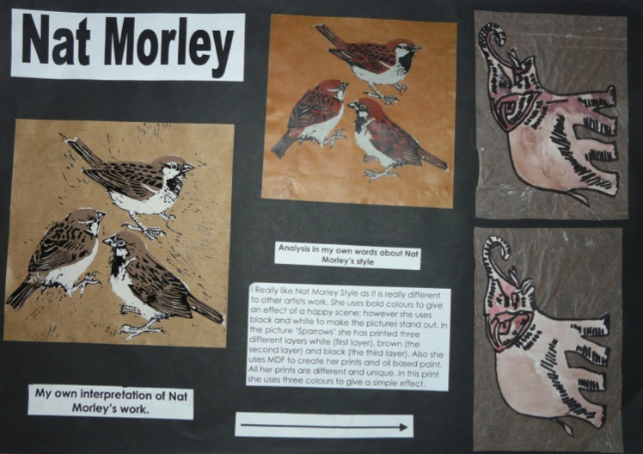
Candidate 1 Portfolio (Graphic Communication)

Slide 2
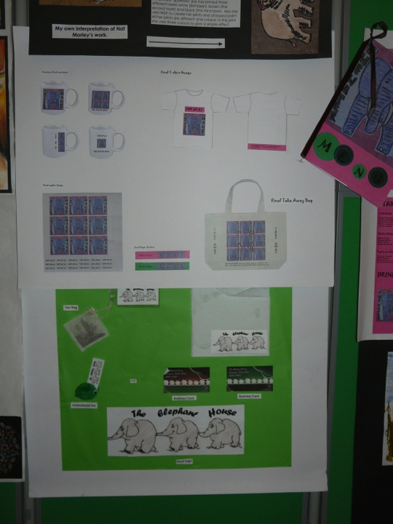
Candidate 1 Portfolio
(Graphic Communication)

Slide 3
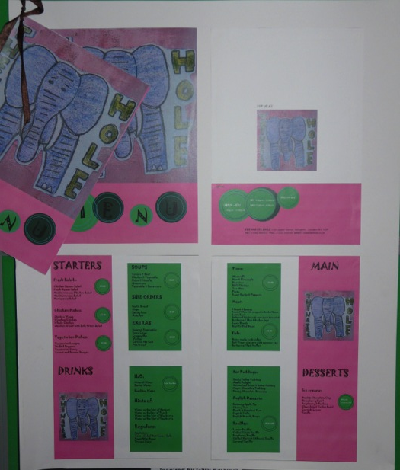
Candidate 1 Portfolio
(Graphic Communication )

Slide 4
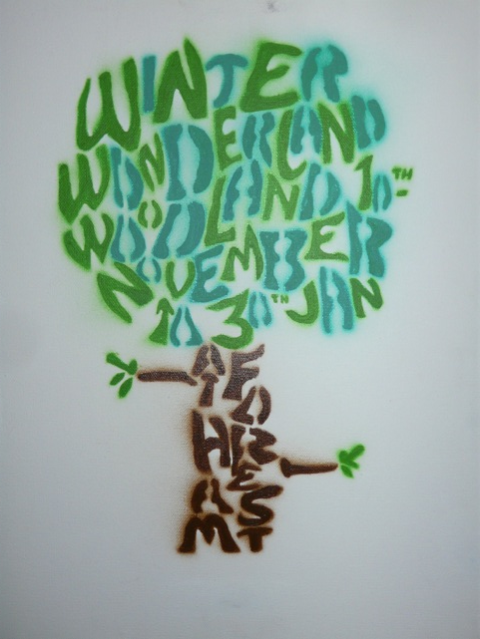
Candidate 1 Portfolio
(Graphic Communication)

Slide 5
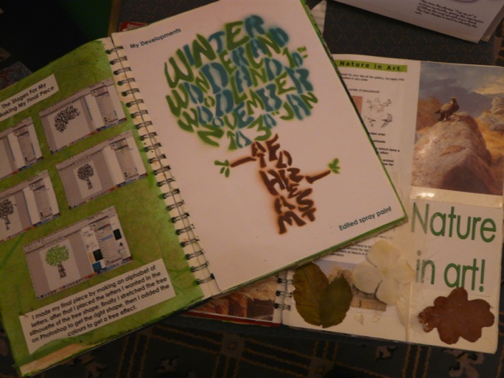
Candidate 1 Portfolio (Graphic Communication)

Slide 6
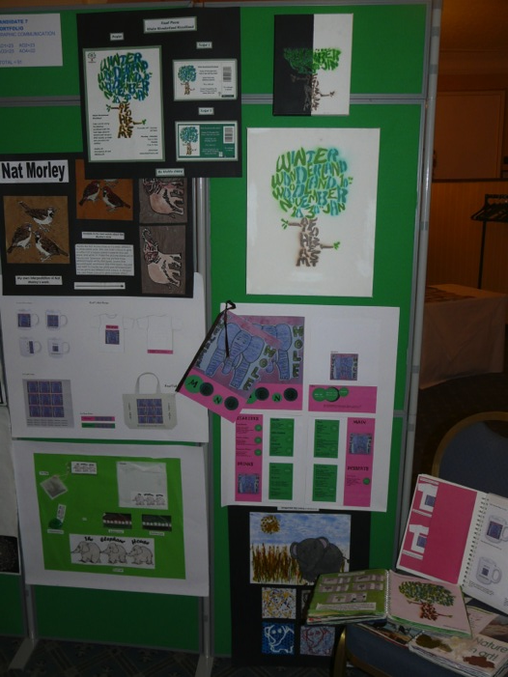
Candidate 1 Portfolio
(Graphic Communication)
A01 – 23
A02 – 23
A03 – 23
AO4 - 22
Total – 91

Slide 7
Candidate 1 Portfolio (Graphic Communication)
A Graphic Communication endorsed entry, consisting of a variety of brief led tasks based on animals and nature. The candidate has shown a strong personal interest in the overall theme and has been able to sustain engagement throughout the Portfolio.
Contextual Understanding is evident in many sections and contributes to the development of ideas, particularly the Nature in Art study and reference to the work of Nat Morley, which has led to some competent lino-cuts.
The quality of the outcomes that contribute towards Creative Making, shows a steady improvement as the coursework has progressed and the candidate has benefited from thorough research, providing an innovative design solution for the Tree based poster work. The range of materials is extensive enough at this level and appropriate to Graphic Communication, but use of photography, more drawing and computer generated developments would have increased the mark awarded to this assessment objective.
Reflective Recording: There is evidence of recording from direct observation, which is commendable practice in endorsed options such as Graphic Communication and Photography. The choice of theme has provided an accessible and suitable subject matter for research. The strength in this assessment objective is that in a design based task the development of ideas towards final outcomes is very clear.
Personal Presentation: The candidate could have benefited from a more critical selection of work, leaving out some of the weaker components. The whole presentation almost represents what was previously recognised as two Coursework, units but this is not an issue for assessment.

Slide 8
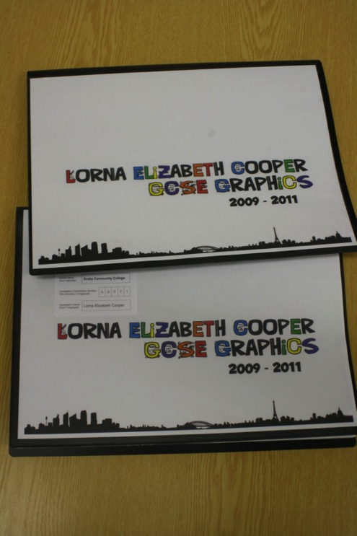
Candidate 2 Portfolio (Graphic Communication)

Slide 9
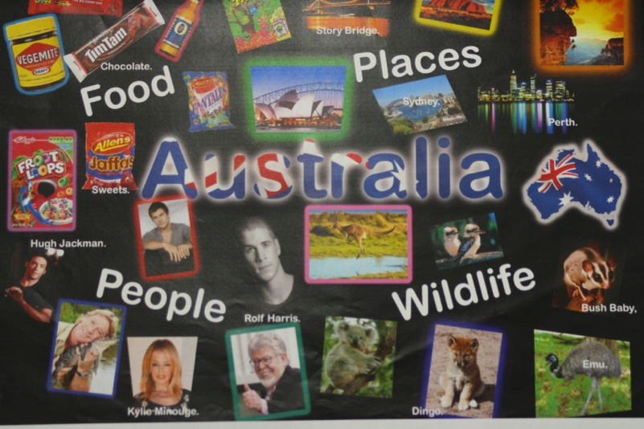
Candidate 2 Portfolio (Graphic Communication)

Slide 10
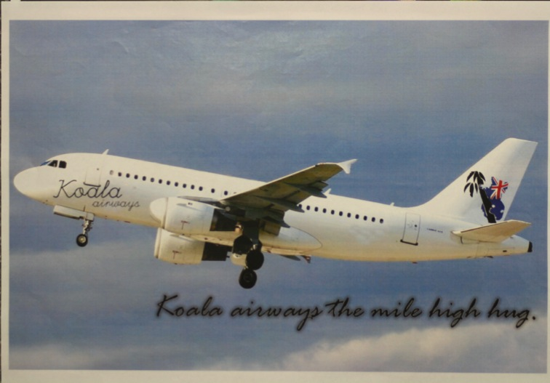
Candidate 2 Portfolio (Graphic Communication)

Slide 11
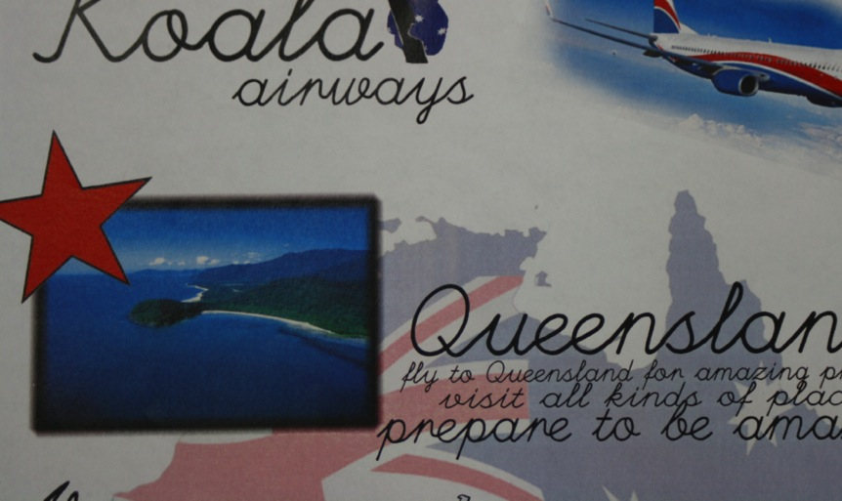
Candidate 2 Portfolio (Graphic Communication)

Slide 12
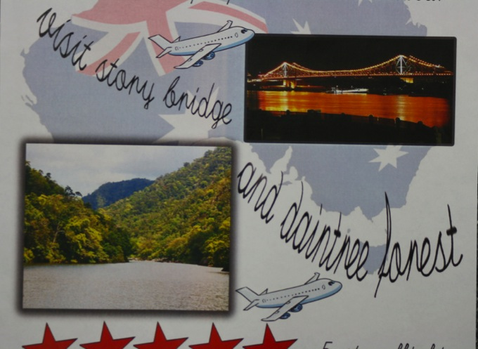
Candidate 2 Portfolio (Graphic Communication)

Slide 13
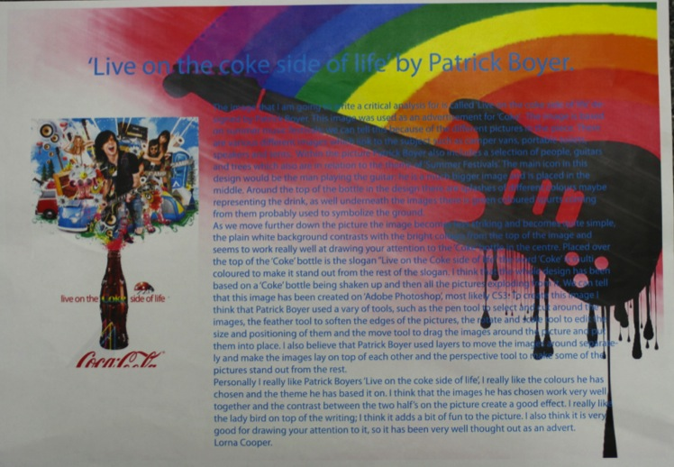
Candidate 2 Portfolio (Graphic Communication)

Slide 14
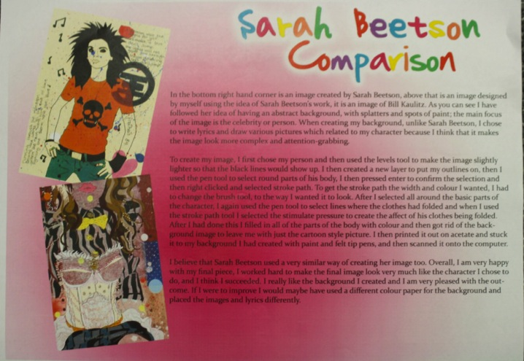
Candidate 2 Portfolio (Graphic Communication)

Slide 15
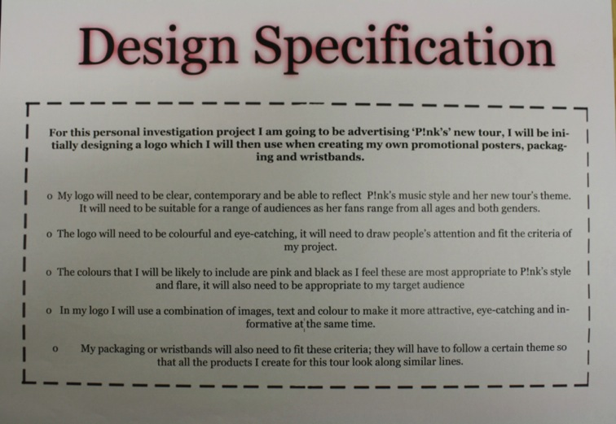
Candidate 2 Portfolio (Graphic Communication)

Slide 16
Candidate 2 Portfolio (Graphic Communication)

Slide 17
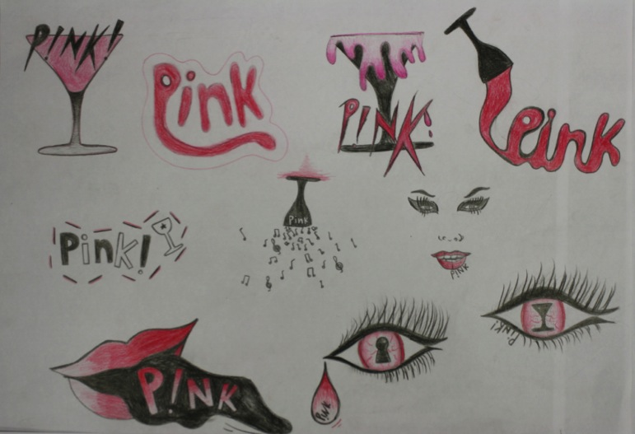
Candidate 2 Portfolio (Graphic Communication)

Slide 18
Candidate 2 Portfolio (Graphic Communication )

Slide 19
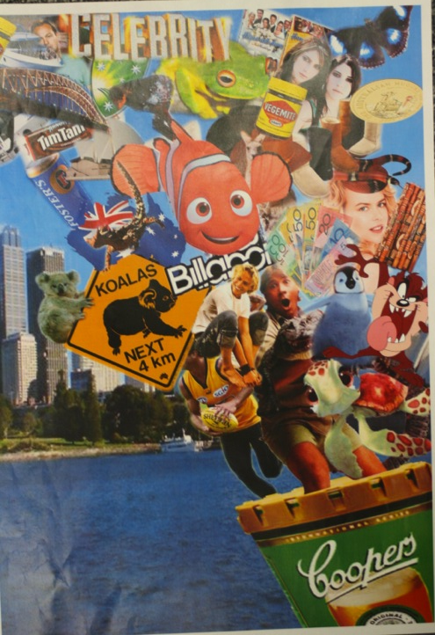
Candidate 2 Portfolio
(Graphic Communication)

Slide 20
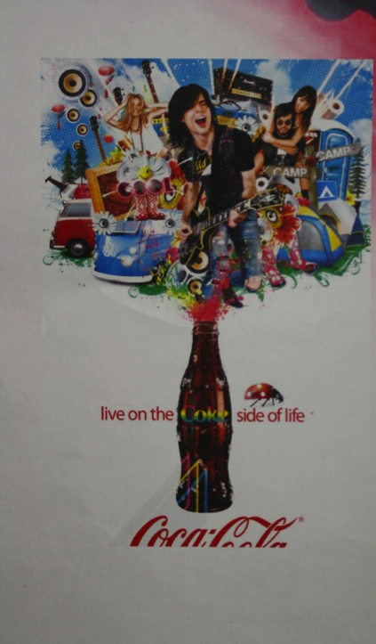
Candidate 2 Portfolio
(Graphic Communication)
A01 – 30
A02 – 30
A03 – 30
AO4 - 30
Total – 120

Slide 21
Candidate 2 Portfolio (Graphic Communication)
All the work selected for this endorsed Graphic Communication submission was presented in two A3 flip files. This allowed for back to back presentations of quality printed computer aided artwork that demonstrated high quality work, covering each of the Assessment Objectives at full marks.
Contextual Understanding: A variety of appropriate artists and graphic designers were investigated in the exploration and development of ideas relating to the design brief. The candidate documented visually and via annotation their clear understanding of the context of the work.
Creative Making; There is much evidence of the candidate experimenting and applying appropriate computer software to enhance ideas for design development. Every page clearly demonstrates their best efforts to improve the quality of work in progress leading to refined final outcomes.
Reflective Recording: Direct observational studies have been incorporated into the ideas for possible design solutions and clear design developments are in evidence; from initial research through to high quality final design outcomes, with appropriate evaluations.
Throughout the Personal Presentation the candidate has designed and developed her own ideas and possibilities to produce imaginative outcomes. Every page is set out to follow a design brief with clear design research. Development of ideas has been sensitively refined and the outcome is explicitly connected to the work of appropriate artist(s) and graphic designer(s).

Slide 22
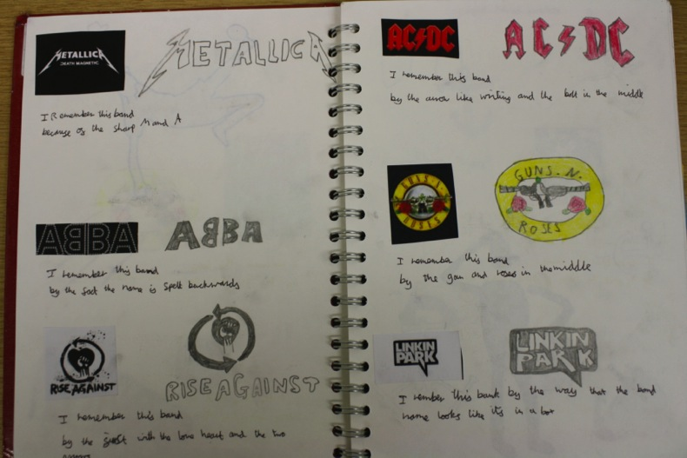
Candidate 3 Portfolio (Graphic Communication)

Slide 23
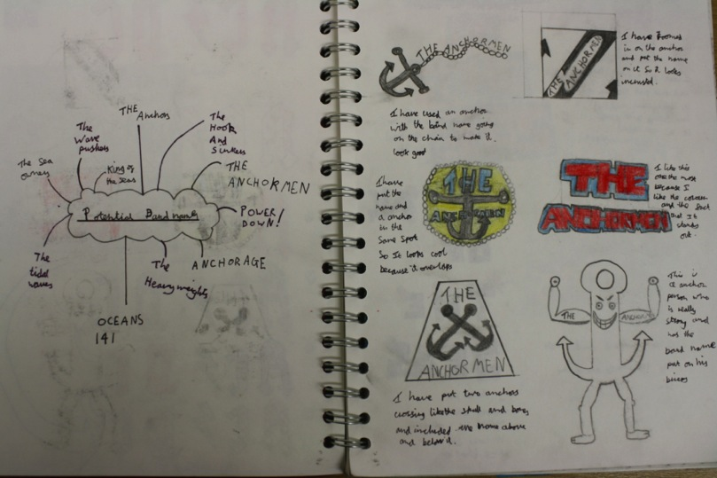
Candidate 3 Portfolio (Graphic Communication)

Slide 24
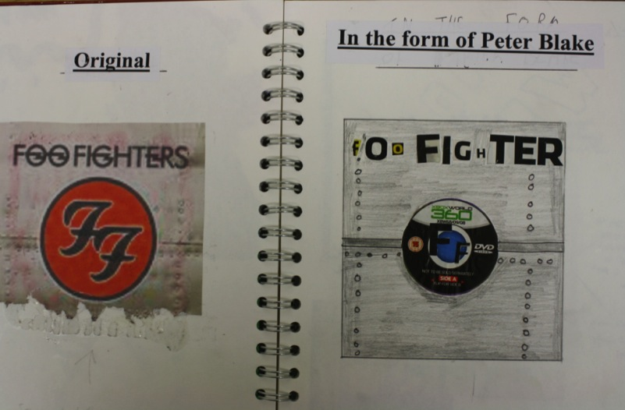
Candidate 3 Portfolio (Graphic Communication)

Slide 25
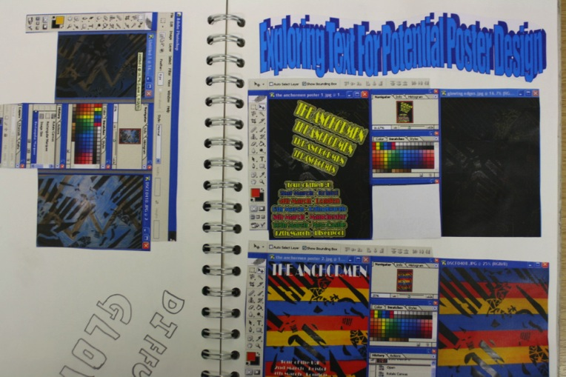
Candidate 3 Portfolio (Graphic Communication)

Slide 26
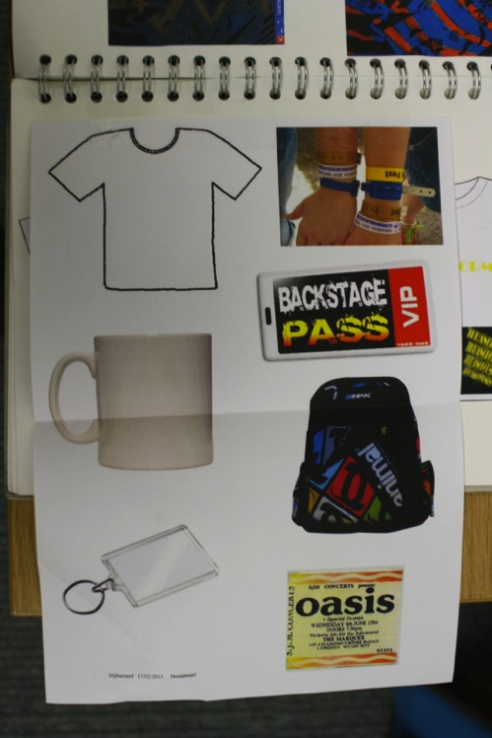
Candidate 3 Portfolio
(Graphic Communication)

Slide 27
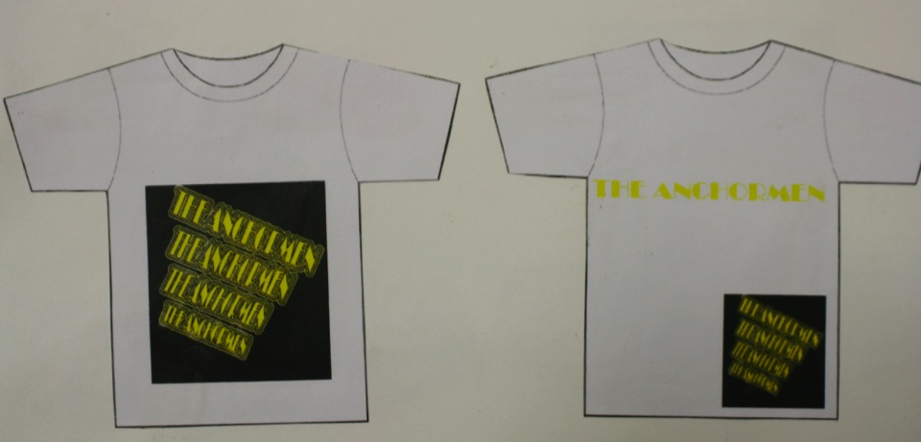
Candidate 3 Portfolio (Graphic Communication)

Slide 28
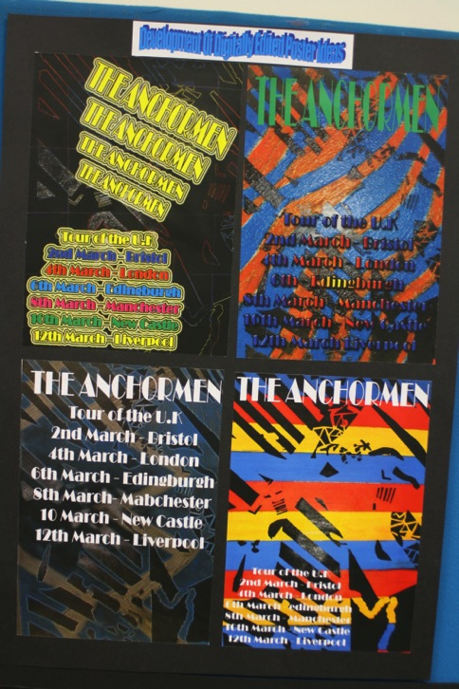
Candidate 3 Portfolio
(Graphic Communication)

Slide 29
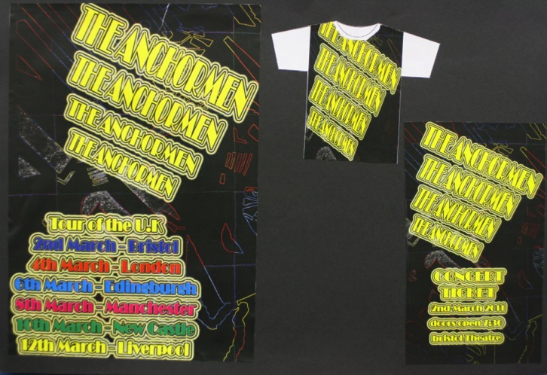
Candidate 3 Portfolio (Graphic Communication)

Slide 30
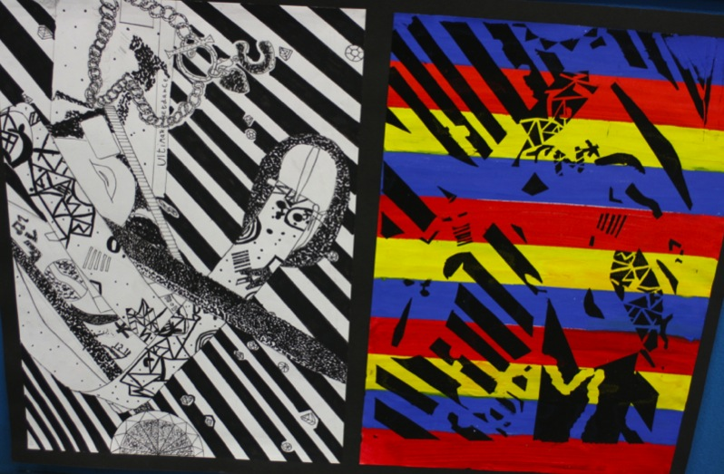
Candidate 3 Portfolio (Graphic Communication)

Slide 31
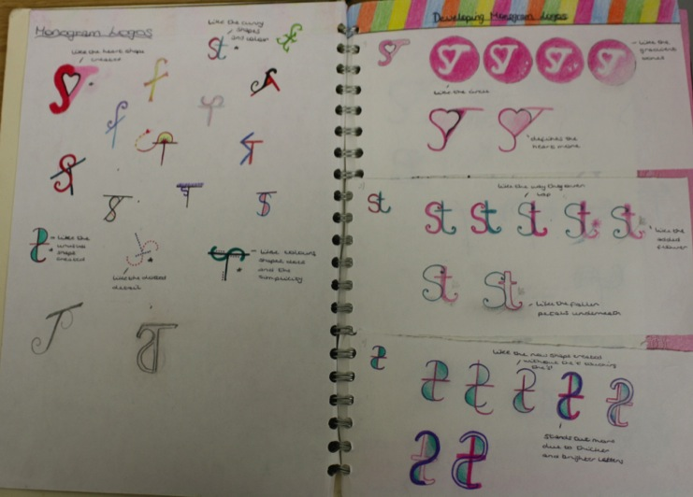
Candidate 3 Portfolio (Graphic Communication)

Slide 32
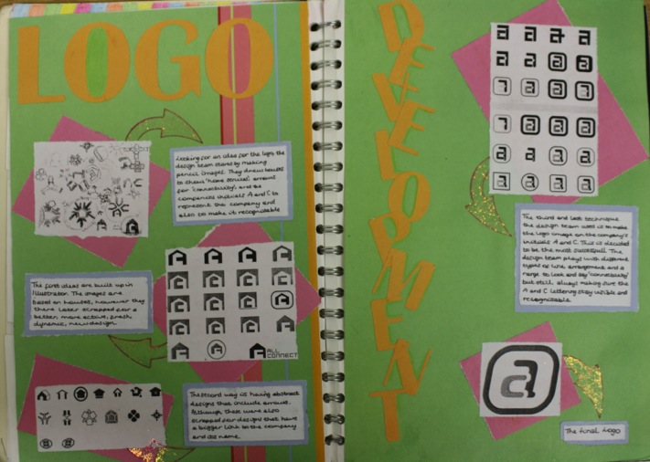
Candidate 3 Portfolio (Graphic Communication)

Slide 33
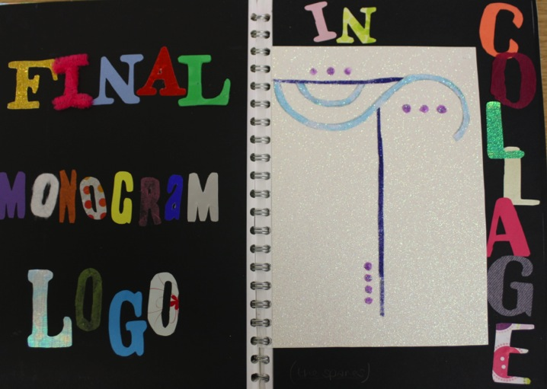
Candidate 3 Portfolio (Graphic Communication)

Slide 34
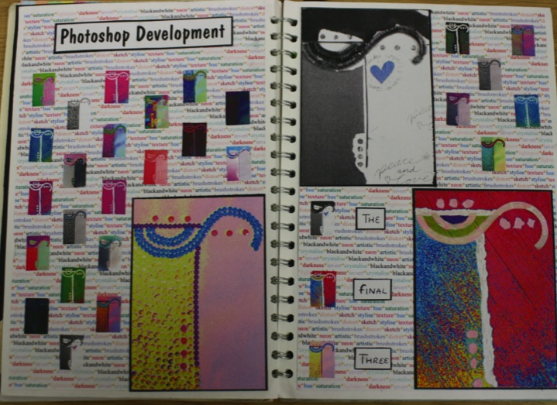
Candidate 3 Portfolio (Graphic Communication)

Slide 35
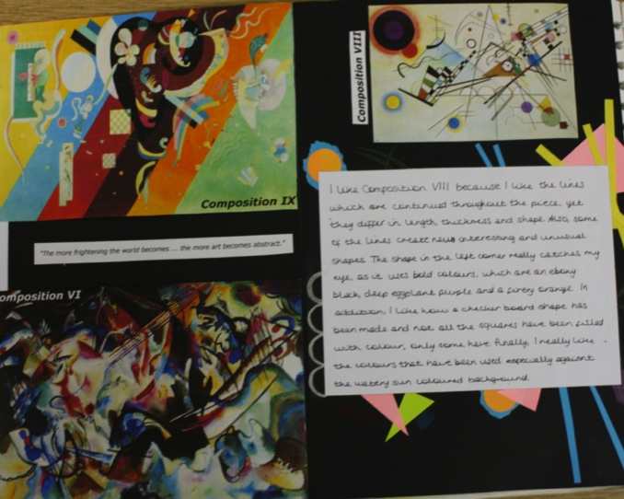
Candidate 3 Portfolio (Graphic Communication)

Slide 36
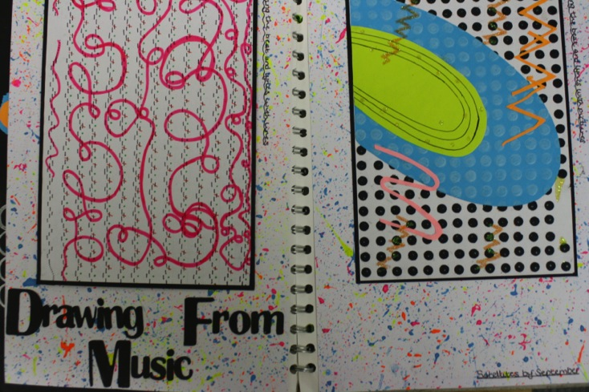
Candidate 3 Portfolio (Graphic Communication)

Slide 37
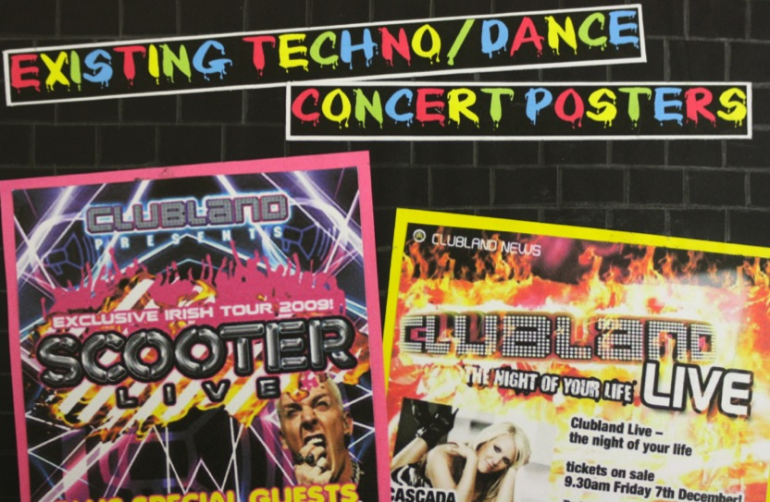
Candidate 3 Portfolio (Graphic Communication)

Slide 38
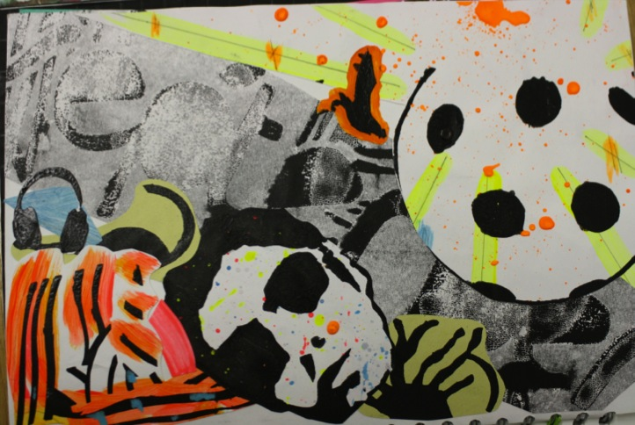
Candidate 3 Portfolio (Graphic Communication)

Slide 39
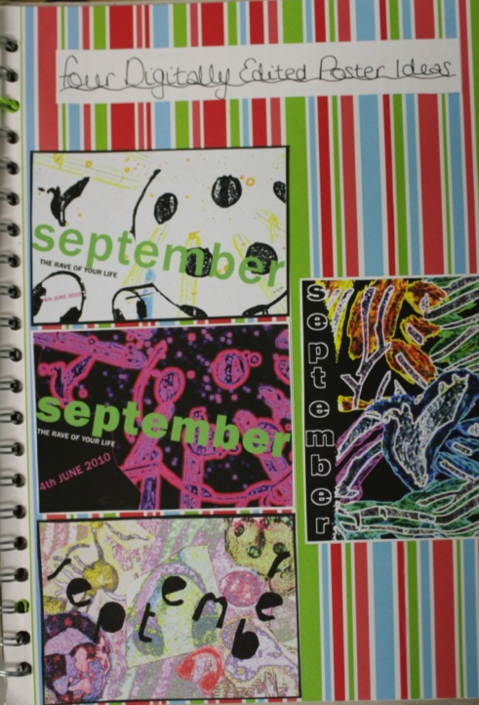
Candidate 3 Portfolio
(Graphic Communication)

Slide 40
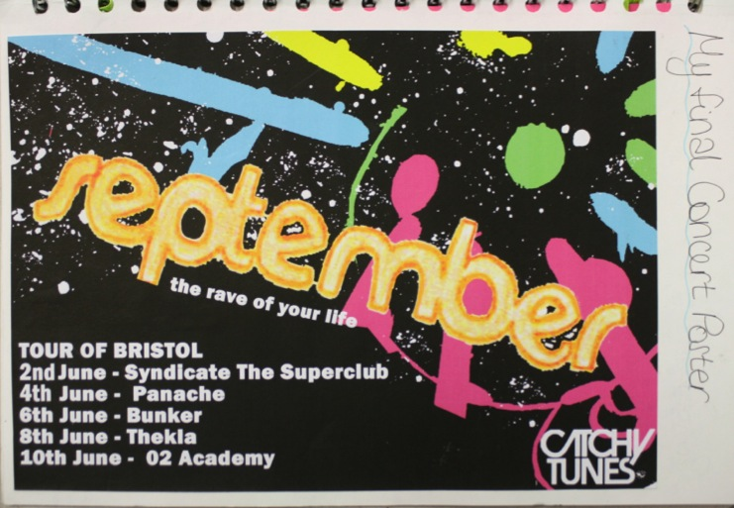
Candidate 3 Portfolio (Graphic Communication)

Slide 41
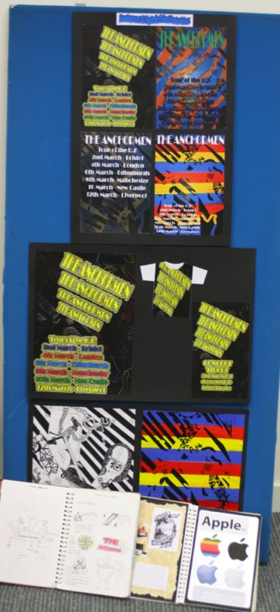
Candidate 3 Portfolio
(Graphic Communication)
A01 – 18
A02 – 18
A03 – 18
AO4 - 18
Total – 72

Slide 42
Candidate 3 Portfolio (Graphic Communication)
This Graphic Communication Endorsed submission comprises of 2 CP1 work books, concluding with a poster outcome advertising a Techno Music event. It is well balanced with equal marks awarded across the Assessment Objectives and the quality and quantity of work is consistent to the mark awarded.
The Candidate Portfolio includes good Contextual Understanding with initial studies based on primary source visits. This has clearly informed the candidate’s development and experimentation with ideas and potential possibilities for Graphic Communication outcomes.
Reflective Recording: there is also clear evidence of design development and the utilisation of new media to undertake the final outcomes in particular. The standard of work is consistent throughout the Portfolio and the candidate has benefited from vocational and creative experiences such as: working with others and exploring design experiences. Opportunities to extend and refine the quality and use of media were more limited.
The final outcome has been developed from initial research and ideas, utilising mark making imagery developed with the use of digital technology. The Personal Presentation is succinct and comprehensive, with appropriate annotation that has maximised potential.

